Slide 1
BULLYING
Catherine C. Swope, LPCC-s

Slide 2
Bullying effects everyone, one way or another. You may not work with teens but the trend is for younger youth to deal with this issue.
Why all the hype?
I’m not working with teens, so this doesn't apply to me!

Slide 3
What is Bullying?

Slide 4
What is bullying?
Definition:
Bullying is an act of violence that involves the imbalance of power between the bully/ies and victim/s. It is intentional, repeated hurtful acts, words or other behaviors committed by one or more persons against another (or group of others) in an obvious or subtle way.

Slide 5
What is bullying?
Physical:
hitting, pushing, pinching, kicking, spitting, hair pulling, taking or damaging someone else’s property, taking money from a person, assault or sexual assault.

Slide 6
What is bullying?
Verbal / Communicative :
using words to hurt or humiliate another person (this is in all forms of communication such as social media, creating songs, taunts, emails, texting or voice mail), menacing or terrorist threats, spreading rumors, sexual harassment.

Slide 7
What is bullying?
Relational / Emotional:
trying to convince peers to exclude, upset, embarrass or reject another person, cutting another off from social connections and friends.

Slide 8
What is bullying?
Sexual:
sexual bullying singles out a person because of gender or sexual orientation and demonstrates unwarranted or unwelcome sexual behavior. Examples include: sexual comments, abusive comments, urination on another person, unwanted physical contact.

Slide 9
What is bullying?
Racial:
racial bullying involves rejection or isolation of a person because of ethnicity. Examples include: gestures, racial slurs or taunts, name calling, making fun of customs/skin color/accent/food choices.

Slide 10
What is bullying?
Reactive:
someone who has been repeatedly bullied, now becomes the bully, hurting others the way they have been hurt in the past. Striking before they become the target again.

Slide 11
In the news…
12/3/2021 Beautiful 10 year old Isabella Tichenor died by suicide weeks after serious Dept of Justice report is filed against her school district. Her radiant smile faded after she began 5th grade.
Notes:
Tyler Clementi – Rutgers Student

Slide 12
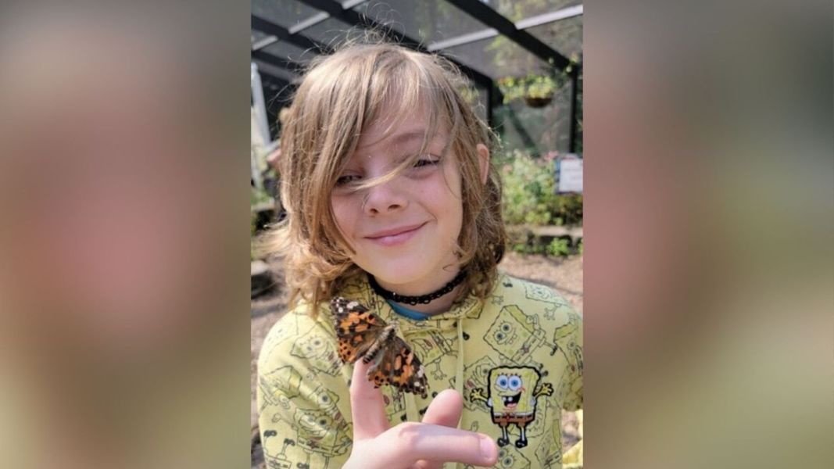
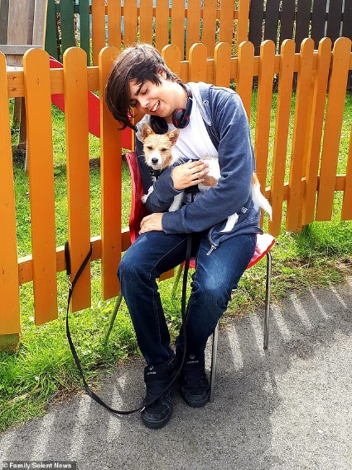
In the news…
11/27/2021 Kind, gentle 12 year old Eli Fritchley dies by suicide after years of relentless bullying. Even with all the attacks, he never blamed anyone and instead would shine compassion from his gentle soul.
Teenager, 16, killed himself after being 'relentlessly' bullied for being autistic and gay
Cameron Warwick, 16, struggled with depression and had autism
His mother said he was bullied at school for being gay, after coming out at 12
She said pupils would throw food at him, call him names and trip him up at lunch
Cameron was found dead in woods in Fareham, Hampshire after missing college
Notes:
2 young victims from 2010 and 2012

Slide 13
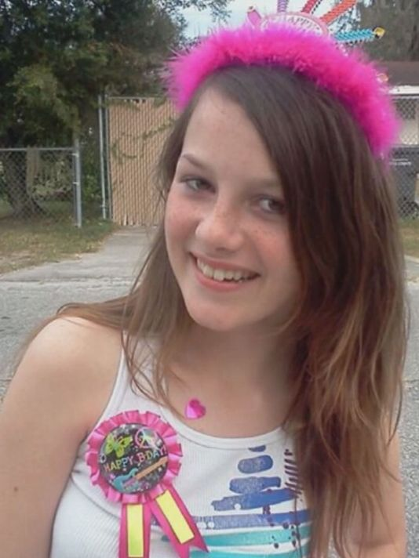
Rebecca Sedwick
Two girls, a 12 and 14-year-old, were arrested in a Florida bullying case after one of them admitted online over the weekend that she harassed a 12-year-old girl who killed herself last month, a sheriff said Tuesday. (Oct. 15, 2013)

Slide 14
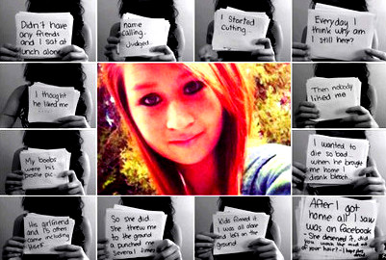
In the news…

Slide 15
Who will you see as an advocate and support person to children?

Slide 16
Who might you encounter as a casa, counselor or support to a youth?
1) Those being bullied

Slide 17
Who will you meet?
2) Those who are bystanders
Notes:
Help for those experiencing feelings of helplessness, powerlessness and cowardice.

Slide 18
Who will you meet?
3) The Bully
The Expected Bully
The Unexpected Bully
Notes:
The bully everyone expects – tough person, acts out aggressively, etc.
The bully NO one expects – usually there for unrelated issues, but part of issues can be linked to the bullying behavior that may be happening.

Slide 19
Help for the Bullied

Slide 20
Help for those who are bullied
Why don’t those being bullied tell?

Slide 21
Help for those who are bullied
F E A R

Slide 22
Help for those who are bullied
FEAR of:
Retaliation
Becoming worse
Being laughed at further

Slide 23
Help for those who are bullied
It is this same fear that feeds a bully.
For many of the bullies the purpose is control of their world and peer groups.

Slide 24
Help for those who are bullied
“Fear is interest paid on a debt you may not owe”.
It is this fear that drives a youth to the point of hopelessness and helplessness.

Slide 25
Help for those who are bullied
Bullying or abuse makes one feel that no matter what you say or do, NO ONE will listen and it will NEVER change.
Notes:
What do you need to be as the counselor? You need to be that one person, the person who will LISTEN. Always remember if they share their story with you it is a gift.

Slide 26
Help for those who are bullied
Ways to help…
Put away the “W” Questions
Notes:
As the counselor put away the W questions (why, what, when, etc.) and listen to their story. Many of these students have few friends and rarely have someone listen to their story.

Slide 27
Help for those who are bullied
LISTEN
Take time to really hear their story without judgement or the why questions. They need to know you are hearing them and believe them and in them.

Slide 28
Help for those who are bullied
Recognizing the Signs
Look for the following evidence if you suspect someone might be a victim of bullying:
Change in appetite or eating habits
Loss of interest in school and schoolwork, possibly including worsening grades
Difficulty going to sleep or staying asleep (insomnia)
Frequent stomachaches, headaches, or other excuses to stay home from school
Sudden withdrawal from family activities
Notes:
Any one of these behaviors may not be cause for alarm, but several of them combined could signal that your child needs your help, so start asking then some questions. Left unchecked, youth who are bullied for a long time can suffer serious problems throughout their lives.

Slide 29
Help for those who are bullied
Recognizing the Signs (cont’d)
Change from happy and secure to moody and depressed
Torn or blood-stained clothes
Change in the group of girls she usually hangs out with, especially if her friends suddenly stop coming around
Sudden need for extra money for school lunches
Increased anxiety
Spending more time on the computer and not wanting you to see what she's doing online
Notes:
Any one of these behaviors may not be cause for alarm, but several of them combined could signal that your child needs your help, so start asking then some questions. Left unchecked, youth who are bullied for a long time can suffer serious problems throughout their lives.

Slide 30
Help for those who are bullied
Ways to help…
Help the parent/caregiver with their reactions
to the bullying
Notes:
Often a parent reacts and wants to step in to protect and help. This always makes it worse. Usually the youth will hide the escalation of events from the parent due to shame, wanting to protect the parent’s feelings, or fear that something bad will happen to the parent.

Slide 31
Help for those who are bullied
Ways to help…
Find a purpose
Notes:
As Jodee Blanco’s father puts it: help them find purpose for their life “something that makes you want to get up in the morning, no matter what” (p142).

Slide 32
Help for those who are bullied
Ways to help…
List of supporters
Notes:
Often these youth feel alone. Creating a list of people who are there for them. “God keeps putting people in my corner at just the right time who give me courage and strength to come out for one more round” (p.212)

Slide 33
Help for those who are bullied
Ways to help…
Survivor Stories
Notes:
Letting them know others have suffered and have made it through. Some of the country’s most successful people- musicians and moguls, authors and actors were teen misfits, such as Lady Gaga, Emma Watson, Robert Pattenson, Sandra Bullock, Prince Harry, Howard Stern, Michael Phelps. Chris Rock, Christina Agulara, Pierce Brosnan, Bill Clinton, Tiger Woods, Jessica Alba and Christian Bale. “The heartache they endured at school defined their character and determination” (p.213).

Slide 34
Help for those who are bullied
Ways to help…
Tools to Stand
Notes:
Helping the youth stand up for themselves, “Somebody like you never fights back. Why do you take it…Why didn’t you fight back and tell us to go screw ourselves or something?...Everybody at school knows that if they pick on you, you’ll take it. It’s your own fault” (p236-7).

Slide 35
Help for those who are bullied
Ways to help…
For verbal use the FAT model:
FEAR: don’t show the bully any fear, use body as ally.
ATTENTION: don’t give the bully any attention, don’t look, respond in any way
THINGS: never give material things to the bully, once you give in, it never stops

Slide 36
Help for those who are bullied
Ways to help…
For physical bullying
The bullied has the right to defend themselves and need to. If a physically bully knows the other youth will not fight back, they will always be a target.
Suggest the child takes martial arts training and instruct parents to ask the instructor to teach the child the five most effective self-defense (blocking and control) movements.
Notes:
Martial Arts: This will help your child if the bully tries to intimidate, for the youth to be thinking of the best combination rather than fear. Often bullies will sense the new confidence of the youth and back down. Remember bullies feed off fear, don’t give them something to bite.

Slide 37
Help for those who are bullied
Ways to help…
For physical bullying
Often when a youth stands up for themselves, others who are marginal will then befriend the youth who was being bullied and they can create a group to stand against the bully in the future

Slide 38
Help for those who are bullied
Ways to help…
For Both types of bullying
Teach the young person social skills, such as how to connect.
Give them a list of connection topics and questions they can use to ask appropriate personal, family, hobby, music, interest, etc. questions.
Notes:
Often the bullied child has not learned appropriate ways to connect with other youth their same age.
Don’t just give the list and let them go try it out, try it out with them. Just like coaching them on how to control their fear in body and voice, you are coaching them on what and how to ask questions that get another person to open up and create connection.

Slide 39
Help for those who are bullied
Ways to help…
For Both types of bullying
Teach the youth to advocate for themselves
Teach the parents how to advocate for their youth
AND…
Advocate for your kid
(smile and lean approach)
Notes:
It is important to work with and advocate for your client with the school officials but do not depend on them doing the right thing.
Keep talking, have parents keep talking and use the smile and lean approach.

Slide 40
Help for those who are bullied
Ways to help…
Help your youth learn skills to get them into a friendship or social group.
This is the goal! Helping them help themselves to create friendships and be a part of a social group, not on the outside of the social groups.

Slide 41
Help for those who are bullied
Ways to help…
Simple model
Walk with awareness, calm and confidence
Feel one way but act another
Filter hurtful words
Communicate with others to gain help
Use physical self-defense as a last resort
Notes:
Walk with awareness, calm and confidence – You are less likely to be bothered if person practices holding body tall, relaxed, w/relaxed look on face. Be aware of possible harmful situations.
Feel one way but act another – normal to feel fear but don’t let it show on the outside. Help clients imagine they are mad, sad or scared as they practice this skill so that the counselor can help mirror their expressions.
Filter hurtful words – words do hurt but can be thrown away, help client know the truth of who they are and not let hurtful words stick to them, become a non-stick surface.
Communicate with others to gain help – Talk, find others to talk with, support, but not fight the battle for them.
Use physical self-defense as a last resort – they have the right to defend themselves.

Slide 42
Help for the Bystanders

Slide 43
Help for those who are bystanders
60 to 70% of students in schools are those who are not usually bullied and do not do the bullying.
They are not in the top popular group but can float back and forth between social groups fairly well.
These are the followers in school. They follow the trends, the rules and at times bullying.
Notes:
Youth who was in DH for vandalizing property. Youth was there after the fact, but witnessed what had been done, did not tell adults what had happened and told others they had been there. The reality for the youth and parents that the youth spent time in Juvenile Jail was heartbreaking to watch.

Slide 44
Help for those who are bystanders
Ways to help…
Help them develop a good sense of self
Help them build and develop their own self esteem.
Help them build and develop greater depths of empathy by exposing them to stories of those bullied
Give them the same techniques you give the bullied so that they can help coach and encourage any who are being bullied.
Help them find other avenues for friendships and activities.

Slide 45
Help for the Bullies

Slide 46
Help for those who are bullies
Expected or Blatant Bully Profile:
The blatant bully is less than 10% of a student body.
Usually they get caught 1 out of every 10 acts of bullying.
Often they are using their bullying to distract themselves from feeling emotions of life situations and therefore lose empathy for their victims.
They often lack basic social skills and therefore do not know how to interact well with their peers.
They look for fear in others to exploit.

Slide 47
Help for those who are bullies
Expected or Blatant Bully Profile:
Normal Profile
Impulsive, hot-headed, dominant
Easily frustrated
Lacking empathy
Lacking social skills
Having difficulty following rules
Viewing violence in a positive way
Physically stronger than other children (this is more a characteristic of boy bullies)

Slide 48
Help for those who are bullies
Expected or Blatant Bully Profile:
How to Help…
See need for Change
Help them learn social skills they may be lacking
Provide Clear Behavioral Expectations That Are Free from Loopholes or Ambiguity
Avoid Debates and Arguments
(Wrestling Pigs)
Notes:
Help the person in your office see the need for change. You have to make it something they will buy into or there will be no behavior change.
Provide Clear Behavioral Expectations That Are Free from Loopholes or Ambiguity
Avoid Debates and Arguments – the aggressor likes to control (Don’t wrestle with a pig; you both get dirty, but the pig likes it)

Slide 49
Help for those who are bullies
Expected or Blatant Bully Profile:
How to Help…
Avoid Repetitious or Standardized Responses
Reinforce Positive Achievements, but Cautiously
Teach Social Skills
(emotion regulation, self-regulation, communication skills & social thinking)
Notes:
Avoid Repetitious or Standardized Responses - Standardized, predictable responses to bullying behavior (e.g., "When you do this, this is [always] what will happen") enable proactive aggressors to plan their offenses so as to maximize personal benefit and minimize personal cost. Keeping proactive aggressors uncertain about the specific consequences of aggressive behavior through the use of variable response protocols denies them opportunities for advance planning on the basis of anticipated cost and reward. It also decreases their opportunity to calculate loopholes in established policy that will enable them to avoid responsibility for their planned offenses. The counselor must have an understanding of the individual aggressor's view of behavioral cost and reward and then work to develop disciplinary responses to aggression that, in the aggressor's eyes, outweigh its rewards.
Reinforce Positive Achievements, but Cautiously - One way that school counselors can effectively work to reduce proactive aggressors' reliance on aggression for personal validation is by seeing to it that they receive sufficient validation for the pro-social things that they do. In doing so, however, they must not lose sight of the fact that the observed accomplishments of a student prone to proactive aggression may have possibly been achieved through coercion.

Slide 50
Help for those who are bullies
Expected or Blatant Bully Profile:
How to Help…
Don't Drop Your Guard
Focus on Feelings Rather than Facts
Don't Stop at Consequences; Teach Pro-Social Behavior
Teach Social Skills they may be lacking
Notes:
Don't Drop Your Guard - Their quest for personal control and validation through threats and acts of manipulation, coercion, and physical force has become automatic in their relationships with others and, as such, should be anticipated whenever they are not pressured to relate to others in a different way. Effectively, their appetitive behavior can be expected to continue until they determine that the risks and costs of getting caught outweigh the potential for personal gain. Thus, an important step in helping proactive aggressors change their behavior (and ultimately, their perspective) is to ensure, through careful and continuous monitoring of their activities, that their risks of getting caught are high.
Focus on Feelings Rather than Facts - By focusing on the feelings surrounding suspected aggression, the counselor can eliminate the proactive aggressor's grounds for rational or logical denial of responsibility, because there is no standard for reference from which the rightness or wrongness of feelings can be reasonably argued. Proactive aggressors need to learn that there may be consequences when others feel victimized by their actions, regardless of whether their appetitive intentions can be proven beyond dispute. This may be the only way that they will begin to consider the feelings of others before they choose aggressive courses of action in the future.
Don't Stop at Consequences; Teach Pro-Social Behavior - Proactive aggressors often have well-developed skills in a restricted range of social interactions that promote their self-serving objectives. However, they tend to lack an understanding of social rules and to have a narrow (or nonexistent) repertoire of alternative social skills that would allow them to satisfy their personal needs without infringing on the rights and needs of others (Sutton, 2001). To be effective, interventions aimed at extinguishing proactive aggressors' self-serving behaviors must always include instruction in alternative skills that will enable them to effectively meet their needs in more pro-social ways. Teachable moments right after the incident allow for teaching and modeling skills such as: active listening (to others' views), accepting failure, impulse control, collaborative problem solving, and conveying respect, as well as promoting their emphasis in the classroom, school counselors can directly help proactive aggressors expand their limited inventory of socially acceptable responses to others.

Slide 51
Help for those who are bullies
Un-Expected Bully Profile
These are the youth you may meet that surprise you. They may come have signs of depression, eating disorder, parents catch them doing drugs or alcohol, poor grades, etc. These bullies sneak up on and usually surprises the professionals because they do not expect it from this type of youth.
Usually but not always these are girls. Charol Shakeshaft writes, “Boys bully in your face. Girls bully behind your back.”
These tend to be students in the popular group. They have higher verbal and social skills than the blatant bully and use verbal and social bullying as their mode of violence against the victim.
These bullies only get caught about 1 out of every 50 incidents of bullying.
Often you may hear this being called relational aggression or RA.

Slide 52
Help for those who are bullies
Un-Expected Bully Profile
This type of bully, bullies because they may:
Have learned the habit of bullying at home.
Be insecure.
Need to feel powerful.
Want to get attention and be popular.
Have personal issues.
Lack Social Skills
Notes:
They've learned the habit of bullying at home. Bullies often (but not always) come from homes where they are bullied or abused by their parents or older siblings. Bullying is a way for them to regain some of the control they have lost at home.
They may be insecure. In some cases, bullying is a cover-up for insecurity. A bully may be sensitive about her weight or the clothes he/she wears, and bullying others allows him/her to attack them before they attack her. These may be the girls who know they are not as smart, pretty or financially secure as others in their popular group.
They need to feel powerful. Those who bully need to control and exert power over others. This tactic makes them seem more powerful, often targeting girls or guys who are passive, easily pushed around, or have very few friends. They often gang up on another girl or guy to demonstrate their control.
They want to get attention and be popular. This is for many girls but guys fall into this category as well. They will bully to gain attention from their peers. They think that by being mean to others they will become more popular with the "cool" crowd. Unfortunately, this is often true, which makes bullying even more tempting to many teens, especially girls.
They have personal issues. Quite often, one may bully because he/she is having troubles at home or at school, which cause him/her to act out against others. Underneath the cool or tough exterior, the bully is likely to be angry, depressed or anxious about other issues in their life.

Slide 53
Help for those who are bullies
Un-Expected Bully Profile
Bullying by girls is usually sneakier and less physical than bullying by boys, although some girls do use physical violence to bully other girls. Other types of bullying include the following:
Verbal assaults
Exclusion
Online attacks
Scare tactics
Phone calls
Notes:
Verbal assaults. Girls typically use verbal attacks (name-calling, gossip, insults, etc.) to target their victims. Sometimes these assaults take place in front of the victim. other times, they happen behind the victim's back.
Exclusion. One of the most common ways that girls bully is by excluding the victim. Girls often form groups of similar social status and shun other girls who try to join. They either tell the victim to leave them alone or simply walk (or run) away without saying a word to the victim.
Online attacks. Cyber bullying (online bullying) is becoming a common form of bullying, especially by girls. Cyber bullies use computers to send mean e-mails to their victims and through instant messaging, blogs, and chat rooms. Again, exclusion is used in cyber bullying by simply ignoring certain girls while carrying on conversations with others who are in the "group." For more on cyber bullying, see the Eduguide article "What is Cyber Bullying and How Can I Protect My Daughter?"
Scare tactics. Actions like stealing lunch money (or lunches!) or threatening to take away friendships are ways bullies scare victims into doing what the bullies want. Girl bullies may even use threats of physical punishment to scare victims.
Phone calls. Anonymous phone calls to the victim's house are common among girls who bully. The caller may call repeatedly and hang up each time, or she may pretend to be someone else and confuse or scare the victim.

Slide 54
Help for those who are bullies
How to help:
These bullies have the same needs as the expected bullies, with one caveat. They may look like a “good kid” but they are a bully.
Remember they are the more sneaky; it is much harder for them to be caught because the adults in their life all call them the “good kids”.
It is rare that a youth with little or no voice would accuse someone who is popular of bullying without some merit to their claim.
Even if it seems outrageous to the school officials, have them watch, listen and learn.

Slide 55
Help for those who are bullies
Get them to see need for Change
Provide Clear Behavioral Expectations That Are Free from Loopholes or Ambiguity
Avoid Debates and Arguments with them but help them to see what they may have been doing.
Help them build empathy for others by focusing on FEELINGS not on FACTS
Help them learn social skills they may be lacking (emotion regulation, self-regulation, communication skills & social thinking)
Notes:
Psychology Today, post April 16th, 2019 – teach them emotional regulation, self-regulation, communication skills and social thinking.
Programs: Social Thinking & Collaboratives Problem solving.

Slide 56
Questions? …

Slide 57
Thank you!!

Slide 58
Contact information
Catherine Swope, LPCC-S
Director of Advocates for Families
1763 St. Rt. 60, Ashland, OH 44805
419-281-3788 (w) or 419-665-1377 (c)
catherine@advocatesforfamilies.org

