Slide 1
Ruff ruff: taking the bite out of juvenile court proceedings
Judge Linda Tucci Teodosio
Beth cardina, LSW
Geoff Auerbach, MSSA
Special guest: Tater tot

Slide 2
objectives
participants will gain an understanding of the benefits of having a "canine companion" in Juvenile Court settings.
participants will be able to identify barriers in implementing a "canine companion" program.
participants will experience A “View From The Bench”

Slide 4
Being moved to a new home and living with strangers
Not understanding everything that is happening
Being asked to “tell your story” even though it is supposed to be a secret
Don’t know who, or if, it is safe to trust

Slide 5
NOW imagine seeing this….

Slide 6
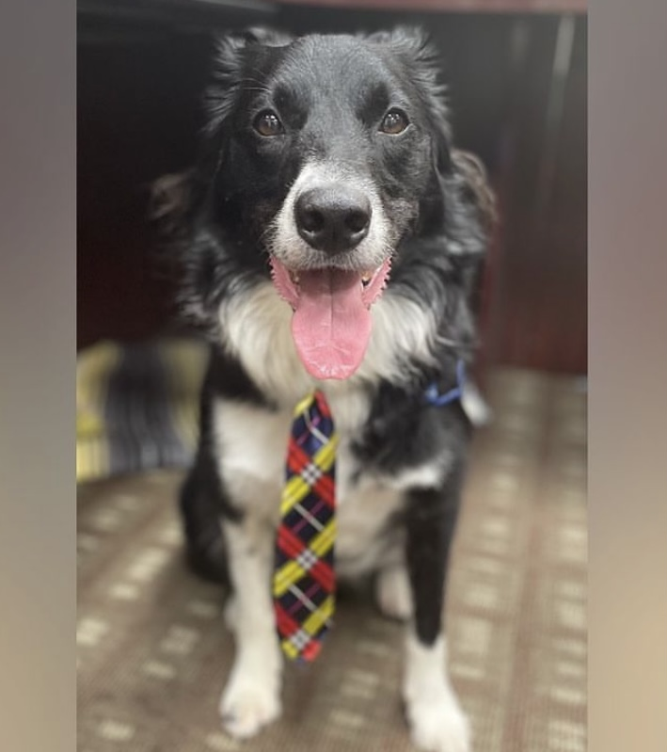

Slide 7
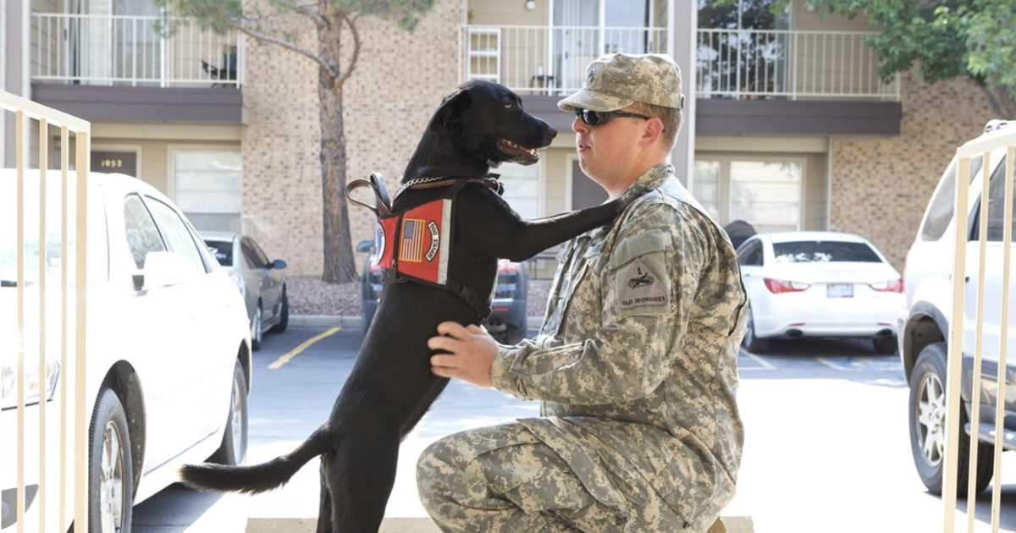
History of animal use in therapy and trauma response:
1919
Animal visitation programs existed in hospitals as early as 1919 (Palley, O’Rourke & Niemi, 2010).
1940s
In the 1940s animals were used to help veterans after World War II
1962
In 1962, Boris Levinson, a child psychologist noticed that his dog had a significant impact on withdrawn and unresponsive children (Hamama et al.,2011)

Slide 8
Impacts and Considerations
Impacts include: lowered anxiety and increased trust-building provided by the unconditional, accepting, and supportive nurturing environment provided by a trained animal (Hamama et al., 2011).
Considerations include: fear, allergies, group conflict, zoonotic diseases, language barriers, cultural status of animals, personal preferences

Slide 9
benefits
Research shows spending time with a dog reduces stress.
In many cases, children or adults are able to open up about traumatic experiences while in the presence of a dog.
More than 200 dogs now work in courtrooms across the country, though they are still being met with some resistance.
https://www.clickorlando.com/news/local/2020/04/01/how-one-therapy-dog-is-going-virtual-to-support-neglected-kids/

Slide 10
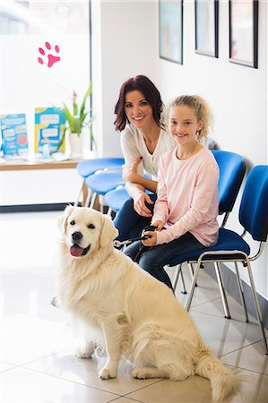
Another amazing discovery is that petting a dog or cat for as little as a minute stimulates the production of oxytocin. This hormone enhances trust, cooperation and love between a caregiver and a child.

Slide 11
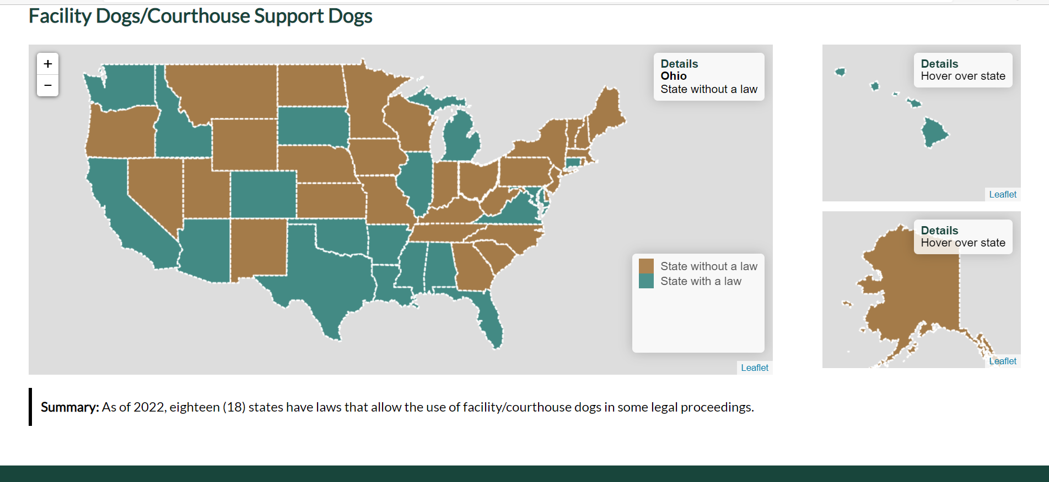

Slide 12
Barriers
legal implications and liability, allergy concerns, hygiene and sanitation concerns, safety concerns, cultural differences, fear of dogs, animal welfare, funding associated with animal maintenance and program implementation, as well as a lack of administrative and staff support
This Photo by Unknown Author is licensed under CC BY-SA-NC

Slide 13
This Photo by Unknown Author is licensed under CC BY-SA

Slide 14
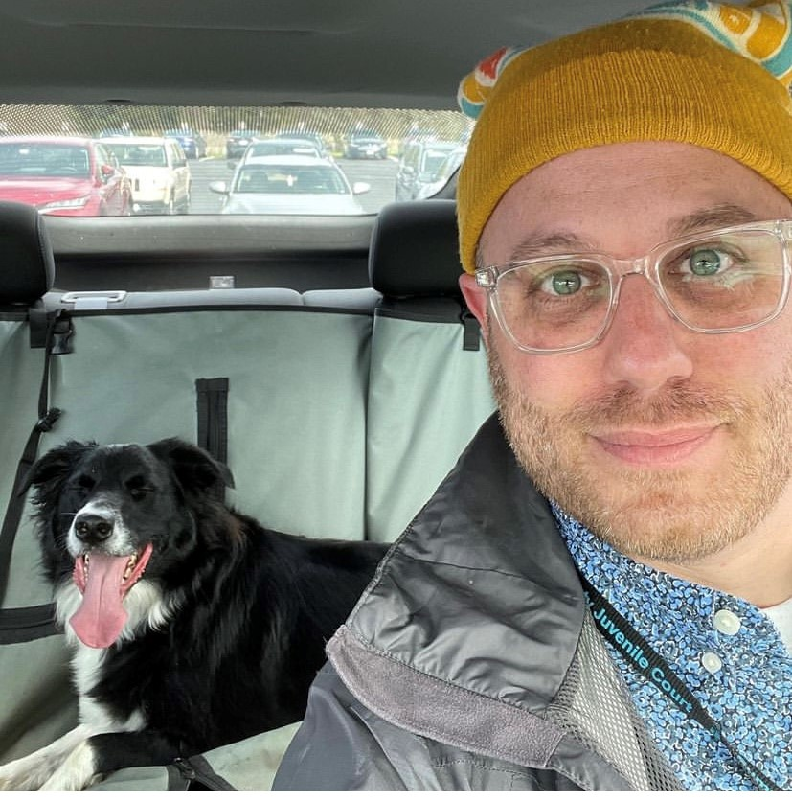
Once upon a time…
There was a boy and
His dog

Slide 15
Ways Tater tot is utilized
Court Hearings
Visitors
Detention Center
CASA Volunteer’s/GAL’s
Staff

Slide 16
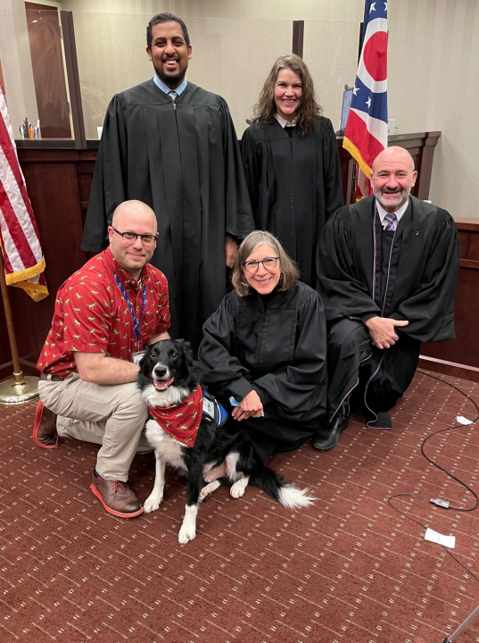
View from the bench
“Participating in court proceedings can be an extremely emotional and stressful experience for children,” said Teodosio. “The more that we can do to alleviate the stress and apprehension they feel, the more likely we are to obtain the information needed to make difficult and sometimes life-altering decisions.”

Slide 17
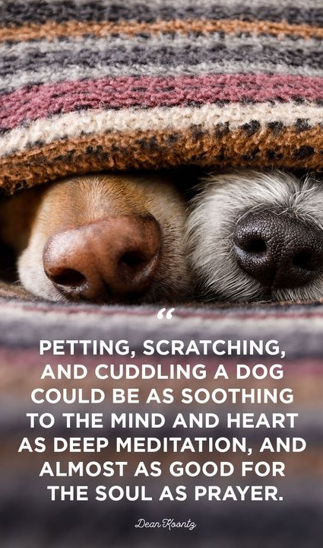
The honorable Tater tot

