Slide 1

DOMESTIC VIOLENCE AND ANIMAL ABUSE
“Abusers utilize a pattern of coercive tactics and intimidation by whatever means necessary to gain and maintain power and control over their victims”

Slide 2

Todd Curtis – Retired Chief Investigator,
Wood County Prosecutor
31 Years of Law Enforcement Service
Retired Det. Sgt. Perrysburg Township Police Dept.
State of Ohio Master Criminal Investigator
Certified Criminal Profiler – Forensic Criminology Institute
Certified Court expert Domestic Violence and Strangulation Assault Investigation
State of Ohio and State of North Carolina Criminal Justice Instructor
Adjunct Faculty at Owens Community College

Slide 3

Heads Up…
Today we will look at…
Correlation between DV and Animal Abuse
Profile of the Abuser and the Victim
Example Cases
Strangulation Assaults
Lethality Assessments
Officer Safety
Questions

Slide 4

Abuse of Animals / pets IN D.V.
Cruelty / abuse of animals is a significant way to make a statement.
Abusers use animal abuse to vent frustration and anger as well as power promotion of self-esteem
The killing of animals has been linked to rehearsals for killing human victims by criminal profilers.
Most abusers believe there is no risk to them for animal cruelty.

Slide 5

“Abusers utilize a pattern of coercive tactics and intimidation by whatever means necessary to gain and maintain power and control over their victims”

Slide 6

Animal abuse often coincides with domestic violence, including intimate partner abuse and child abuse.

Slide 7

Profiling the abuser
Abuse of any living creature is a CHOICE behavior
In Domestic situations, violence involves repeated assaults / events
Violence is just one of the methods involved in the process of gaining power and control
Understand – this is all self-serving for the offender fulfillment

Slide 8

Common Character traits: Profiling the abuser
Most Abusers have an inferiority complex but create the “mirage” of being superior / “god-like”
Abusers lack empathy
Incapable of seeing they have a problem
Sneaky and extremely manipulative
Prey on others, ego gratification
Defy, challenge and demean authority

Slide 9

Profiling the abuser
Poor impulse control
Number one victims are within the family
Strong candidates for sociopathic violence
Castle mentality
Desperate thinking

Slide 10
MOTIVES of the abuser
Power Assertive Behavior
Intended to restore offender self confidence or self-worth through moderate or highly aggressive means.
“The Punch”
Power Reassurance Behavior
It is intended to restore the offender self confidence or self-worth with low aggression means

Slide 11

Abuse of a companion animal is one of the four most significant risk factors associated with someone committing domestic abuse and is an indicator of the use of controlling and violent behaviors.

Slide 12


Profiling the Victim
“Why do they stay?”
Financial Abuse
A woman is 70 times more likely to be murdered in few weeks after leaving the abusive partner
Remember the conditioning…. Violent acts have been demonstrated – examples made.
Threats to the kids (even greater if from another marriage), pets and animals

Slide 13

Profiling the victim
Trained that the violence will get worse if authorities are notified
All done behind closed doors
Measures are taken to prevent discovery
Domestic Violence is 3rd leading cause of homelessness
Preservation

Slide 14
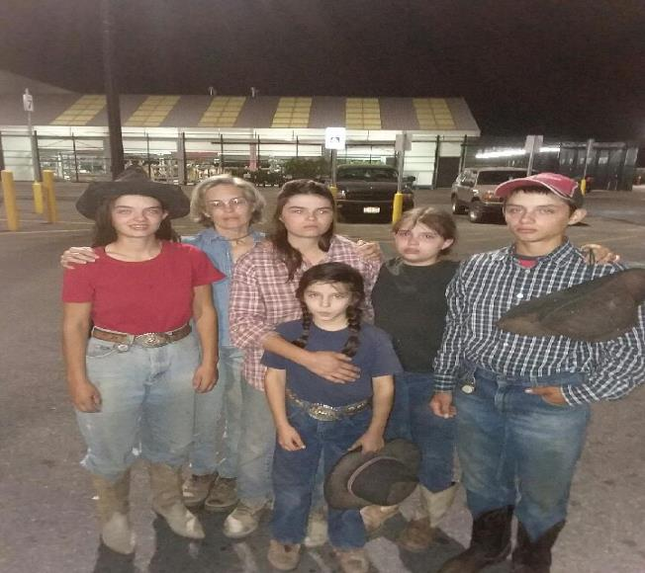
This is Real…
Family fled to Ohio after years of abuse and isolation
Husband / Father given a life sentence
All members of the family
“Family” pets
https://www.krem.com/article/news/local/bonner-county/priest-river-man-given-life-sentence-for-unbelievable-abuse-of-his-own-children/293-558026940#:~:text=COEUR%20D%E2%80%99ALENE%2C%20Idaho%20%E2%80%93%20A%20Priest%20River%20man,different%20charges%20for%20the%20abuse%20of%20his%20kids.

Slide 15

Case Example
Raymond Cervantes
Killed his wife’s dog and assaulted her daughter during incident in Lucas County.
Jailed then let out on EHM

Slide 16
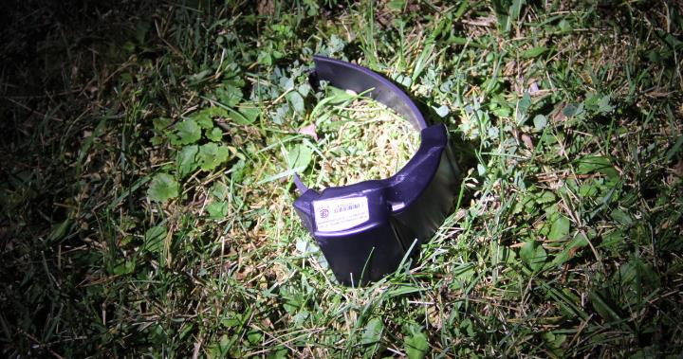
August 2020
Perrysburg Twp
Cervantes manipulated his wife into coming to his sister’s.
Cut off ankle monitor
Lies in wait

Slide 17
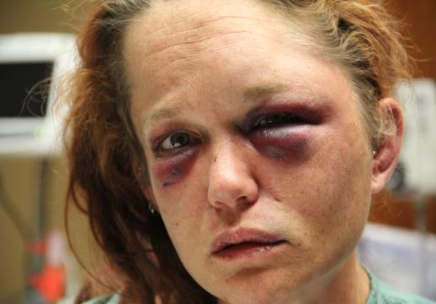
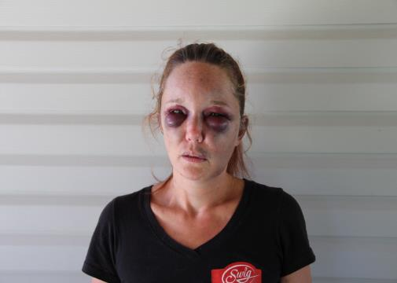
Case Example
Night of incident at hospital
Follow up three days later

Slide 18
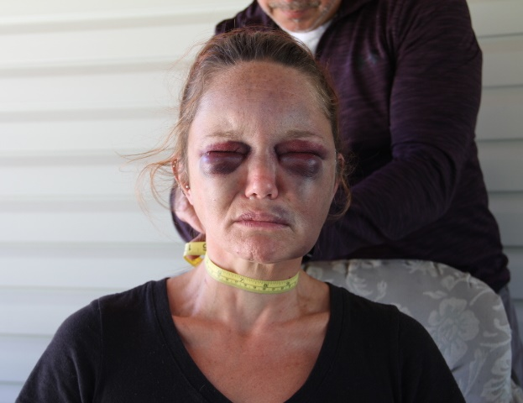
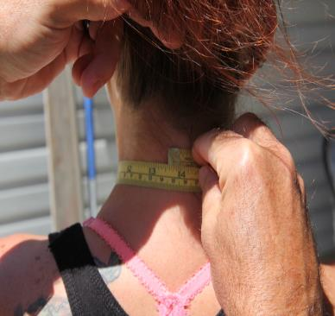
Evidence for Strangulation

Slide 19
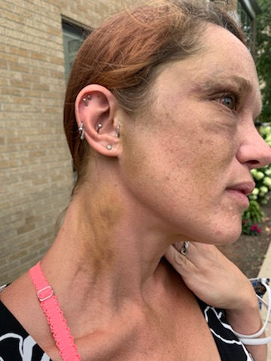
Case example
Level of anger and violence increases
If victim is not immediately located, violence acted out on whatever available for impact
“If I can’t have you no one is gonna”
Strangulation…

Slide 20
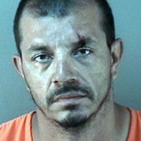
Raymond Cervantes
Man facing attempted murder racks up charges between three counties
It took a Henry County jury less than two hours to find a Toledo man guilty of the 2020 attempted murder of his wife.
https://www.sent-trib.com/2023/07/13/i-cant-forget-what-you-did-man-sentenced-for-attempted-murder-of-ex-wife/
Convicted in Lucas, Henry and Wood Counties for Cruelty to animals, attempted murder, felonious assault, kidnapping, escape and tampering with evidence

Slide 21
Strangulation law in ohio
ORC 2903.18
(1) "Strangulation or suffocation" means any act that impedes the normal breathing or circulation of the blood by applying pressure to the throat or neck, or by covering the nose and mouth.
(2) "Dating relationship" has the same meaning as in section 3113.31 of the Revised Code.
(3) "Family or household member" has the same meaning as in section 2919.25 of the Revised Code.
(4) "Person with whom the offender is or was in a dating relationship" means a person who at the time of the conduct in question is in a dating relationship with the defendant or who, within the twelve months preceding the conduct in question, has had a dating relationship with the defendant.
(B) No person shall knowingly do any of the following:
(1) Cause serious physical harm to another by means of strangulation or suffocation;
(2) Create a substantial risk of serious physical harm to another by means of strangulation or suffocation;
(3) Cause or create a substantial risk of physical harm to another by means of strangulation or suffocation.
(C) Whoever violates this section is guilty of strangulation.

Slide 22
ORC 2903.18
PENALTY SECTION
(1) A violation of division (B)(1) of this section is a felony of the second degree.
(2) A violation of division (B)(2) of this section is a felony of the third degree.
(3) A violation of division (B)(3) of this section is a felony of the fifth degree. If the victim of the violation of division (B)(3) of this section is a family or household member, or is a person with whom the offender is or was in a dating relationship, a violation of division (B)(3) of this section is a felony of the fourth degree. If the victim of the offense is a family or household member, or is a person with whom the offender is or was in a dating relationship, and the offender previously has been convicted of or pleaded guilty to a felony offense of violence, or if the offender knew that the victim of the violation was pregnant at the time of the violation, a violation of division (B)(3) of this section is a felony of the third degree.
(D) It is an affirmative defense to a charge under division (B) of this section that the act was done as part of a medical or other procedure undertaken to aid or benefit the victim.

Slide 23
“Serious Physical Harm”
ORC Defines
(5) "Serious physical harm to persons" means any of the following:
(a) Any mental illness or condition of such gravity as would normally require hospitalization or prolonged psychiatric treatment;
(b) Any physical harm that carries a substantial risk of death;
(c) Any physical harm that involves some permanent incapacity, whether partial or total, or that involves some temporary, substantial incapacity;
(d) Any physical harm that involves some permanent disfigurement or that involves some temporary, serious disfigurement;
(e) Any physical harm that involves acute pain of such duration as to result in substantial suffering or that involves any degree of prolonged or intractable pain.

Slide 24
Symptoms from Strangulation
Couldn’t breathe –Trachea obstructed
Saw Spots, lights, darkness – Blood Flow restricted
Dizziness – could be from lack of oxygen, blood flow or both
Can’t remember – hippocampus cells (memory and recall) more susceptible to anoxia
Anoxia is the absence of oxygen supply to tissue
The brain cells are dying – up to 32,000 neurons lost per second
Loss of bladder function – after 15 seconds – bowl control after 30 seconds

Slide 25
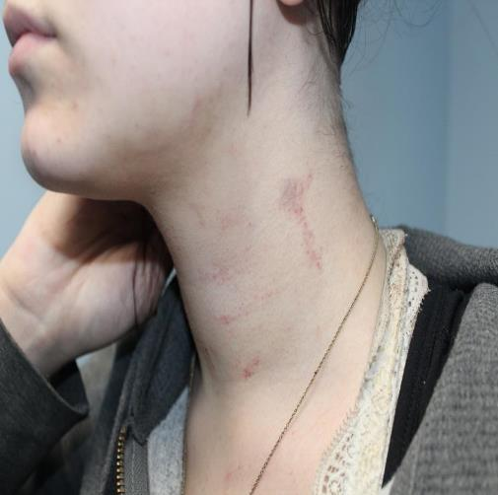
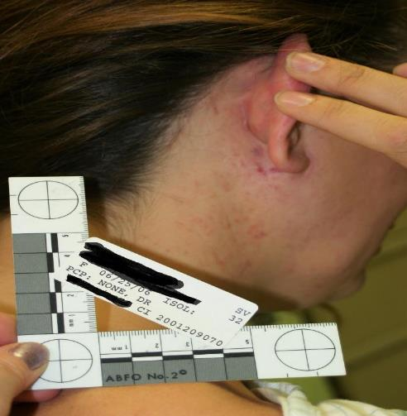
50 % of Strangulation Assaults show no Marks – Follow up with victims!

Slide 26
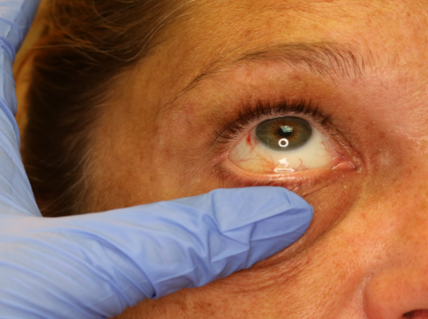
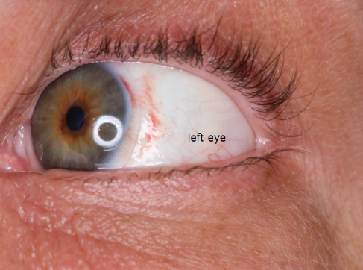
Vascular Congestion = Petechial rupture
Scalera Hemorrhage

Slide 27
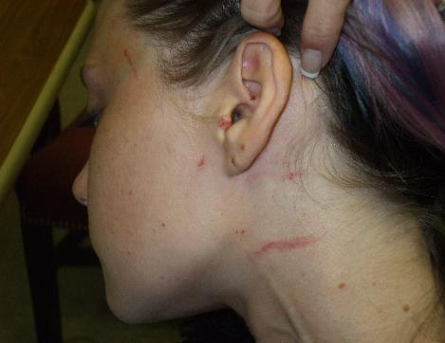
Strangulation Assaults
Important to move the hair
Check for grasp points
Direction of the marks
Check under chin
Follow up photos
Check for veinous pressure signs

Slide 28
Officer Investigation and evidence collection
Body Camera footage!
Written statement before much questioning (if possible). Evidence can be right there in their own words: “I tried to walk away but her put me in a choke hold and pushed me to the floor until I was dizzy and couldn’t yell for help”.
Photos – Incident, 48-72 hours (Re-Interview), 5 days and if need be, keep at it.
911 Call
Forensic collection
Audio or video of follow up interview when taking FOLLOW UP PHOTOS!

Slide 29
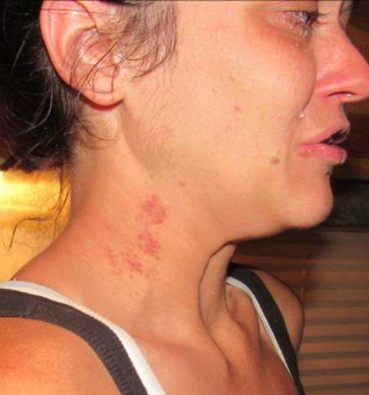
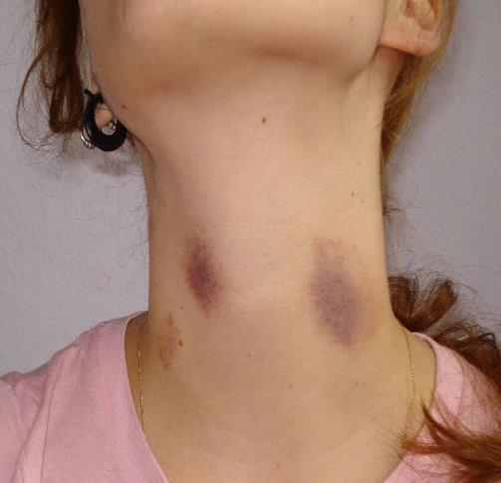
“I didn’t choke her…”

Slide 30
Suspect / defense Excuses
“Those aren’t from choking her those are hickeys.”
Hickey
Vessels Burst
Drawn in / upward
Normally solid
Oval or football shape
Strangulation
Vessels Burst
Locations
External pressure downward
Pattern disruption
17-Year-Old Dies After Hickey From Girlfriend Causes Stroke
https://time.com/4471274/teenager-dies-hickey-love-bite/

Slide 31
“She likes me to choke her during sex”
*Breath Play – can induce the temporary release of endorphins leading to a very brief heightened state of arousal. Can promote trust and panic can increase some excitement.
However… oxygen and blood flow restrictions can limit orgasm and it is certainly not physically possible to achieve orgasm while unconscious.
* - BDSM community members and sexual therapists

