Slide 1



Hope and Healing Survivor Resource Center
Office Locations:
Summit County: 974 E. Market St. Akron, OH 44305
Medina County: 696 E. Washington St. Medina, OH 44256
www.hopeandhealingresources.org
@hhscmc

Slide 2

Mission Statement
At Hope and Healing, we are committed to the prevention of violence through social and systemic change and providing trauma-informed, culturally responsive services to survivors of domestic and intimate partner violence, sexual violence, and human trafficking in Medina and Summit counties
Our Philosophy
Healing. Hope. Empowerment.

Slide 3











Comprehensive Programs for Survivors
24-Hour Crisis Hotline
24-Hour Emergency Shelters - Summit & Medina
24-Hour Hospital Accompaniment
Clinical Services
Support Groups
Court & Legal Advocacy
Community-Based Case Management
Supportive Housing
Prevention, Education, and Outreach

Slide 4


Domestic Violence Vs. Intimate Partner Violence
Domestic Violence
Violence or other abuse by one person against another in a domestic setting, such as in marriage or cohabitation.
Intimate Partner Violence
Physical violence, sexual violence, stalking, psychological aggression (including coercive tactics), and financial abuse by a current or former intimate partner.

Slide 5

What makes an Intimate Partner?
“An intimate partner is a person with whom one has a close personal relationship that may be characterized by the partners’ emotional connectedness, regular contact, ongoing physical contact and sexual behavior, identity as a couple, and familiarity and knowledge about each other’s lives. The relationship need not involve all of these dimensions (cdc.gov).”
  Spouses
  Boyfriends/girlfriends/partners
  Dating partners
  Sexual partners

Slide 6
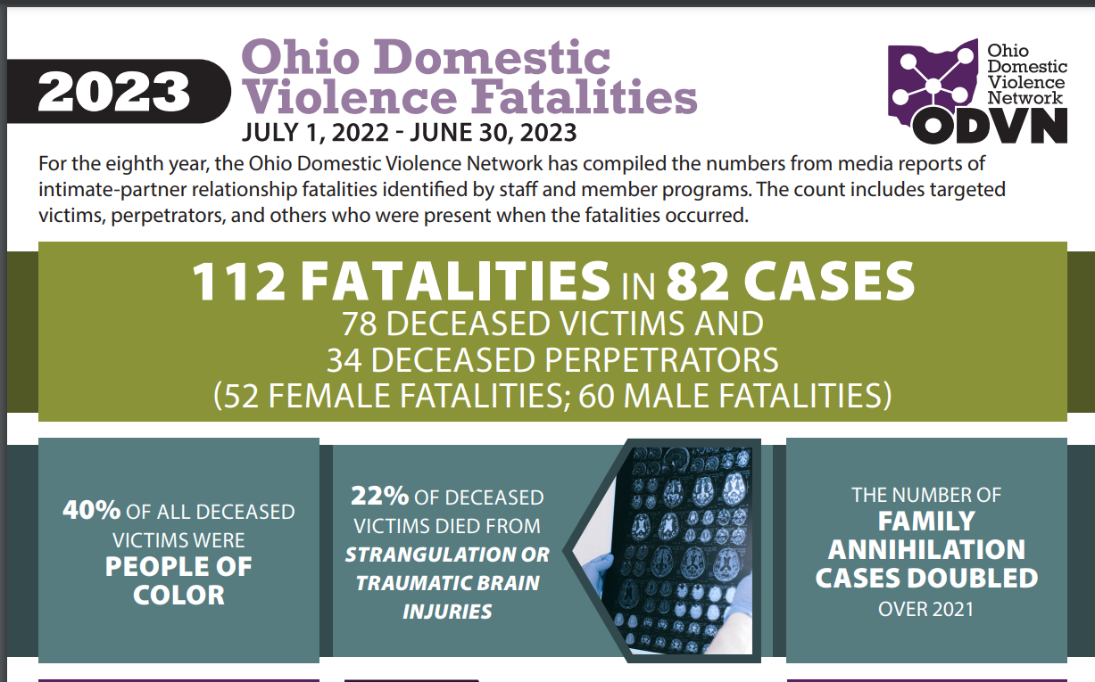

TEXT TEXT TEXT
Presentations are communication tools.
TEXT TEXT TEXT
Presentations are communication tools.
TEXT TEXT TEXT
Presentations are communication tools.
TITLE TITLE TITLE

Slide 7
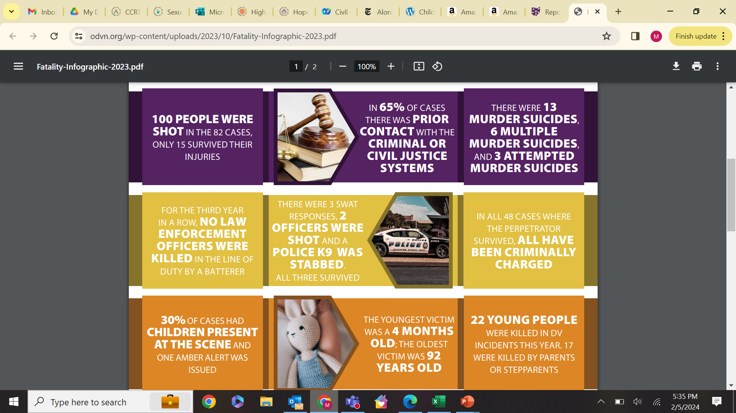

Slide 8
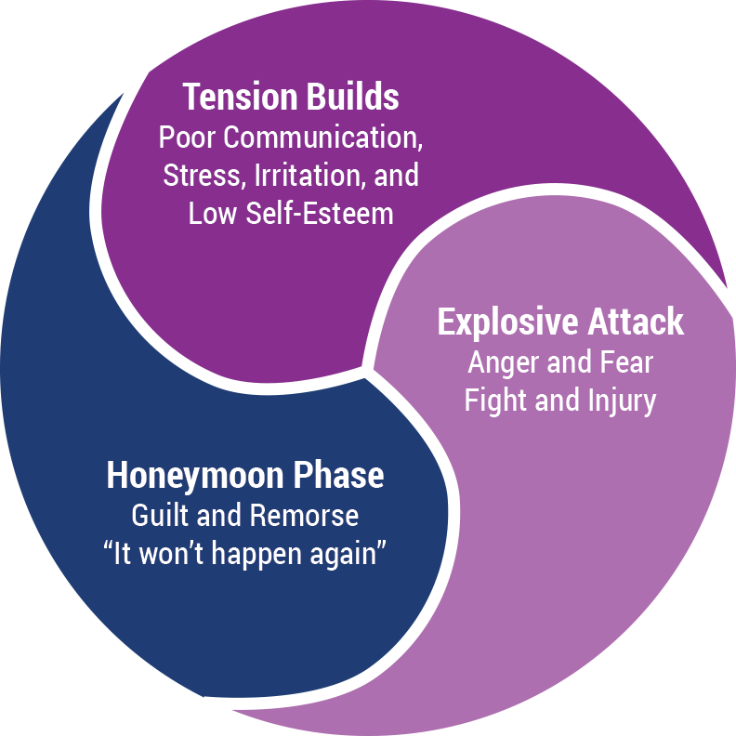
The Cycle of Violence

Slide 9
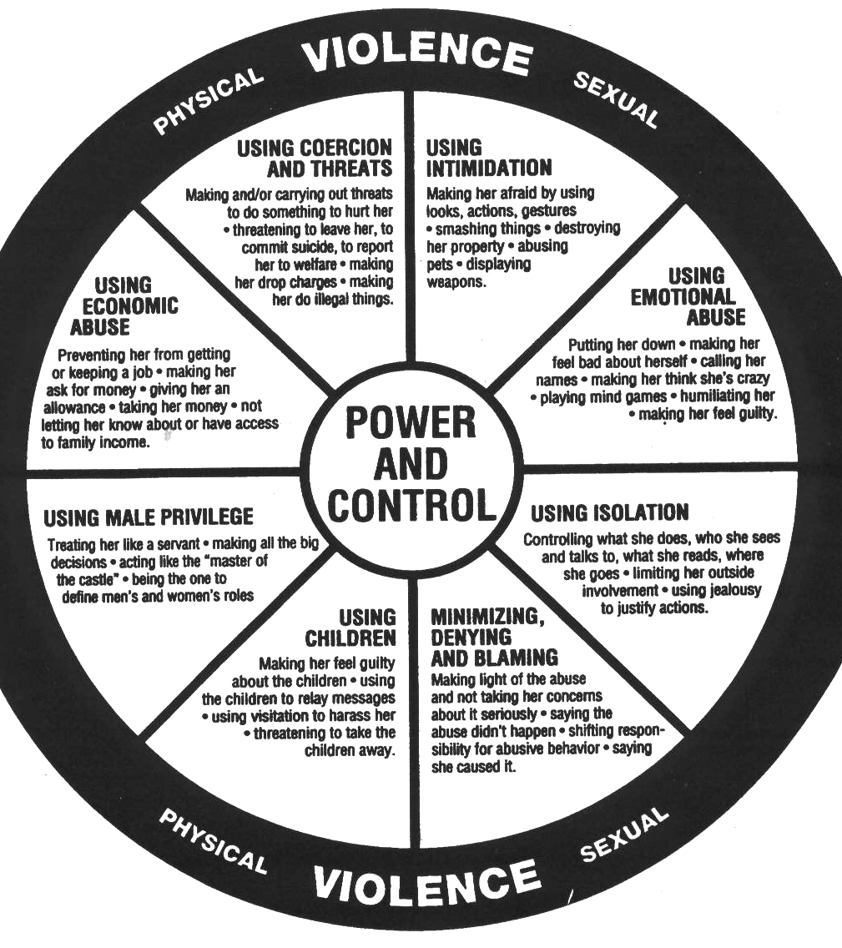
Power and Control Wheel

Slide 10
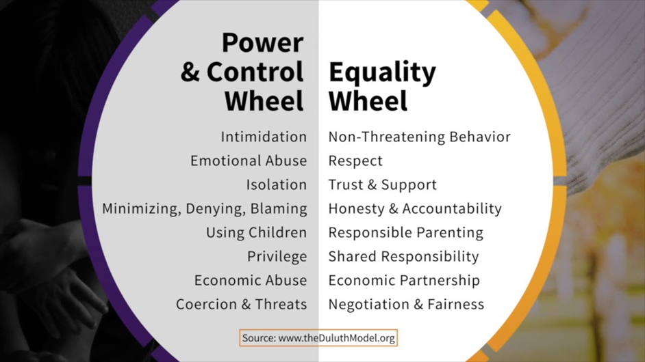

Slide 11
Psychological Aggression
Expressive aggression
Coercive control
Threat of physical or sexual violence
Control of reproductive health
Exploitation of victim's vulnerability
Gas lighting
Notes:
name-calling, humiliating, degrading, acting angry in a way that seems dangerous
limiting access to transportation, money, friends, and family; excessive monitoring of a person’s whereabouts and communications; monitoring or interfering with electronic communication (e.g., emails, instant messages, social media) without permission; making threats to harm self; or making threats to harm a loved one or possession
“I’ll kill you;” “I’ll beat you up if you don’t have sex with me;” brandishing a weapon)—use of words, gestures, or weapons to communicate the intent to cause death, disability, injury, or physical harm
Refusal to use birth control, coerced pregnancy terminations
Immigration status, disability, undisclosed sexual orientations
Same as 5, for example “If you call the police, I could be deported”
Gaslighting explained on next slide

Slide 12
Gas Lighting
Gas lighting is an insidious form of manipulation and psychological control. Victims of gas lighting are deliberately and systematically fed false information that leads them to question what they know to be true, often about themselves. They may end up doubting their memory their perception, and even their sanity. Over time, a gas lighter’s manipulations can grow more complex and potent, making it increasingly difficult for the victim to see the truth
  They tell blatant lies
  They deny you ever said anything, even though you have proof
  They use what is near and dear to you as ammunition
  They wear you down over time
  Their actions do not match their words

Slide 13

Extreme jealousy
Possessiveness
Controlling
Low self-esteem
Unpredictable mood swings
Explosive anger/blaming
Abuse at home
Unrealistic expectations
Too much too fast
Alcohol or drug abuse
Family/friends are worried about them
Instincts are off
Verbal abuse
Partner has abused on the past
“I can change them” mentality
Red Flags

Slide 14
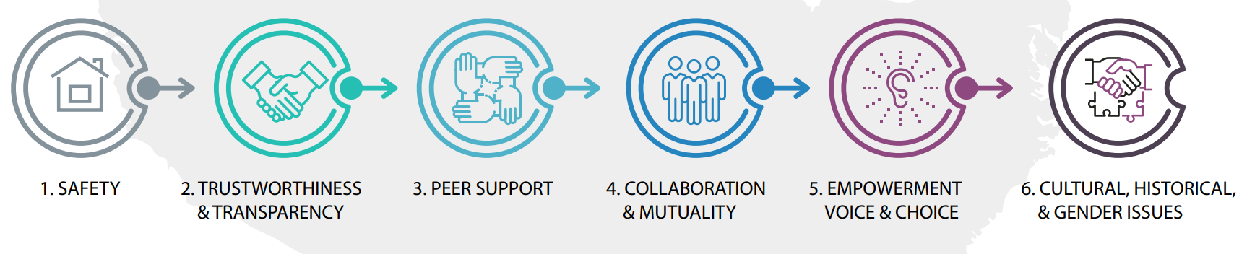

Trauma Informed Care
What happened to you vs. What’s wrong with you

Slide 15
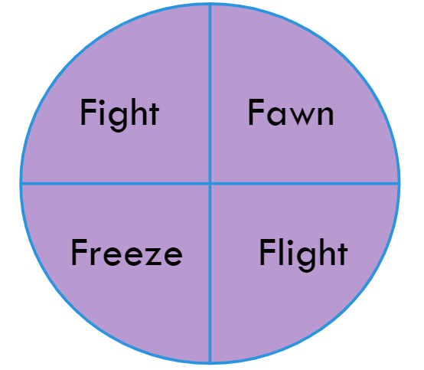
Immediate Reactions to Trauma

Slide 16
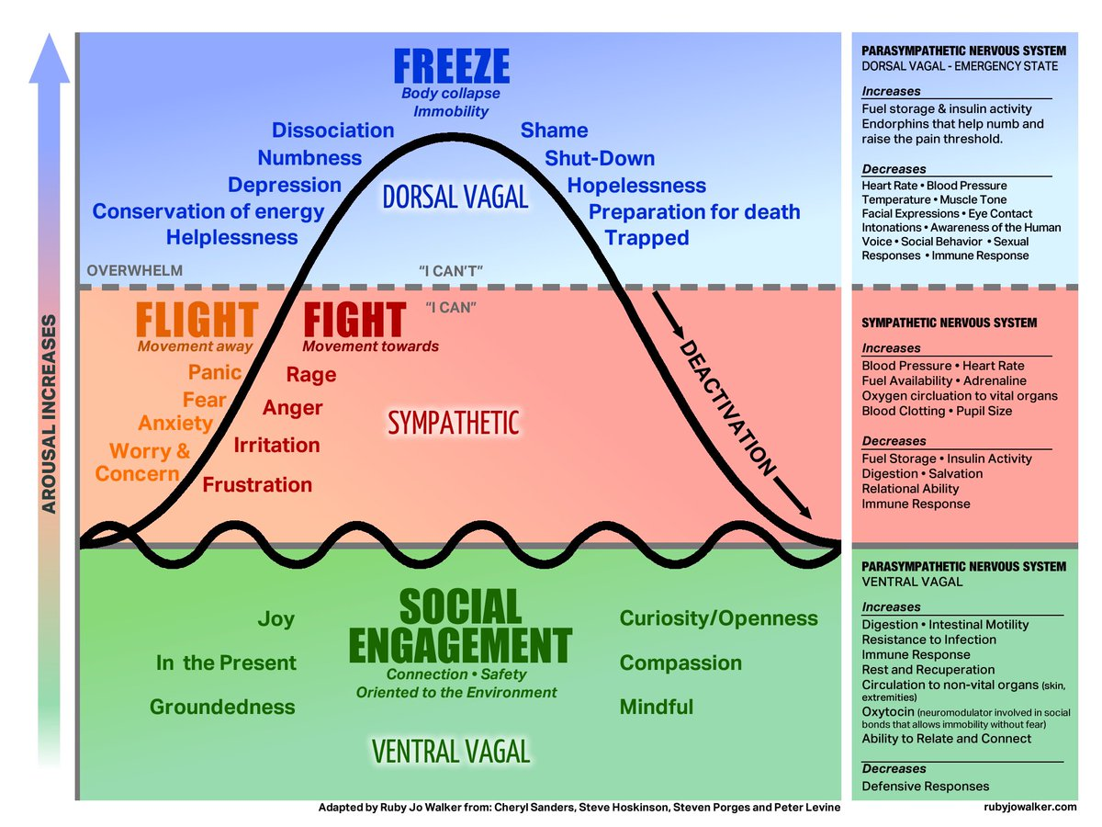
Attachment Styles
  Child reactions to stimulus and people
  Behavior and expressing emotions
Cycle of abuse
Development levels
  Academics and Hobbies
  Social activities

Slide 17
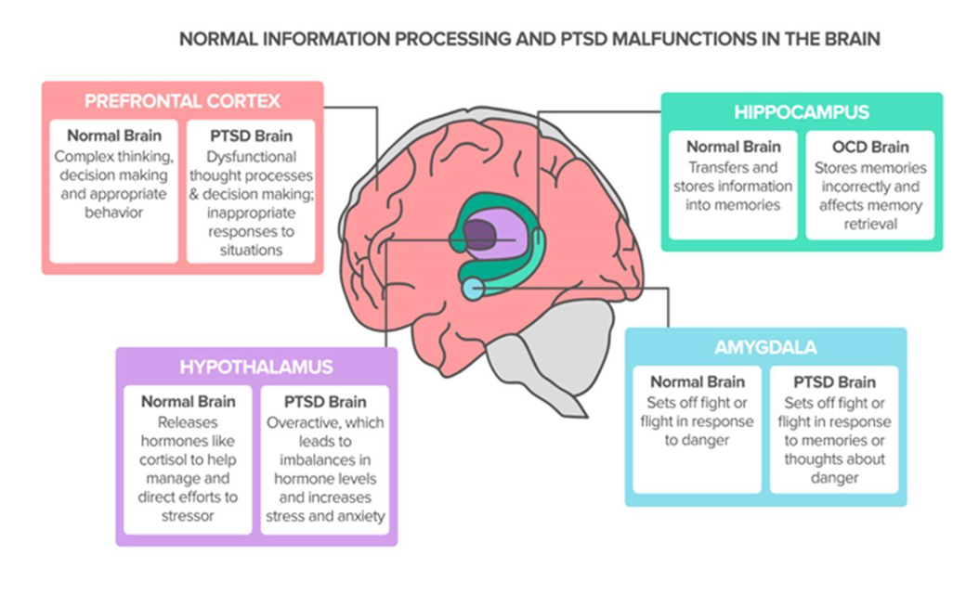
How trauma effects the Brain

Slide 18
Sexual Abuse Impacts
Sometimes it may be hard to prove gut-feelings that a child is being abused to others that we work with and corroborate with.
  Not all abuse leaves signs that law enforcement or the courts may be able to distinguish between.
There are many ways children may exhibit signs of sexual abuse.
  Changes in behavior
  Fear of going home
  Changes in sleeping, eating habits
  School performance/attendance declining
  Risk-taking behaviors
  Inappropriate sexual behaviors
Notes:
Abnormal Sexual Behaviors:
Excessive masturbation
Leaving ‘clues’ that appear to intentionally invite discussion of sexual issues
Complaining of pain while using the toilet, or exhibiting symptoms of a sexually transmitted disease such as an offensive odor
Resistance to the removal of clothing at appropriate times (bath, bed, toilet, diaper change)
Any symptom indicating evidence of physical traumas to the genital or anal area
Engaging in persistent sexual play with friends, toys or pets
Initiating sophisticated sexual behaviors, language, or knowledge
Asking an unusual amount of questions about human sexuality
General behavioral changes
These can include:
Beginning to wet the bed
Experiencing a loss of appetite or other changes in eating habits, including trouble swallowing
Developing frequent unexplained health problems
Regression to behaviors too young for the stage of development previously achieved
Engaging in self-mutilations, such as sticking themselves with pins or cutting themselves
Changes in beliefs or discussions
These changes can include:
Refusal to talk about a secret shared with an adult or an older child
Discussions about a new, older friend; suddenly thinks of self or body as dirty, repulsive, or bad.
Symptoms of anxiety
These include unexplained sleep disturbances (sweats, terrors, nightmares); showing a new or unusual fear of certain people, places or locations; having unexplained periods of panic or alarm.

Slide 19
Age Appropriate Conversations
Go over personal safety with child, gauge where there knowledge is lacking, and where it exceeds.
Going over healthy relationships, boundaries, and consent
  Depending on age of child, sexual context should be included or excluded.
When addressing abusive behaviors, make sure we are not demonizing the parent.

Slide 20
Trauma Bonding Model
Notes:
Now that we’ve reviewed the definition & risk factors, we’ll look more closely at the different dynamics involved in trauma bonding

Slide 21

Trauma Bonding
Trauma bonding is the strong, emotional attachment to a person that occurs in the presence of danger, shame, and exploitation
  Imbalance of power and a cycle of intermittent good-bad treatment
“Trauma bonded” rather than “codependent,” or “self-defeating”
  Labeling victims and survivors as “codependent” negates the traumatic context
  Blames, shames, and places inappropriate responsibility on victims and survivors
Notes:
“Common question – Why don’t victims leave in these situations?”
Codependency was a term originally created to describe the relationship dynamics between a person with a substance use disorder & a family member with enabling types of behaviors.
Trauma bonding is a response to chronic abuse and trauma. It is not due to an inherent dysfunctional attachment ability, weakness, or lack of self-sufficiency. These behaviors are a direct response to the trauma they have endured and how their minds have figured out how to survive.
To label trauma victims and survivors as co-dependent is inaccurate, harmful, and not a trauma-informed approach. Such terms imply victims or survivors have a choice when in reality, oftentimes,, they did not. They may have been told that if they set up boundaries and stop giving into the other person’s needs, then it will be fixed. This is not possible when the trauma bond is at play. There is a threat to their survival that leaves them powerless and in a situation where compliance is necessary for survival

Slide 22
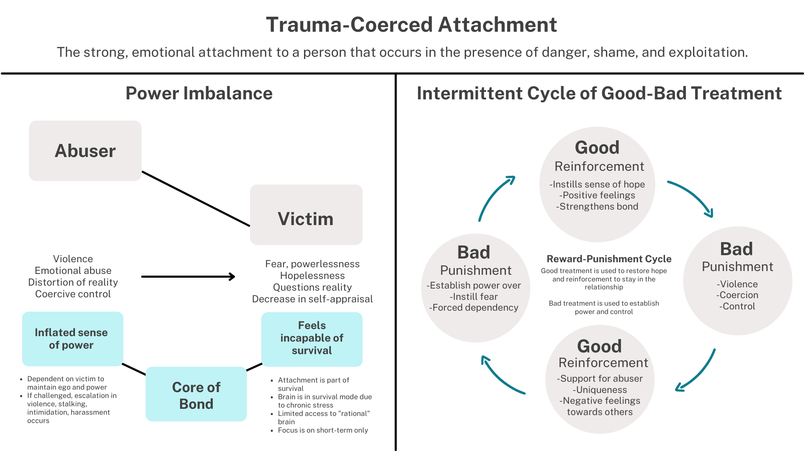
Ashley Kline
RCC of Medina & Summit Counties
Notes:
These relationships start off with some sort of “good” (that’s the context as trafficker as a protector; a partner in IPV; a family member in CSA) – that’s what keeps them engaged – the belief that this good part will stay and the bad will fall away.
Ashley –
1)Power Imbalance
2)Intermittency of Abuse
Good tx – SENSE OF HOPE
Threat response is regularly activated
Brain is in survival mode
Focus is on short-term survival
not thinking of how to escape; - access to rational brain for long term planning is limited
thinking of how to stay alive & how to make it more bearable moment to moment
Loss of desire to escape becomes more habitual the longer the bond is maintained - not passivity or learned helplessness. Rather, it is an effect of the trauma bond & how they have learned to survivor

Slide 23
Power imbalance and good/bad treatment
Cycle of abuse – There is a belief of change
Emotional support
Financial support
Fear of leaving –What happens next
Where will I go? How will I survive?
Children
Children learn abuse is “normal,” all they have ever known
Trauma Bonding

Slide 24
When everyone around you has strong negative reactions, yet you continue covering up, defending or explaining a relationship.
When there is a constant pattern of non-performance and yet you continue to believe in false promises.
When there are repetitive, destructive fights that nobody wins.
When others are horrified by something that has happened to you and you are not.
When you obsess over showing someone that he or she is wrong about you, your relationship or the person’s treatment of you.
When you feel stuck because you know what other person is doing is destructive but you believe you cannot do anything about it.
When you feel loyal to someone even though you harbor secrets that are damaging to others.
Signs of Trauma Bond

Slide 25

Trauma-Coerced Attachment
“Trauma-coerced attachment” rather than “codependent” or “enabling”
  Terms negate the traumatic context
  Blames, shames, and places inappropriate responsibility on survivors
  Survivor behaviors developed in the context of danger and exploitation are survival – not weakness
The abuser is responsible for creating and maintaining this dynamic as a means of power and control
  Professionals should strive to maintain this perspective when working in various systems and with survivors
  Difference between “she is trauma bonded” (responsibility on survivor) vs. “the abuser uses coercive control to enforce a trauma bond”
Notes:
Ashley
To label trauma victims and survivors as co-dependent is inaccurate, harmful, and not a trauma-informed approach.
Such terms imply victims or survivors have a choice when in reality, oftentimes,, they did not. They may have been told that if they set up boundaries and stop giving into the other person’s needs, then it will be fixed. This is not possible when the trauma bond is at play. There is a threat to their survival that leaves them powerless and in a situation where compliance is necessary for survival. Trauma bonding is a response to chronic abuse and trauma. It is not due to an inherent dysfunctional attachment ability, weakness, or lack of self-sufficiency. These behaviors are a direct response to the trauma they have endured and how their minds have figured out how to survive.

Slide 26
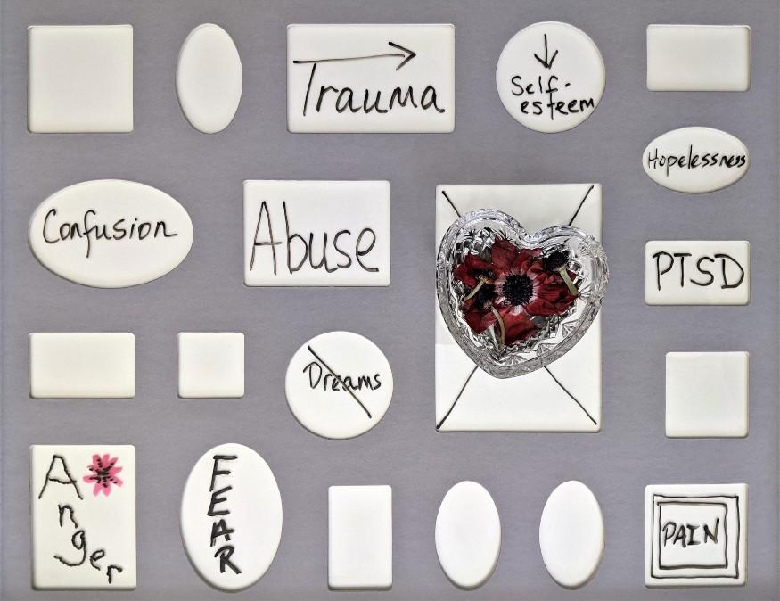
Trauma Bonding within Victimizations
Trauma bonding can occur in a variety of situations
A child who does not disclose sexual abuse by a family member
A partner who declines to testify against their abuser
A trafficking victim who accepts legal consequences, so their trafficker avoids criminal prosecution
Notes:
Megan
-Trauma bonding can occur in a variety of situations
-As with most types of abuse, pereptrators will exploit vulnerablities
Later in this presentation, we will look at how trauma coerced attatchment can occur within the victimization types of childhood sexual abuse, IPV and human trafficking. But first we we will more closely explore the ristk factors and dynamics of trauma bonding.

Slide 27
Common Risk Factors
History of abuse and neglect – ACEs
Poverty and homelessness
Limited access to educational and economic opportunities
Involvement in child welfare system
Substance use and mental health factors
Structural inequities due racism and systems oppression Communities that have been marginalized – race, immigrant & refugee, LGBTQ+
Witnessing violence in the home and community
Low self-esteem
Unmonitored access to technology (more specific to trafficking & childhood sexual abuse risk)
Notes:
Megan

Slide 28
Poverty and associated factors (e.g., overcrowding, high unemployment rates)
Low social capital-lack of institutions, relationships, and norms that shape a community’s social interactions
Poor neighborhood support and cohesion
Weak community sanctions against IPV (e.g., unwillingness of neighbors to intervene in situations where they witness violence)
High alcohol outlet density
Traditional gender norms and gender inequality (e.g., women should stay at home, not enter workforce, and be submissive; men support the family and make the decisions)
Cultural norms that support aggression toward others
Societal income inequality
Weak health, educational, economic, and social policies/laws
Community and Societal Risk Factors

Slide 29
  Take the time to listen, approach your loved one at a time and place that is safe
  Communicate that you care and believe your loved one, validate what your loved one, that they are not “crazy”
  Normalize, normalize, normalize! Let them know it is not their fault
  Help encourage your loved one, support them, and do not force them to disclose anything if they are not comfortable
  Be patient, self-empowerment may take longer than you think.
  Respect the choices of your loved one and connect them with resources if necessary
  Consider contacting your local domestic violence hotline to learn about the resources in your area should your loved on want them
Co- Survivors

Slide 30
Co- Survivors
Don’t’s:
  Do not accuse, diagnose, or judge your loved-one’s choices
  Do not draw conclusions
  Do not judge or criticize the abuser
  Do not pressure your loved one to leave the abusive relationship, but do communicate that you are there to support them.
Notes:
Why wouldn’t we want to judge or criticize the abuser? – Lack of safety for loved one.
There are many reasons they may be choosing to stay. It is possible their abuser has threatened to hurt them or their children if they try to leave. The abuser may control all of their finances and may have isolated the victim from friends and family, leaving the victim with very few resources of their own. The abuser may have promised to change, and the victim may still love him/her. It is never as simple as encouraging a victim to “just leave”—but by all means, communicate to your loved one that help does exist, and that people in their community care about them and their children and want them to be safe.

Slide 31
Impact of Witnessing Violence
Violence is a learned behavior, child more apt to perpetrate violence if exposed to it.
Can cause varying amounts of self-destructive behaviors and depressive symptoms such as:
  Isolation
  Self-harm
  Drug addiction
  Stealing/Theft
  Mood Swings/Irrtability
Understanding personal boundaries as an advocate, knowing what you can help with and what you can’t, and being consistent where you can.

Slide 32
Self Care and Coping as Advocates
It is important that we are taking care of ourselves.
  Many advocates may feel burnt out due to vicarious trauma experienced on a daily basis at work.
There are many self care and coping mechanisms we can use to help ease the mental, and emotional burden that comes with the field we work in.
  Journaling
  Getting enough sleep
  Support System
  Counseling
  Light exercise
  Listening the music
  Ect.

Slide 33
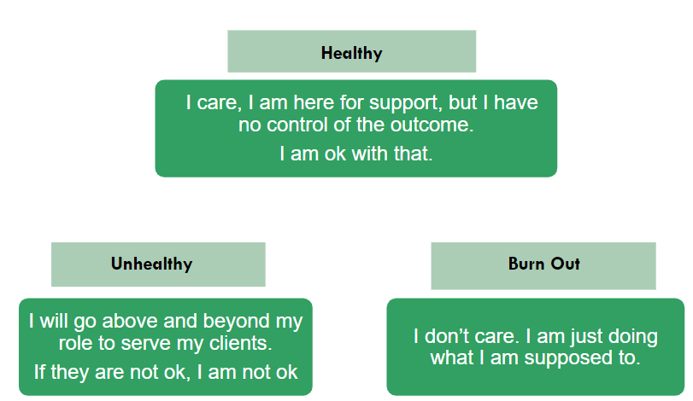
Attachment to Outcome Styles

Slide 34
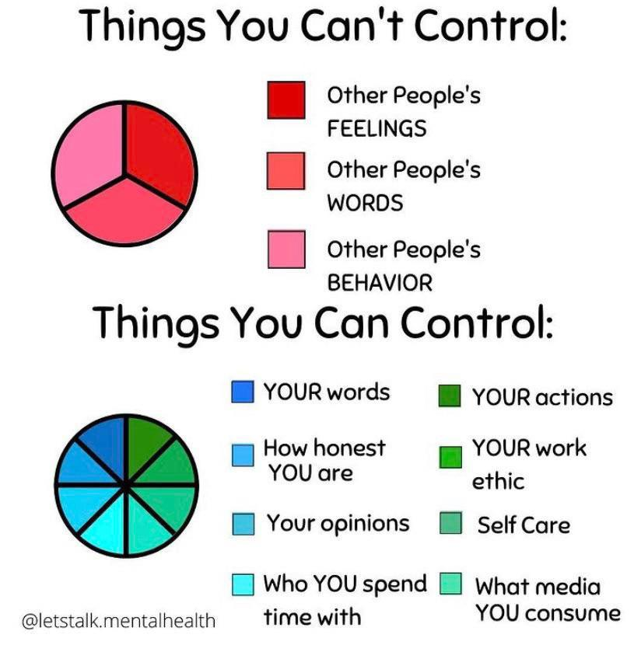
What’s In Your Control?

Slide 35
Safety Planning
Where they feel:
  Safe
  Unsafe
Who:
  Trust
What:
  Risks
  Worked/not worked
  Coping mechanisms
  Resources

Slide 36
Parent Participation and Awareness
It is important that we realize that we can not depend on a child in this situation to help better the conditions they’re living, we must build repour with the parents/guardians as well
Educating the parent/guardian without demonizing their current behaviors is also key
  If we build repour, a parent may be more open to changing abusive/toxic behaviors towards the child.

Slide 37
Parental Alienation
Most parents or guardians may feel alienated by the process of CASA, Child protective Services, or any social workers becoming involved at all.
Building repour with the parents is so important
  If they don’t trust you, they’re going to be difficult to work with and to get them to participate.
As advocates we need to mindful on they we vocalize changes to parents.
  Stay away from any language used that may be considered damning.

Slide 38
How Can I Help?
Listen
Support them where they are
Keep their needs in mind
Empower them
Validate seriousness
Do not blame them
Provide resources

Slide 39
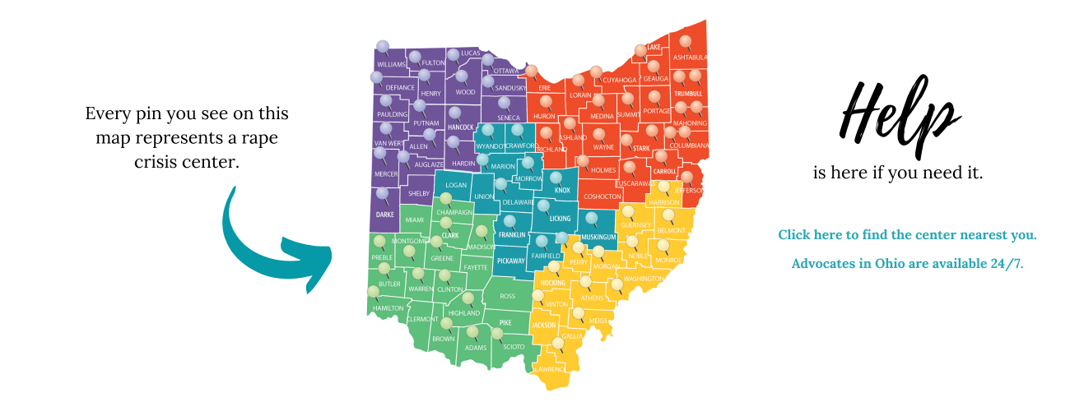
Community Resources
OAESV/Rape Crisis Centers

Slide 40
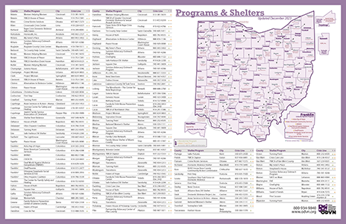
Community Resources
ODVN/Emergency Shelters

Slide 41
Community Resources
Intersectional Resources
  Runaway Resources
  Unhoused Resources
  Human Trafficking Resources
  Substance Use Resources
  Continuous Support Resources

Slide 42
Community Resources
National Resources
  American Academy of Child and Adolescent Psychiatry Child Abuse Resource Center
  National Children's Advocacy Center
  National Runaway Safeline

Slide 43
Questions?

Slide 44
Hope and Healing Survivor Resource Center
Hope and Healing Hotline 330-374-1111
Business Line 330-374-0740
Email: info-rcc@hope-healing.org
Website: https://hopeandhealingresources.org/

