Slide 1
The Center for
Family Safety and Healing
Supporting Healthy Teen Relationships +
Social Media
Caitlin Tully

Slide 2
Learning Objectives
Recognize signs of healthy, unhealthy and abusive behaviors in adolescent relationships
Understand how youth use technology, including technology-facilitated abuse
Explore resources for professionals to support healthy relationships and digital well‐being for youth
Notes:
*Getting ghosted
Where could that come from?

Slide 3

Reflection
Dating relationships are the same for teens now as they were for me as a teen.
Notes:
*Getting ghosted
Where could that come from?

Slide 4
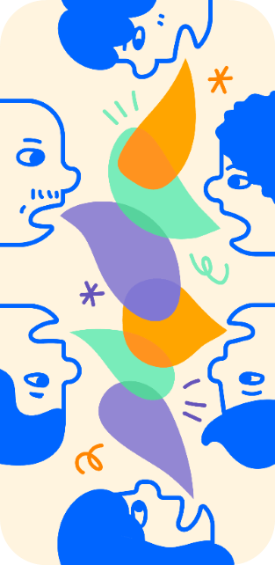
Teen Relationship Pressures
Teens have limited prior relationship experiences and may not have a blueprint for healthy relationships.
Teens are highly influenced by norms among their peer groups.

Slide 5
Teen Relationship Pressures
Technology is extremely integrated into many teens’ lives and may be used against a dating partner.
Teens are living in what the WHO calls an infodemic – “an overabundance of information—some accurate and some not—that makes it hard for people to find trustworthy sources and reliable guidance when they need it.”

Slide 6
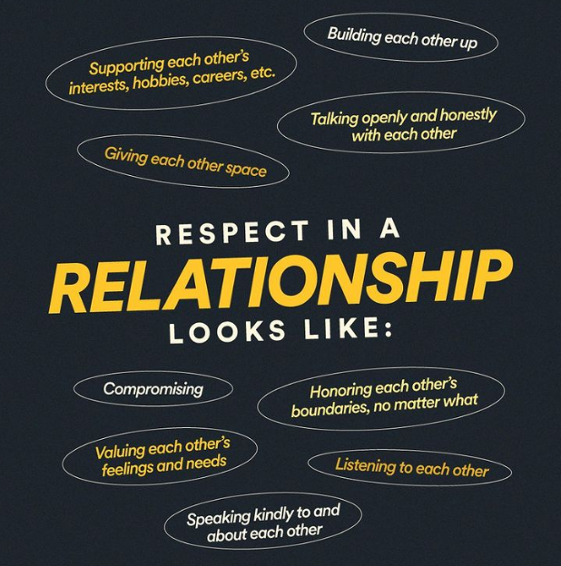
Key Aspects of
Healthy Teen Relationships
Comfortable Pace
Trust
Honesty
Independence
Respect
Graphic Source- loveisrespect.org, posted on Instagram October 25,2021

Slide 7
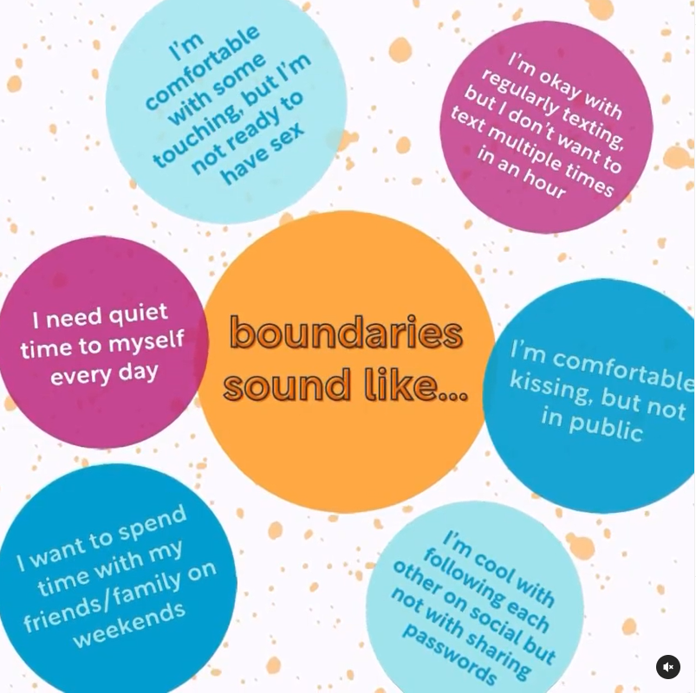
Key Aspects of
Healthy Teen Relationships
Equality
Compassion
Taking Responsibility for Actions
Healthy Communication
Graphic Source- loveisrespect.org, posted on Instagram
July 14,2021

Slide 8
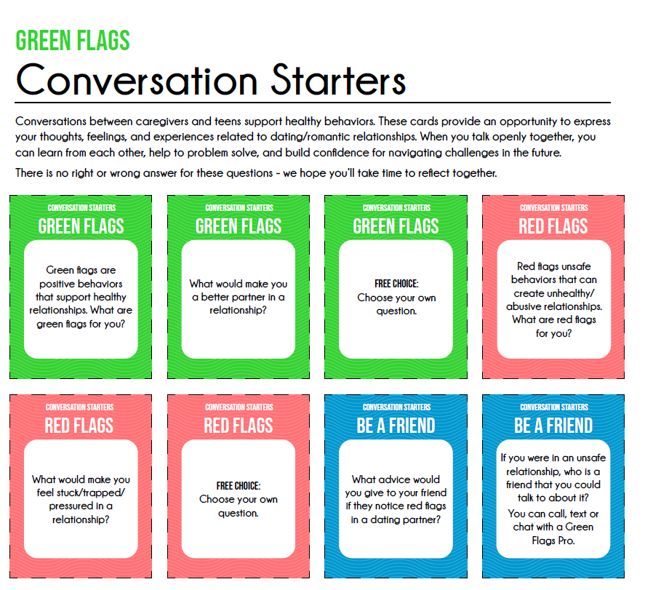

Slide 9
Reflection
Most adults can identify the warning signs of abuse in teen dating relationships.
Notes:
*Getting ghosted
Where could that come from?

Slide 10
Over 80% of parents believe that teen dating abuse is not an issue or admit they don’t know if it’s an issue.
A majority of parents (58%) could not correctly identify all of the warning signs.
https://www.breakthecycle.org/dating-violence-research
Notes:
Reference: https://www.breakthecycle.org/dating-violence-research

Slide 11
Teen Dating Abuse (TDA) impacts adolescents from every zip code, income level, race, religion and nationality.
1 in 3 adolescents in the U.S. is a victim of TDA, a figure that far exceeds rates of other types of youth violence.
Notes:
Teen Dating Abuse (TDA) impacts adolescents from every zip code, income level, race, religion and nationality.
1 in 3 adolescents in the U.S. is a victim of TDA, a figure that far exceeds rates of other types of youth violence.
Even if teens are not in relationships, they are learning what is normal from their peer group. If they have friends or classmates in unhealthy or abusive relationships, that influences their expectations about relationships.

Slide 12
Engaging in Abusive Behavior
Exhibit a controlling attitude toward their partner or others
  “They aren’t allowed to wear leggings or a crop top. They represent me in school.”
Believe that abusive behaviors are acceptable/normal
  “Everyone looks through their partner’s account. I didn’t hit them.”

Slide 13
Engaging in Abusive Behavior
Rationalize their monitoring, controlling, manipulative, violent or abusive behavior
  “It’s my right to treat my partner this way. It’s because I love them so much. I’m just a jealous person.”
Make excessive and/or unwanted texts, calls or emails to partner
  “You better check in with me or else. You have 15 minutes to text me back…”

Slide 14

Accountability with teens engaging in abusive behaviors is an opportunity for growth.
We can work to re-establish what healthy boundaries are in relationships and provide a space to support the teen’s healthy brain development, so they are able to be in safe, healthy relationships.
Notes:
We have the opportunity when people are young, to learn from experience. If we find that there are patterns occurring that are not able to be disrupted, then it’s time to consider seeking out professional support.

Slide 15
Experiencing Abusive Behaviors
Retreat from school or activities and experience isolation or withdraw from friends/family
  “I’m just not into sports anymore. I don’t know why my grades are dropping.”
Making changes in clothing/appearance
  Stops/starts wearing makeup or wears clothes to hide injuries
Notes:
You may see a dramatic drop in grades, an increase in absences or truancy or a parent who expresses confusion and concern about a sudden change in personality. You may hear statements like, “I’m just not into that sport anymore. I don’t really have an answer for you.” They may be evasive or apologetic about the changes that you notice.
A change in clothing or appearance is not limited to hiding injuries from physical abuse. It may also been a reflection of emotional abuse or coercive control. In particular, female victims of abuse may hear things like, “I don’t want anyone else looking at you so you can’t wear makeup, leggings or a form fitting outfit.”
Victims may respond to abusive behaviors in a variety of ways. You may see hypervigilance, including constantly checking a phone, fidgeting, staring at a doorway or packing up their bag 5 or more minutes before a bell. Other high risk behaviors include threats of self harm, substance abuse and other high risk behaviors.

Slide 16
Experiencing Abusive Behaviors
Exhibit anxiety/hypervigilance, depression, or engage in substance abuse or other high-risk behaviors
Receive excessive or unwanted texting, calls, or emails
  “I’m not going to put my phone away! You don’t understand.”
Notes:
You may see a dramatic drop in grades, an increase in absences or truancy or a parent who expresses confusion and concern about a sudden change in personality. You may hear statements like, “I’m just not into that sport anymore. I don’t really have an answer for you.” They may be evasive or apologetic about the changes that you notice.
A change in clothing or appearance is not limited to hiding injuries from physical abuse. It may also been a reflection of emotional abuse or coercive control. In particular, female victims of abuse may hear things like, “I don’t want anyone else looking at you so you can’t wear makeup, leggings or a form fitting outfit.”
Victims may respond to abusive behaviors in a variety of ways. You may see hypervigilance, including constantly checking a phone, fidgeting, staring at a doorway or packing up their bag 5 or more minutes before a bell. Other high risk behaviors include threats of self harm, substance abuse and other high risk behaviors.

Slide 17
Types of Abusive Behaviors
Type | Examples
Coercive control | Isolation from friends and family, lack of agency
Verbal | Humiliation, insults, put downs, constant blaming or yelling…
Psychological/Emotional | Jealousy, gaslighting, threats, intimidation…
Sexual | Pressure/engage in sexual act without consent, threats/rumors if partner refuses, reproductive coercion
Physical | Hitting, slapping, punching, pinching, shoving…
Technology-Facilitated | Pressure for nude images, excessive or unwanted texts, access to device/account without permission…
Notes:
Abuse can be verbal, emotional, sexual, physical or digital.
Coercive control is a pervasive form of abuse that focuses on stripping a teen of their sense of self. A partner will isolate a victim from friends or family and control the choices that a teens makes in their every day life.
Verbal abuse includes a teen constantly being criticized and told they aren’t good enough. This can cause teens to lose confidence and lowers their self-esteem. As a result, they may start to blame themselves for their partner’s abusive behavior.
Emotional abuse includes gas lighting, a pattern of manipulation that makes a victim question their own sanity, so that they start to believe and accept what the abuser is telling them is real. For example, a teen may change settings on a phone or move things in a car/locker. They may say, “See, you’re going crazy. Your keys are right here. That app is right here.”
Physical abuse may or may not cause injuries or pain. Students may minimize these behaviors or say they were just playing around but the goal of the behavior is power and control.
What have you seen in classrooms related to digital dating abuse? The three most common forms of digital dating abuse are pressure for nudes, threats via text and access to a device without permission.
Resource: https://www.loveisrespect.org/is-this-abuse/types-of-abuse/

Slide 18
Reflection
I am knowledgeable about technology-facilitated abuse.
Notes:
*Getting ghosted
Where could that come from?

Slide 19
What is Technology-Facilitated Abuse?
Technology-Facilitated Abuse is the use of technologies such as texting and social media to bully, harass, stalk or intimidate a partner.

Slide 20
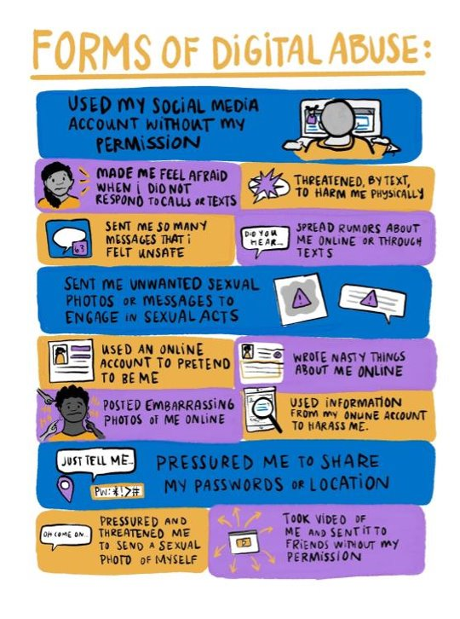

Slide 21
Technology-Facilitated Abusive Behaviors
Digital Sexual Coercion – Pressure to “sext”
Direct Digital Aggression – Shared an embarrassing photo/video story about a partner
Digital Monitoring and Control – Monitoring location, communications, etc.

Slide 22
What is Sextortion?
Definition
Resources
Sextortion is defined as an interaction on social media or dating app (Snapchat, TikTok, Tinder, etc.) where intimate photos are shared, at which time one person of the interaction threatens to release the images unless they are paid money.
https://dpps.msu.edu/news-and-alerts/news/what-is-sextortion-and-how-to-prevent-it
Internet Crimes Against Children (ICAC) Task Force:
https://www.icactaskforce.org/
HB 531 - Braden’s Law
  Sextortion of minor is a first-degree felony
  Immunity for victims who sent explicit images

Slide 23
What is a Deepfake?
TAKE IT DOWN Federal Law
Definition
Previously called synthetic media, it is an image/video that has been digital manipulated to replace one person’s likeness with another. This digital manipulation often occurs using A.I, artificial intelligence.
Prohibits the online publication of intimate imagery (both authentic and computer-generated) for adults harmed or expectation of privacy OR a minor when the intention is abuse, harassment, or sexual gratification.

Slide 24
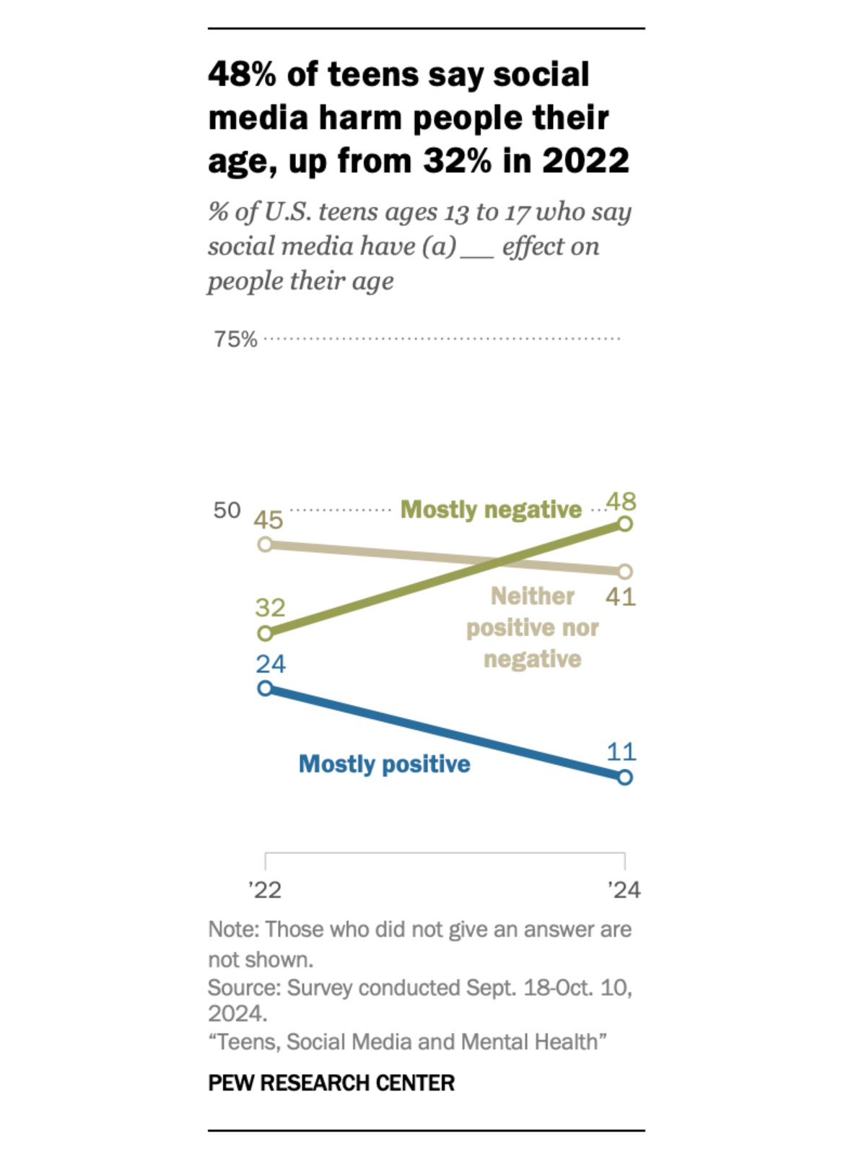

Slide 25

Healthy Digital Boundaries for Teens
Teens have different social and emotional needs as they grow, and supportive adults need different strategies during these ages and stages.
The foundation for online safety is creating healthy digital boundaries — what families are comfortable doing, seeing, and feeling while using technology and how they would like to be treated by others.

Slide 26
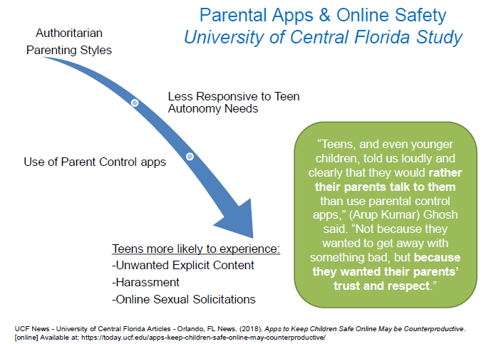
Notes:
When love and control are paired together by adults in their lives, teens have a harder time separating the control tactics a romantic partner may use.
In their mind, they see it as “my caregiver loves me and says this is how they keep me safe” and then they hear their romantic partner saying something similar.
“I’m worried about other people coming onto your social media. That’s why you should give me your password.”

Slide 27
Approximately Ages <13 – 15
Set clear boundaries.
Use logical consequences when teens cross safe boundaries.
Teens may highly value screentime. Try not to use screentime as a reward or discipline, outside of the family media agreement.
Focus on risk coping skills and exit strategies.
(Dahl et al., 2022)
Notes:
Additional source: https://www.commonsensemedia.org/research/the-common-sense-census-media-use-by-tweens-and-teens-2019

Slide 28
Risk Coping Skills – “What If?”
“What if you see that someone is being bullied in a group chat? What about a game chat/Discord/Twitch?”
“What if someone is making you uncomfortable online? Do you know how to report someone in Instagram/Snapchat/TikTok/Be Real?”
Have these conversations often and paired with fun activities – keep it casual.

Slide 29
Exit Strategies
Use family codewords to navigate complex social situations.
  A flower emoji could mean that they need you to call them.
  The word “blueberries” means they need you to say no to a request.
Take the social heat for turning off a device or location services.
  “Ugh, my mom won’t let me FaceTime tonight! She’s so mean!”
  “I’m not active because my dad make me go into ghost mode.”
“If you call me and need help, I will stay calm, and we can wait until the next morning to talk about consequences.”
(Englander et al., 2023)

Slide 30
Approximately Ages <16 – 18
It is normal for young people to take more risks and assert more independence. Try to withhold judgment and let them know that you are there to help if they need you.
(Dahl et al., 2022)

Slide 31
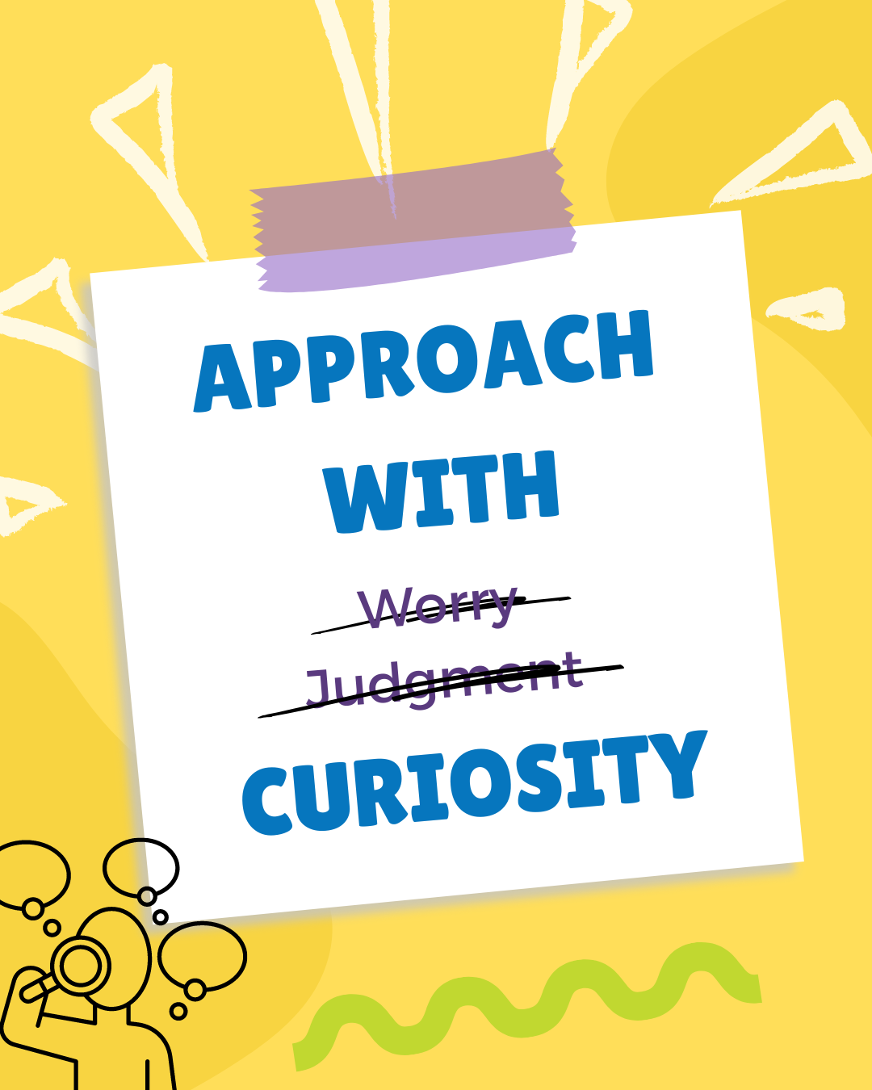
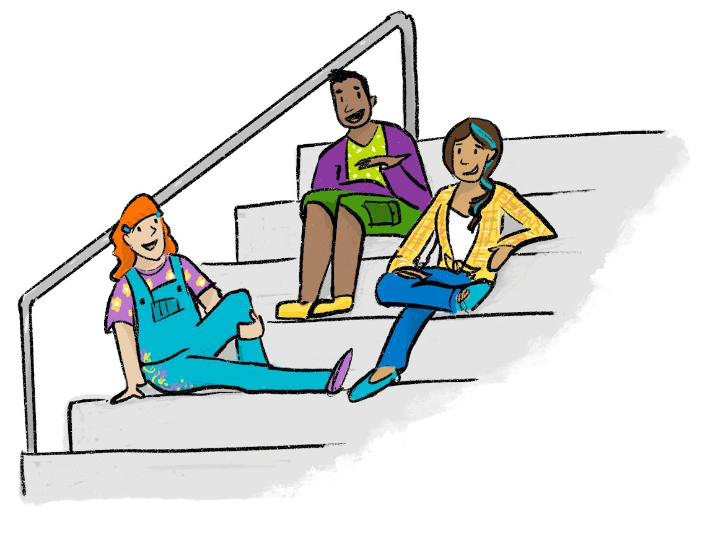

Slide 32

Approach with Curiosity
Tell me about how this person/ group/ app is important to you?
How do you feel when you are with this person/ group/ app?
What does this app do, that another app doesn’t?
If you had to go on a road trip, would you take this person/ group with you? What would they bring to benefit the trip?
Notes:
We model vulnerability when we use power with approaches and so we sometimes have to sit with the messiness of these conversations.
And sometimes as adults, we get it wrong. *shrug* that’s human nature for that to happen.
Let’s take a moment to talk about what happens when there’s a rupture and how we repair in that relationship.

Slide 33

Shifting Our Language
Why don’t you just leave?
You need to…. (tell, report, etc.)
You should call... (resource)
That’s abusive and I’m making a report.
That’s just how relationships are.
I was in that situation and then I realized my own self-worth and left.
Anything you need, call me, day or night, no matter what, I’m there.
What do you need right now?
Is there anything you’ve tried that has helped / made you feel safer?
I know a few places that might help, would you like to look together?
Offer mandatory reporting disclaimers at the beginning of the conversation and periodically throughout.
You’re not alone in what you’re going through. Your description of what’s going on makes sense – I believe you.
I have experienced something similar and I’m glad you opened up to me.
Here are a few ways I could support you, would any of these sound helpful at this point?
Notes:
“that’s so good that you deleted all your social media!” → “You deleted all your socials? How do you feel about that?” “Are you finding other ways to feel connected with your people?”
“You should break up” “That’s abuse” “Sounds like a bad guy” →
Instead of -
If you don’t know what to say, ask “what do you think about that?”
Always feel free to say “I’m not an expert on relationship issues – here’s where to look up more information.”

Slide 34
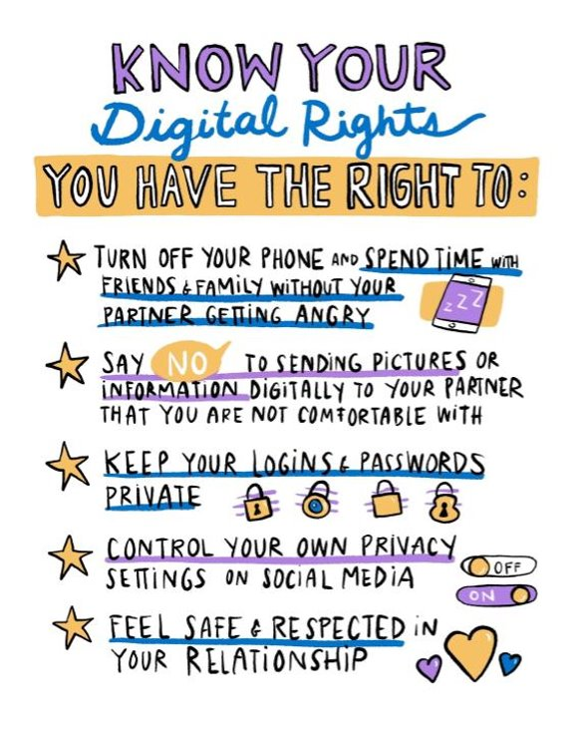

Slide 35
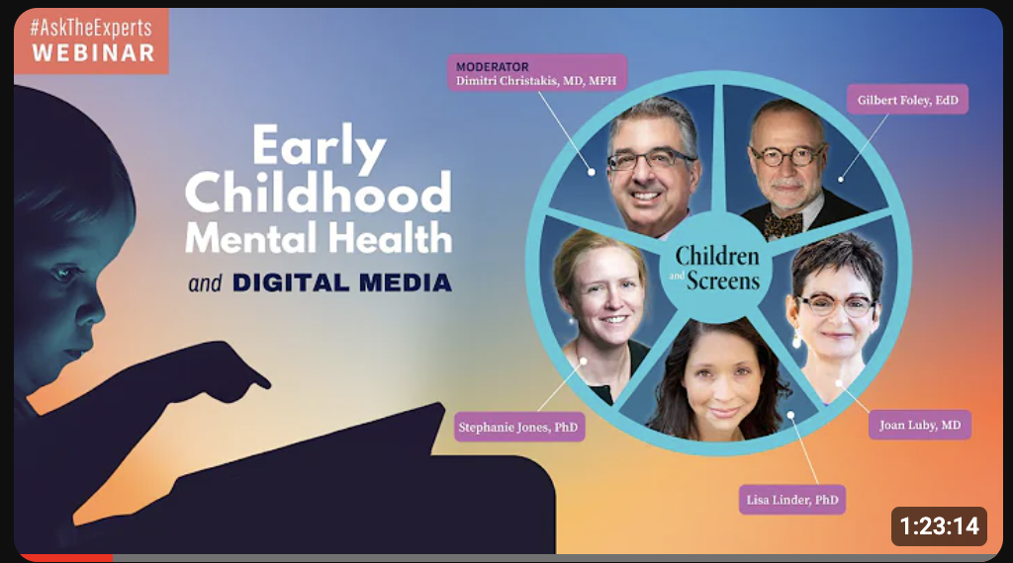
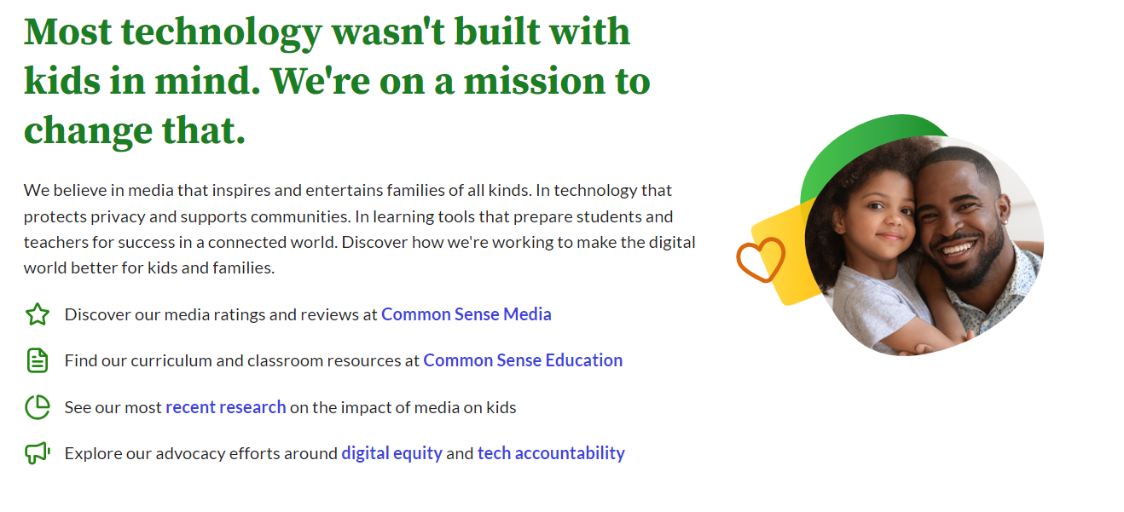
Children and Screens
RESOURCES
Common Sense Media

Slide 36



Slide 37
Green Flags Overview
Educates teens on healthy relationships
Helps adults support healthy teen relationships
Encourages boundary setting
Equips youth to identify signs of abuse
Shares resources to address and prevent abusive behaviors, including call, text and chat services
Notes:
Green Flags is a campaign to educate teens in central Ohio on the characteristics of healthy relationships, encourage boundary setting, equip youth to identify signs of abuse, and direct them to resources to address and prevent abuse. Green Flags can help teens recognize what they want from a partner (and how they want to show up in their relationships), how to look for those traits in themselves and others, and how to set healthy boundaries.

Slide 38

Call, Text, Chat:
Green Flags Pros
Monday – Friday
8 am to 8 pm
Notes:
Our call, text, and chat support resources are available Monday through Friday, 8 a.m. to 8 p.m. They are operated by our specially trained team of experts to address teens’ questions or concerns about relationships and dating abuse. Green Flags also provides safe adults, like parents, guardians, and educators, in the central Ohio community with resources to help support and talk to teens in their lives about healthy relationships and dating safety.

Slide 39

Website:
GreenFlags.info
Take Action
Know Your Green Flags
Know Your Red Flags
Be An Advocate
Notes:
ALENA/NICOLE BACKUP
Now I will give you a tour of the website, GreenFlags.info
Intro: Our newly created website is going to be the vehicle for the Green Flags Campaign. This is where teens are able to reach out to a Green Flags Pro through our call, text, and chat feature which is available Monday-Friday 8am-8pm. We also have afterhours resources available, as well as other avenues of support. The website was built with mobile-use in mind to make it easy for people to access on their phone.
Homepage
- Safety popup with a quick exit feature
- Get help is featured high up on the page for easy access
- Instagram feed is linked at the bottom
Take Action
- Lists ways to get in touch with a Green Flags Pro
- Offers afterhours support options
- Lists ways to help someone else you know
Know Your Green Flags
- This section breaks down what exactly a Green Flag is and provides interactive blogs on various topics to help explain. (Click on Relationship Myths vs. Facts as example)
- Myths vs. Facts Blog: Relationships can be tricky but this interactive flip deck helps to debunk common relationship myths while providing the facts so teens can make informed choices and build healthy relationships. (Scroll over flip deck)
Know Your Red Flags
- This section breaks down what exactly a Red Flag is. These are the unhealthy or hurtful behaviors we want teens to be able to recognize and avoid.
- Types of Abuse (scroll through)
- How to Recognize Red Flags (scroll through)
Be an Advocate
-This is where we invite others to spread the word about #GreenFlags. We also will have a digital toolkit available soon.
-This is also our section for adults and resources for them to support healthy teen relationships. We will be expanding on this section further on in the campaign.

Slide 40
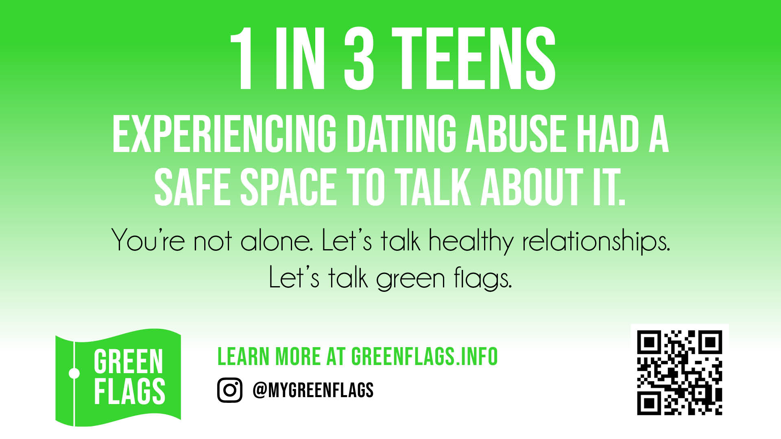

Slide 41
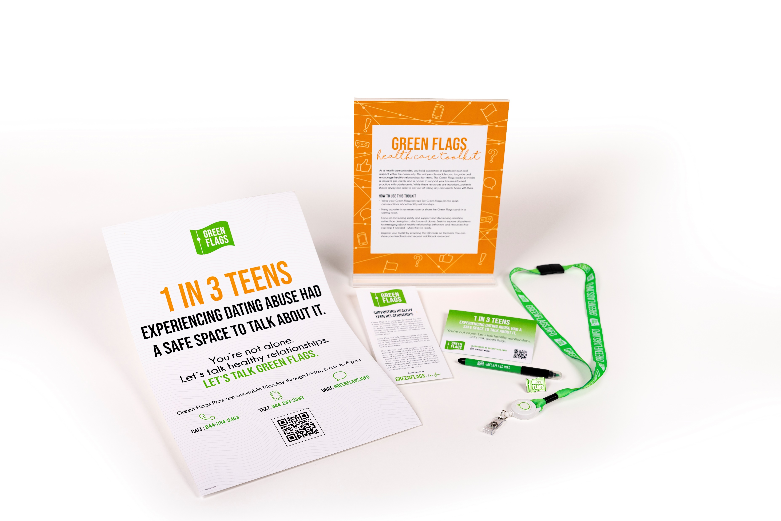
Healthcare Toolkits
Request via GreenFlags@familysafetyandhealing.org
Notes:
ALENA/NICOLE BACKUP
Now I will give you a tour of the website, GreenFlags.info
Intro: Our newly created website is going to be the vehicle for the Green Flags Campaign. This is where teens are able to reach out to a Green Flags Pro through our call, text, and chat feature which is available Monday-Friday 8am-8pm. We also have afterhours resources available, as well as other avenues of support. The website was built with mobile-use in mind to make it easy for people to access on their phone.
Homepage
- Safety popup with a quick exit feature
- Get help is featured high up on the page for easy access
- Instagram feed is linked at the bottom
Take Action
- Lists ways to get in touch with a Green Flags Pro
- Offers afterhours support options
- Lists ways to help someone else you know
Know Your Green Flags
- This section breaks down what exactly a Green Flag is and provides interactive blogs on various topics to help explain. (Click on Relationship Myths vs. Facts as example)
- Myths vs. Facts Blog: Relationships can be tricky but this interactive flip deck helps to debunk common relationship myths while providing the facts so teens can make informed choices and build healthy relationships. (Scroll over flip deck)
Know Your Red Flags
- This section breaks down what exactly a Red Flag is. These are the unhealthy or hurtful behaviors we want teens to be able to recognize and avoid.
- Types of Abuse (scroll through)
- How to Recognize Red Flags (scroll through)
Be an Advocate
-This is where we invite others to spread the word about #GreenFlags. We also will have a digital toolkit available soon.
-This is also our section for adults and resources for them to support healthy teen relationships. We will be expanding on this section further on in the campaign.

Slide 42
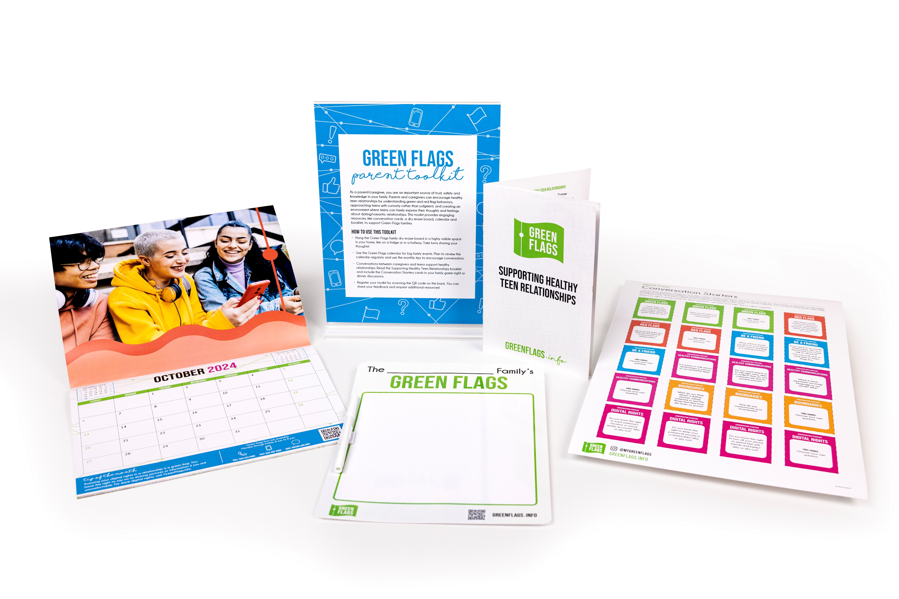
Parent Toolkits
Request via GreenFlags@familysafetyandhealing.org
Notes:
ALENA/NICOLE BACKUP
Now I will give you a tour of the website, GreenFlags.info
Intro: Our newly created website is going to be the vehicle for the Green Flags Campaign. This is where teens are able to reach out to a Green Flags Pro through our call, text, and chat feature which is available Monday-Friday 8am-8pm. We also have afterhours resources available, as well as other avenues of support. The website was built with mobile-use in mind to make it easy for people to access on their phone.
Homepage
- Safety popup with a quick exit feature
- Get help is featured high up on the page for easy access
- Instagram feed is linked at the bottom
Take Action
- Lists ways to get in touch with a Green Flags Pro
- Offers afterhours support options
- Lists ways to help someone else you know
Know Your Green Flags
- This section breaks down what exactly a Green Flag is and provides interactive blogs on various topics to help explain. (Click on Relationship Myths vs. Facts as example)
- Myths vs. Facts Blog: Relationships can be tricky but this interactive flip deck helps to debunk common relationship myths while providing the facts so teens can make informed choices and build healthy relationships. (Scroll over flip deck)
Know Your Red Flags
- This section breaks down what exactly a Red Flag is. These are the unhealthy or hurtful behaviors we want teens to be able to recognize and avoid.
- Types of Abuse (scroll through)
- How to Recognize Red Flags (scroll through)
Be an Advocate
-This is where we invite others to spread the word about #GreenFlags. We also will have a digital toolkit available soon.
-This is also our section for adults and resources for them to support healthy teen relationships. We will be expanding on this section further on in the campaign.

Slide 43
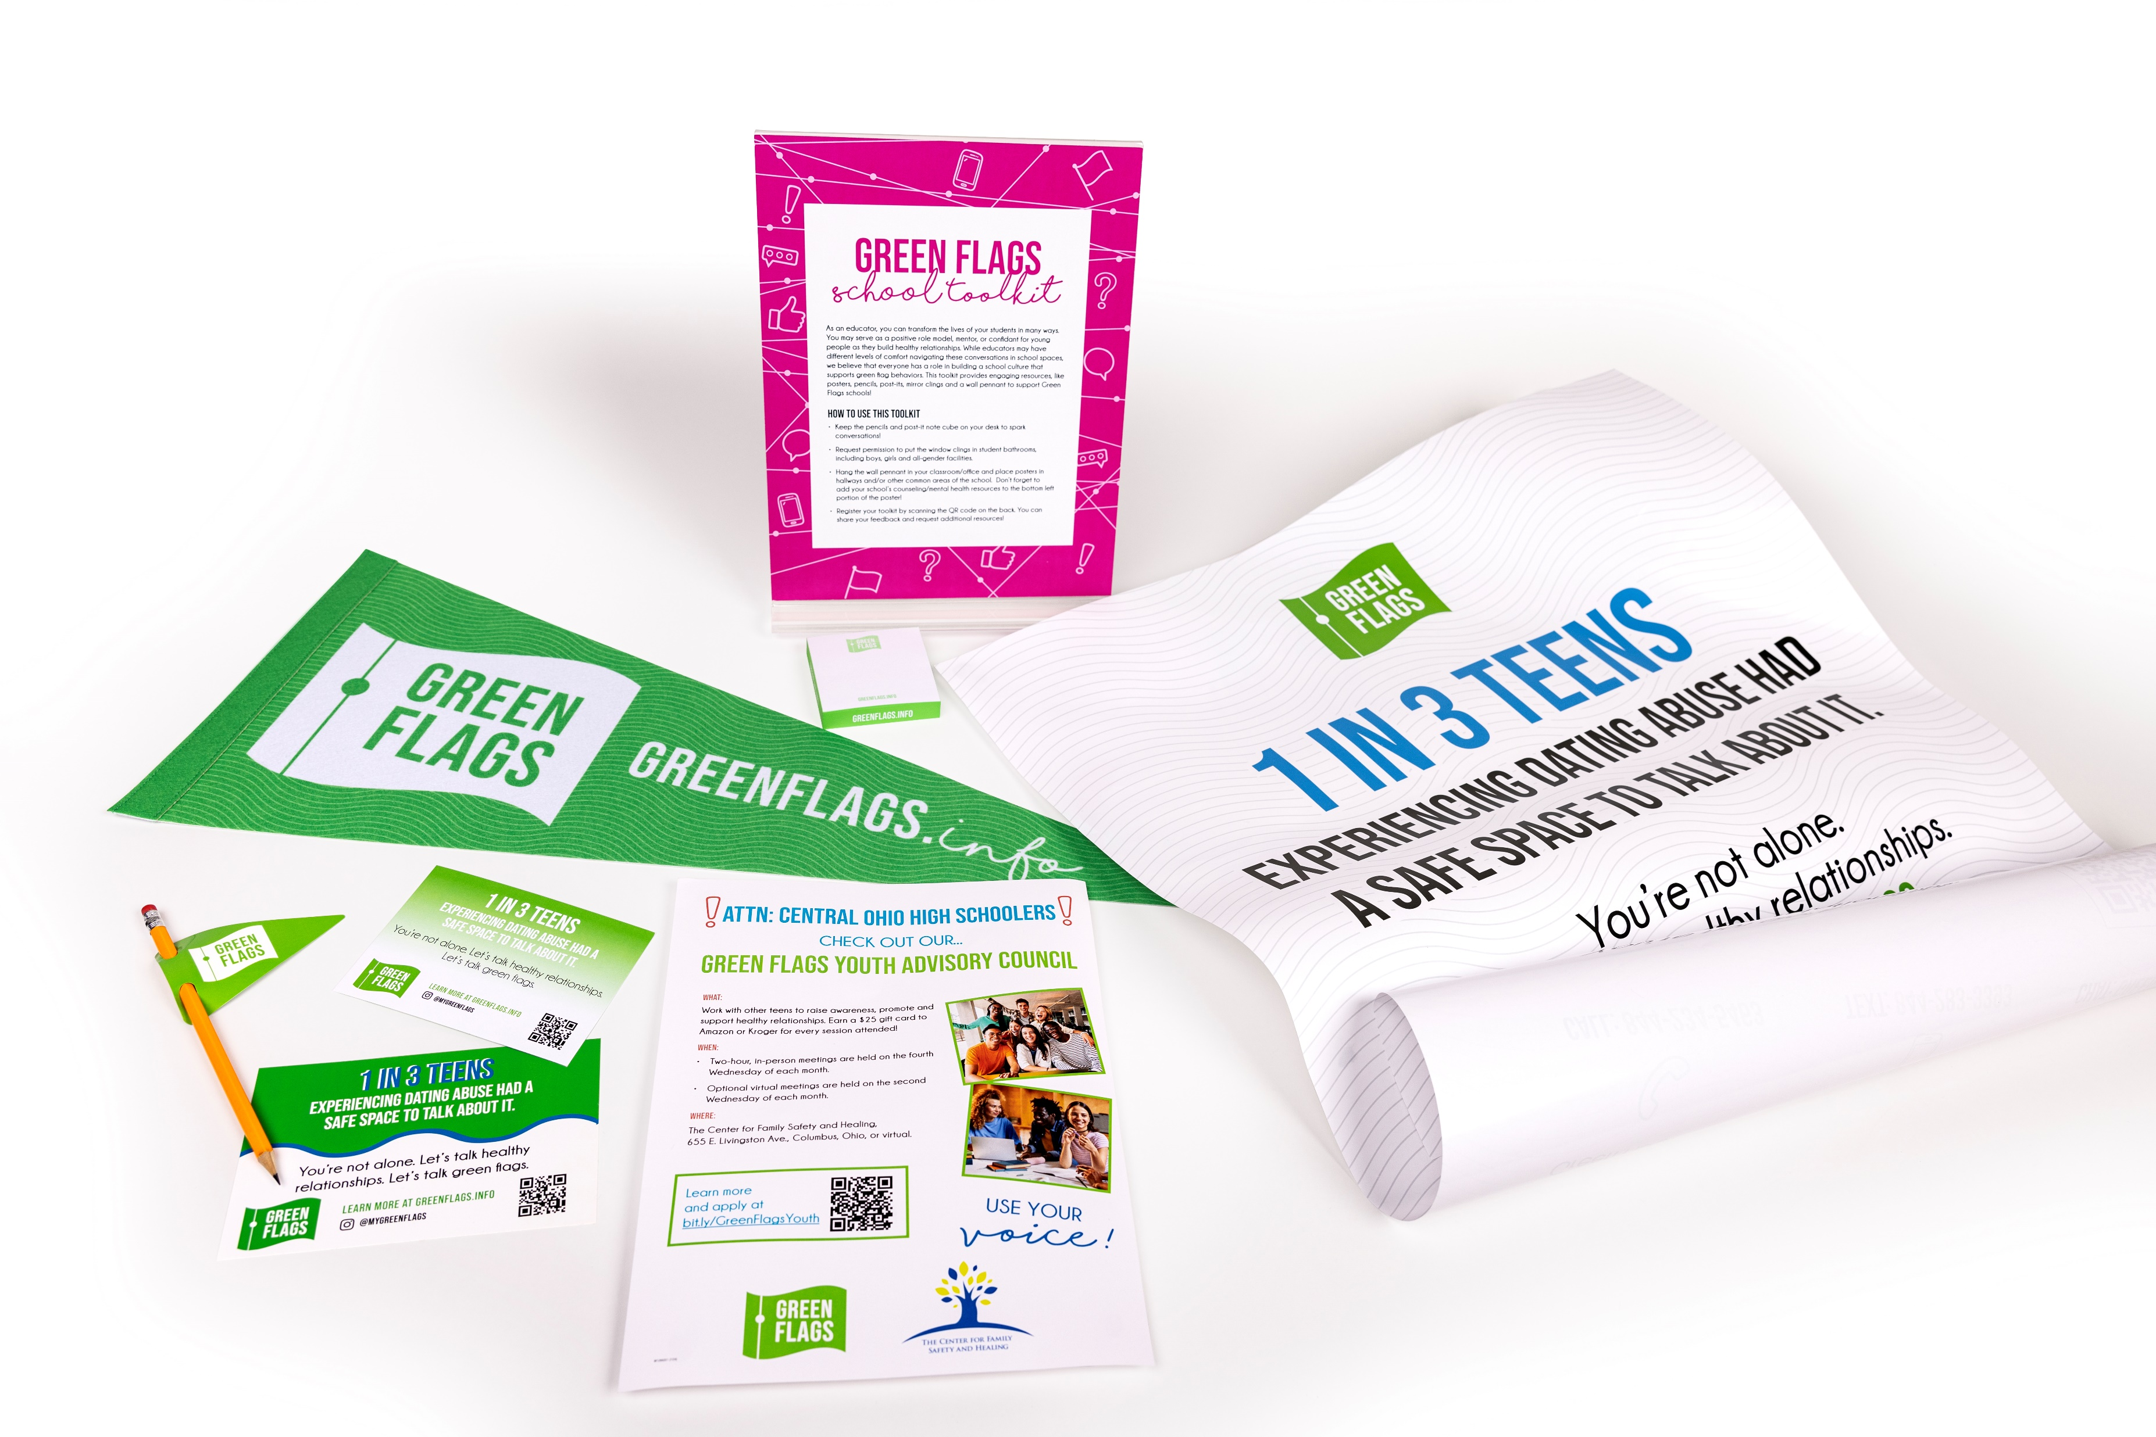
School Toolkits
Request via GreenFlags@familysafetyandhealing.org
Notes:
ALENA/NICOLE BACKUP
Now I will give you a tour of the website, GreenFlags.info
Intro: Our newly created website is going to be the vehicle for the Green Flags Campaign. This is where teens are able to reach out to a Green Flags Pro through our call, text, and chat feature which is available Monday-Friday 8am-8pm. We also have afterhours resources available, as well as other avenues of support. The website was built with mobile-use in mind to make it easy for people to access on their phone.
Homepage
- Safety popup with a quick exit feature
- Get help is featured high up on the page for easy access
- Instagram feed is linked at the bottom
Take Action
- Lists ways to get in touch with a Green Flags Pro
- Offers afterhours support options
- Lists ways to help someone else you know
Know Your Green Flags
- This section breaks down what exactly a Green Flag is and provides interactive blogs on various topics to help explain. (Click on Relationship Myths vs. Facts as example)
- Myths vs. Facts Blog: Relationships can be tricky but this interactive flip deck helps to debunk common relationship myths while providing the facts so teens can make informed choices and build healthy relationships. (Scroll over flip deck)
Know Your Red Flags
- This section breaks down what exactly a Red Flag is. These are the unhealthy or hurtful behaviors we want teens to be able to recognize and avoid.
- Types of Abuse (scroll through)
- How to Recognize Red Flags (scroll through)
Be an Advocate
-This is where we invite others to spread the word about #GreenFlags. We also will have a digital toolkit available soon.
-This is also our section for adults and resources for them to support healthy teen relationships. We will be expanding on this section further on in the campaign.

Slide 44
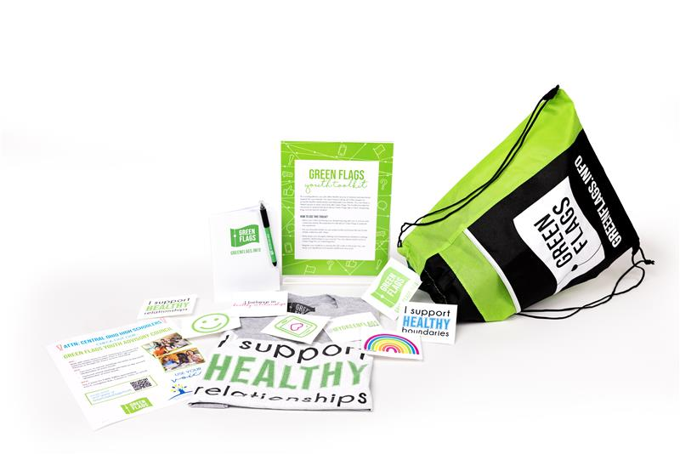
Youth Toolkits
Request via GreenFlags@familysafetyandhealing.org
Notes:
ALENA/NICOLE BACKUP
Now I will give you a tour of the website, GreenFlags.info
Intro: Our newly created website is going to be the vehicle for the Green Flags Campaign. This is where teens are able to reach out to a Green Flags Pro through our call, text, and chat feature which is available Monday-Friday 8am-8pm. We also have afterhours resources available, as well as other avenues of support. The website was built with mobile-use in mind to make it easy for people to access on their phone.
Homepage
- Safety popup with a quick exit feature
- Get help is featured high up on the page for easy access
- Instagram feed is linked at the bottom
Take Action
- Lists ways to get in touch with a Green Flags Pro
- Offers afterhours support options
- Lists ways to help someone else you know
Know Your Green Flags
- This section breaks down what exactly a Green Flag is and provides interactive blogs on various topics to help explain. (Click on Relationship Myths vs. Facts as example)
- Myths vs. Facts Blog: Relationships can be tricky but this interactive flip deck helps to debunk common relationship myths while providing the facts so teens can make informed choices and build healthy relationships. (Scroll over flip deck)
Know Your Red Flags
- This section breaks down what exactly a Red Flag is. These are the unhealthy or hurtful behaviors we want teens to be able to recognize and avoid.
- Types of Abuse (scroll through)
- How to Recognize Red Flags (scroll through)
Be an Advocate
-This is where we invite others to spread the word about #GreenFlags. We also will have a digital toolkit available soon.
-This is also our section for adults and resources for them to support healthy teen relationships. We will be expanding on this section further on in the campaign.

