Slide 1
WELCOME!
WE’RE GLAD YOU’RE HERE.
Enjoy the tunes and we’ll begin soon ☺
Sarah Buffie, MSW, LSW
Soul Bird Consulting
Copyright © 2023 Soul Bird Consulting. All rights reserved.
Notes:
Create the context/invitation:
Several years ago someone asked me – how many times a week are you regulated- I released a deep belly laugh….
When I was asked to come here it wasin the invitation to do a keynote during lunch- I was honored and humbled but what I was really interested in was having the time/space to engage you, us all in an experience that allows us the capacity to relate
Capacity to relate
Using our voice
a circle is an improvement over a square, however, tables reinforce our isolation, our aloneness, this is a metaphor for the kind of connection needed to be trauma responsive. This requires the capacity to relate. Trauma is not an individual event, just as healing is not individual- healing happens in relationship.

Slide 2
To be home is to be known.
It is to be loved for who you are. It is to share a common ground, common interests, pursuits and values with others that truly care about you.
-“Together” Vivek Murthy MD.
Copyright © 2023 Soul Bird Consulting. All rights reserved.
Notes:
Welcome,
Logistics
Flow of the day
Riff on thoughts from the quote
Today we are going to… create a space where we can build up the capacity to help others feel known, deeply, , before we can help others being known, we have to know our selves….our focus is going to be on self and those in the room (talk about people outside of the room we have no power…..)
Name, role, why was it important for you to be here today?

Slide 3
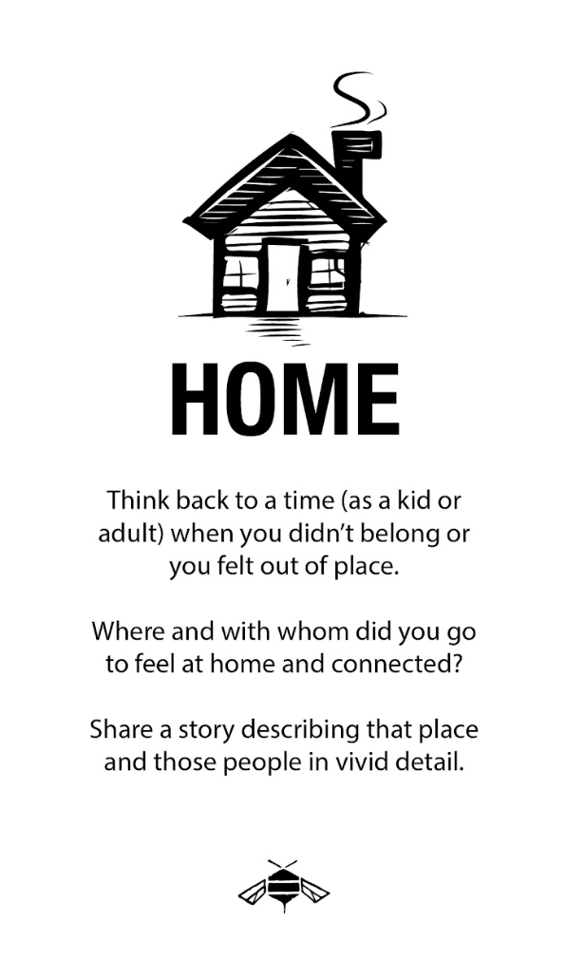

Slide 4
CONTEXT
Our capacity to relate to another human IS the healing component.
Underneath my trauma is my deep isolation. The feeling that nobody knows who I am.
Trauma Responsiveness is:
I want to know who you are. Underneath what happened to you, I want to know who you are, what matters to you, the stories that you hold.
Copyright © 2023 Soul Bird Consulting. All rights reserved.
Notes:
Regulation
Our capacity to relate to others
The way we bring our being into the room we use our voice- we have a short time to dig in and so I’ve taken a slice- we all know the impact of trauma is that we don’t have a voice. . to get into the being of the work we need to unpack what voice means to us- how can we step into that part of our being to
How might we commit our individual and collective power to bring more voice, choice and control in the world? This begins by taking what we know about resilience and applying it to ourselves. Begins by taking what we know about resilience and bringing it to life.

Slide 5
Safe. Seen. Heard.
Copyright © 2023 Soul Bird Consulting. All rights reserved.
Notes:
Why we’re here-
Trauma is an experience of…. Content/Context
Review of trauma (power over, power taken away. Unsafe, unseen, unheard)
Hand brain
Connect before we correct
Connect with emotions the person is experiencing not what they are saying/doing.
People often ask though “what if I don’t know the emotions, what if they are non-verbal? Or they aren’t saying how they feel?” and my answer to that is we need to deepen our capacity to listen for whats NOT being said….what are the emotions underneath the story one is telling or the behavior we’re experiencing in that moment.
It takes practice to be able to reflect back someones emotions in a true authentic way. But thats why we’re here today and I am going to introduce two practices that will support us in building this new muscle.

Slide 6
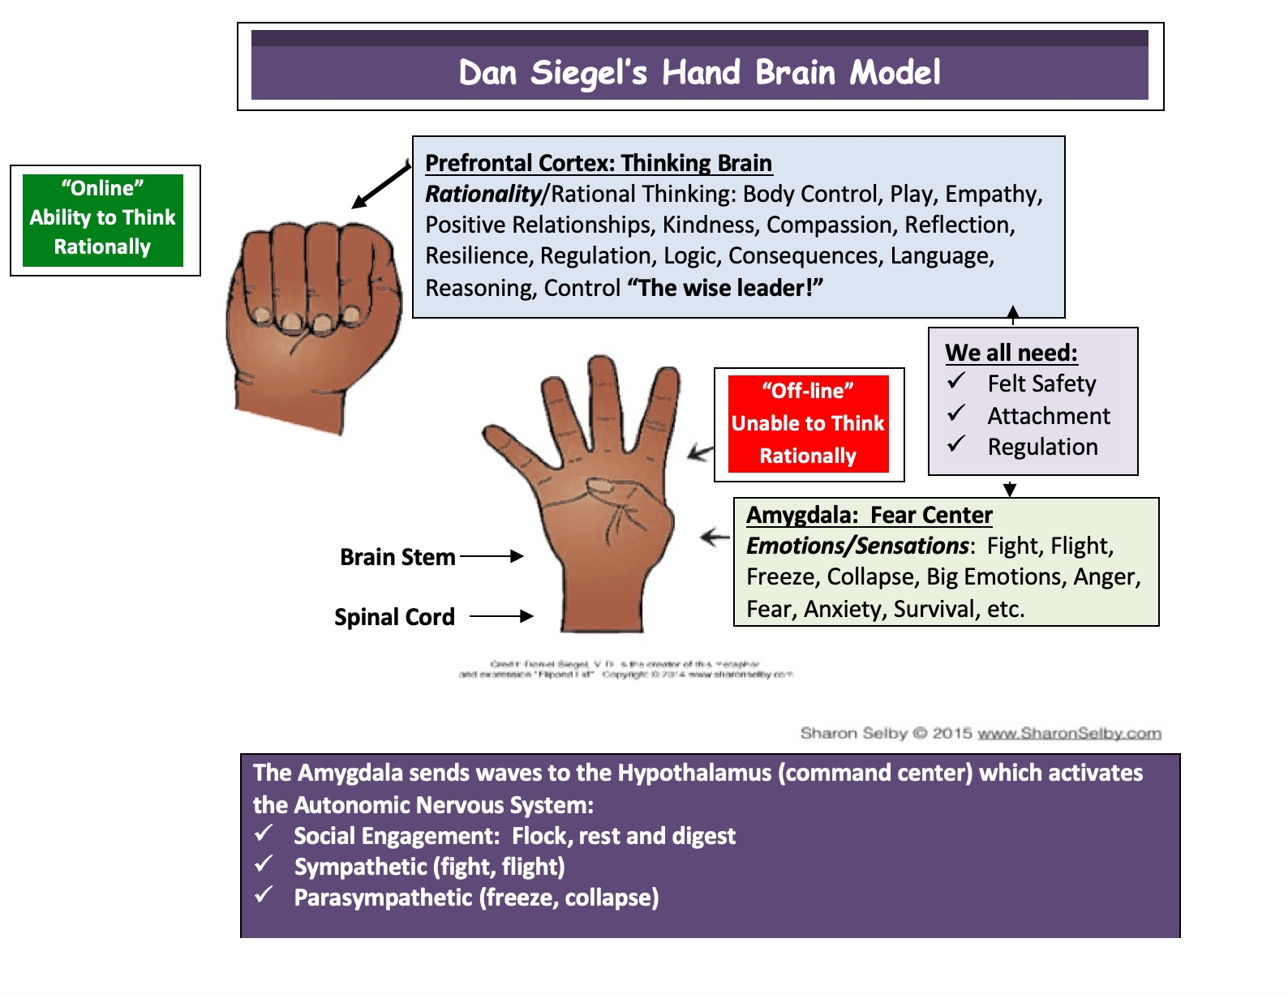
Notes:
Content/Context
Review of trauma (power over, power taken away. Unsafe, unseen, unheard)
Hand brain
Connect before we correct
Connect with emotions the person is experiencing not what they are saying/doing.
People often ask though “what if I don’t know the emotions, what if they are non-verbal? Or they aren’t saying how they feel?” and my answer to that is we need to deepen our capacity to listen for whats NOT being said….what are the emotions underneath the story one is telling or the behavior we’re experiencing in that moment.
It takes practice to be able to reflect back someones emotions in a true authentic way. But thats why we’re here today and I am going to introduce two practices that will support us in building this new muscle.

Slide 7
Notice. Accept. Invite.
Copyright © 2023 Soul Bird Consulting. All rights reserved.
Notes:
Notice, Accept, Invite
This broadens our feelings vocabulary so we can get more familiar with the range of emotions (and body sensations)

Slide 8
Mirror, Affirm, Respond
Copyright © 2023 Soul Bird Consulting. All rights reserved.
Notes:
Both of these practices help us build Relational resilience
Capacity to be safe in relationship with self and others
Introduce the sheets (CREDIT NVC) Sensations, Feelings,

Slide 9
Relational Resilience
The result of feeling predictably physically, emotionally,
and psychologically safe in relationships with others.
Copyright © 2023 Soul Bird Consulting. All rights reserved.

Slide 10
Sensations. Feelings.
Copyright © 2023 Soul Bird Consulting. All rights reserved.

Slide 11
NOTICE – ACCEPT - INVITE
NOTICE- your emotions/sensations
ACCEPT- their role in your life
INVITE- others to join you
Copyright © 2023 Soul Bird Consulting. All rights reserved.
Notes:
Tell a story- noticing worry before a training session, accepting it for the role it has played in my life..worry has helped me study harder, or practice what I preach, worry has helped me ….
But I don’t just want worry with me when I go into a training or fear with me when I have to have a hard conversation with a loved one, I want to be able to invite other emotions to the table, other states of being.
I can invite confidence, humility, precence
Notice- with awareness we have choices
Accept- what you resist persists
This practice broadens our feelings vocabulary so we can get more familiar with the range of emotions (and body sensations) accessible to the human experience

Slide 12
Pick a spot in your life right now, when you know you’re not being heard, or where your voice is unexpressed.
Copyright © 2023 Soul Bird Consulting. All rights reserved.
Notes:
Pick a spot in your life right now when you know you’re not being heard or your voice is unexpressed.
What is that situation, who is involved, what is the context….we’re going to take a few minutes to journal about that experience….
Music…10 minutes

Slide 13
NOTICE
Circle or jot down any sensations that you are experiencing right now in your body as you have been journaling about this experience.
Circle or jot down any emotions you are feeling in this moment
Copyright © 2023 Soul Bird Consulting. All rights reserved.

Slide 14
Accept
These emotions as true for you in this moment.
What we resist, persists.
Their role in your life- maybe they have been helpful before, maybe they served a purpose.
Copyright © 2023 Soul Bird Consulting. All rights reserved.

Slide 15
Invite
We are not our emotions.
I am experiencing ______ (e.g. sadness, anger, joy)
What other emotions/states do you want with you in this moment?
Copyright © 2023 Soul Bird Consulting. All rights reserved.
Notes:
This is an inward practice- a way to deepen our relationship with ourselves but also a way to broaden our feelings vocabularly-
A practice to accept that we are not our emotions and that deep listening starts with the self.
What struck you about that experience.
The invitation is What is something someone else said that resonated with you- how can you share that in a conscience way- if its shorter we get to the heart of it. Because we practice this here it’s because it’s a way of being- reflecting back what we heard someone say with appreciation and resisting our urge to make our point. [notice our desire to hear our voice heard….how meaningful that can be, notice what it feels like when our voice has been heard.

Slide 16
Mirror, Affirm, Respond
Copyright © 2023 Soul Bird Consulting. All rights reserved.
Notes:
This is my RHC adaptation

Slide 17
Relational Communication
Mirror your partner, child, colleague
  The emotions or exact words you’re experiencing from others
Affirm their perceived reality
  Perceived threat and real threat can impact the stress response in similar ways
Respond to the emotion vs. reacting to the behavior
  Safety, Curiosity, Unmet Needs
Copyright © 2023 Soul Bird Consulting. All rights reserved.
Notes:
“trauma responsive communication” is my language

Slide 18
Healing Power of Relational Communication
When you MIRROR, dopamine is released in the brain
When you AFFIRM ones experience or perspective the brain releases oxytocin
Now you are able to RESPOND in a way that addresses the root, vs reacting the symptoms
Copyright © 2023 Soul Bird Consulting. All rights reserved.

Slide 19
What is the crossroads you’re at at this point in your life, personally or professionally?
Mirror the emotions you hear
  Mirror the words you hear- without judgement, advice or your own anecdotes
  Let go of your need to be helpful!
Affirm their courage or experience- thank them for sharing
Copyright © 2023 Soul Bird Consulting. All rights reserved.
Notes:
Covid, the world is burning, white supremacy is running rampant, systemic racism is being named and discussed in a new way (not for everyone, people of color and white allies have been hard at work in their brains and bodies….) school is about to start….etc, state of the world, hardship and the joy…..take some time to journal with the following prompts:

Slide 20
Mirror, Affirm, Respond
Mirror the emotions
Affirm the experience, courage to share
Respond:
  With compassion
  With genuine Curiosity
  To unmet needs
Copyright © 2023 Soul Bird Consulting. All rights reserved.

Slide 21
Consider your role:
How might you offer those you support the deep listening and presence that you have
experienced today?
Copyright © 2023 Soul Bird Consulting. All rights reserved.

Slide 22
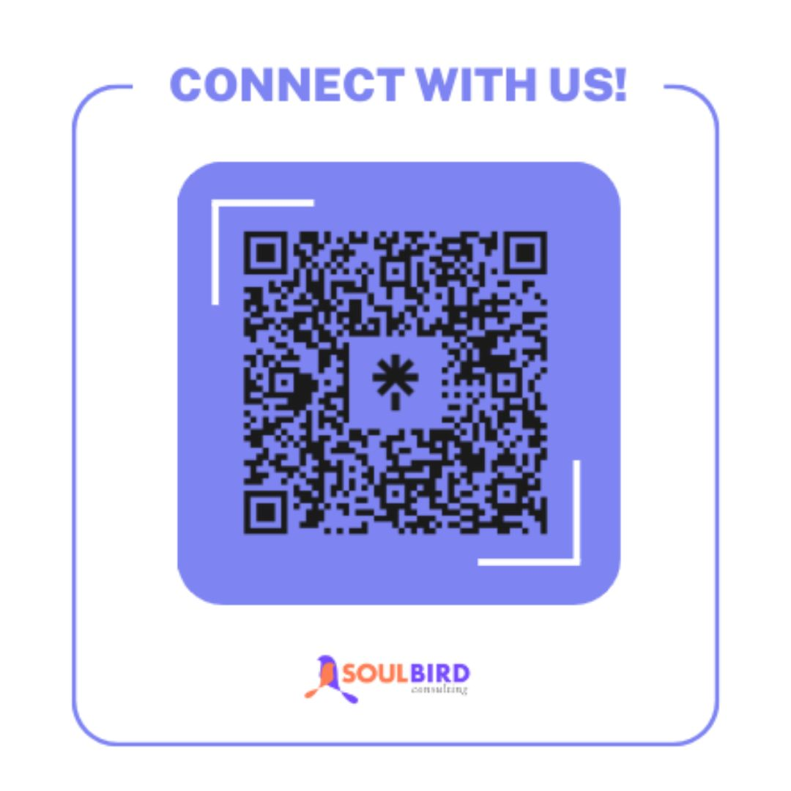
Sarah Buffie, MSW, LSW
sarah@soulbirdconsulting.info
www.soulbirdconsulting.info

Slide 23
References
NVC
  Non-Violent Communication
  https://www.cnvc.org
Dan Siegel
  Hand Model of the Brain
  https://www.youtube.com/watch?v=gm9CIJ74Oxw
Peter Block
  Civic Conversations
  https://www.ndcollaborative.com/six-conversations/
Mary Vicario
  www.findinghopeconsulting.com

