Slide 1
Myth Busters Child Sexual Abuse Edition
This project was supported by Grant 15JOVW-24-GG-00057-JFFX awarded by the Office on Violence Against Women, US Department of Justice. The opinions, findings, conclusions, and recommendations expressed in this publication/program/exhibition are those of the author(s) and do not necessarily reflect the views of the US Department of Justice.

Slide 2
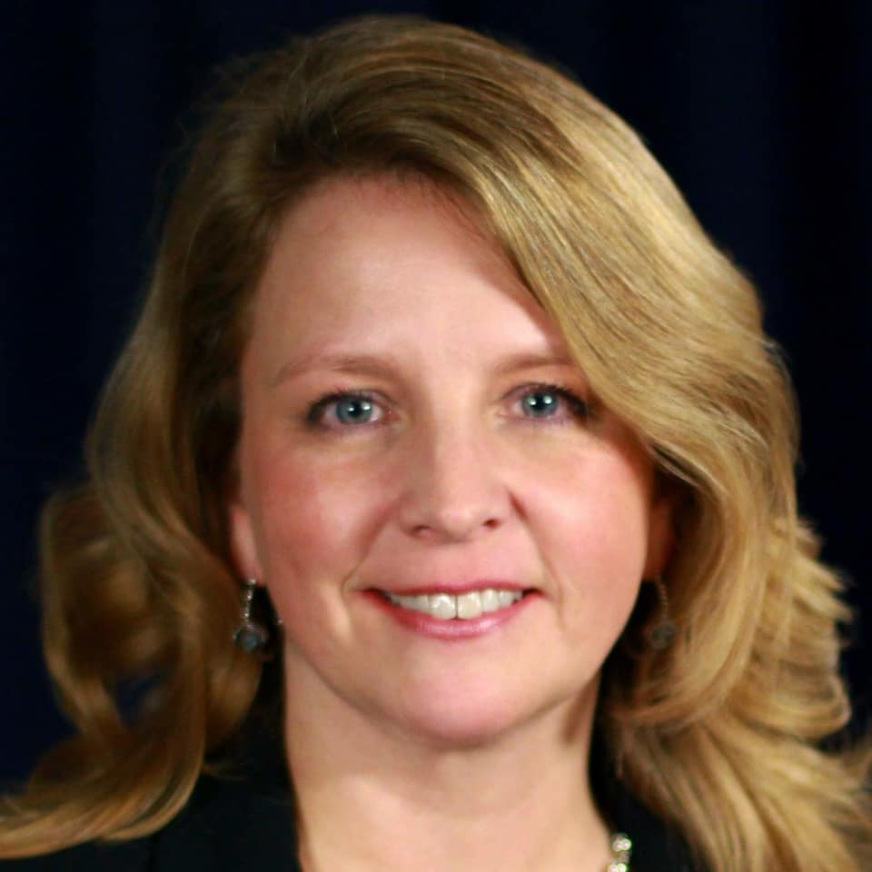
Hello!
I am Lisa DeGeeter
SCO GAL faculty since 2006, preservice, trauma, DV and high conflict courses
Stewards of Children Facilitator, YMHFA Instructor
Former CAC and Rape Crisis Program Director Currently Senior Director of Policy and Prevention @ ODVN
Notes:
Have background, wasn’t random

Slide 3

Point Break
Notes:
Apologize for salty language
Just watch, we’ll come back to this later

Slide 4
Myths and Misperceptions
Notes:
Pick a number exercise
Likely primary ed in US not good/bad right/wrong
Basis in something become myths because they are repeated, believed
You are normal person, but that leaves kids at risk

Slide 5
Economic Myths
Myth
Only happens in poor families
Affluent families are unaffected
Reality
Happens in all socioeconomic groups
No portion of society is immune
Money does change access to services and systems response
Notes:
Can and does happen everywhere
My CPS 97% Medicaid eligible, because non Medicaid not happening---NO, other resources, private, quiet
And mean can shelter, retain atty, advise not to talk, not permit child,
Therapists, educators—they are nice, see other good, believe protective answers, Disbelief and minimization
Spirals wrong conclusions
CPS not involved or unsubbed, so DR courts jump to wrong conclusions

Slide 6
Perpetrator Myths
Myth Reality
Strangers, creepy strangers
Males who are abused always become abusers
Only men abuse
Familial abusers aren’t a risk to others
90%+ know their abuser
More complex, directionality
20% of offenders are women
Rarely have only one victim
Notes:
Trench coats, bushes, dark
Family and household members,
Positions of trust. Control, authority,
10% of volunteers in youth serving orgs are there b/c access to kids
Causation versus correlation, numerous compounding variables, nothing is dispositive
Not just gender, but age, children abuse 40% are older, bigger kids Anatomical doll story Male adult detachable
Are they a person? Could be either a victim or offender
Looked normal
Well educated
Middle class
We make assumptions about private behavior based on public appearances
Hensley 8 kids, nieces and nephews, babysitting kids

Slide 7
Victim Myths
Myth Reality
Child invite sexual assault / don’t say no
Child enjoy the attention/contact
Only happens to girls/ Boys are less traumatized
Children with disabilities less likely to be victimized
Children don’t know how or what to say no to
Attention yes, abuse no
Under age 10, similar rates
Rape/molestation is a
trauma regardless of age or
gender
◊ 88% of disabled children
abused before age 18
Notes:
Seriously?!? Myth of precocious 6 year old not developmentally appropriate, offender seeing what they want to see,
if small child is seductive, it is learned behavior, problem still isn’t the kid, that is grooming
We all like attention, to feel special
Good touch bad touch is a problem, sexual contact generally feels good, young concrete literal kiddos bad = pain don’t penalize a kid for being developmentally on track
Tell immediately

Slide 8
Evidence/Scenario Myths
Myth Reality
There will be physical evidence
Includes physical contact
Parent should have known
90-97% of cases, no physical evidence
Non-contact offense are a precursor
Kids don’t always tell
Disclosures can be misunderstood
Notes:
There will be physical evidence
Curling iron story
No contact offense is an offense, and grooming DON”T MINIMIZE
Shower with 11 year old, his controller sticky
I”d know, 900 don’t tell, most disclosures delays---no you wouldn’t
Perps groom adults too, not in positions of trustand authority b/c people think they are skeevey
Cookies in pocketbook

Slide 9
Disclosure Myths
Myth Reality
Children tell
Children lie
Recanting means it was a lie
Is always reported
90% do not disclose, those who do are often delayed
2% under 11, 4% 11+
Recanting can mean many things, including pressure to recant and unbearable consequences of the truth being known
People who receive disclosures do not always handle them correctly
Notes:
People believe too quickly/without evidence
Parents (moms) always believe and support, and if they don’t kid must be lying
Death example---goes to divorce
Intentionally false statements are rare
Coke bottles and broomsticks example
Hide, delay, questions that taint,

Slide 10
Point Break
Which Ex President was driving the car?
What color was Nixon’s jacket?
What does this have to do with sex abuse?!?
Which Ex President had a shotgun?
Which Ex President said “we’re styling”?
Notes:
Answers in chat
Reagan, Carter, Tan (not a suit) LBJ
We aren’t little kids, not traumatized (in the past 1 at least) 90 second clip of thirty year old movie, no relationship with performers, no jeopardy
Frequently Our expectation of traumatized kids are unrealistic
You aren’t Not bad, lying, manipulative if you got one wrong
But systems fail to protect if all hoops aren’t jumped through, in order, etc.
Only people who benefit from myths and misperceptions are people who harm kids and those who protect them
Give kids space and graced Listen GAL work is slow work patient ear, don’t rush to judgement

Slide 11
Resources
https://nationalcac.org/wp-content/uploads/2018/02/FINAL-10-Common-Myths-with-References.pdf
https://bravehearts.org.au/what-we-do/education-and-training/for-parents/child-sexual-assault-myths-facts/
https://defendinnocence.org/8-myths-about-child-sexual-abuse/
https://www.childhelp.org/blog/child-abuse-myths-misconceptions-prevention/
https://www.d2l.org/education/stewards-of-children/
Notes:
NCAC virtual training center, NCA online learning Engage, plug stewards

Slide 12
Thanks!
Any questions?
You can find me at:
lisad@odvn.org
614-440-5141
Special thanks to all the people who made and released these awesome resources for free:
Presentation template by SlidesCarnival
Notes:
Call email, happy to help

