Slide 1

De-escalation and Crisis Intervention: A Trauma-Informed Perspective
Leah Stone, MSW, LISW-S, RA
Training Director

Slide 2
At the end of this session…
participants will have identified the components of Trauma-Informed de-escalation, including the differences between "power with" and "power over" approaches.
participants will have identified signs that a situation may be escalating and created a list of these signs on a timeline of crisis escalation.
participants will have applied information about crisis intervention and de-escalation to realistic scenarios depicting crises with survivors of abuse.
Notes:
Leah

Slide 3

When is the best time to plant a tree?

Slide 4
When is the second-best time?
Notes:
Crisis Intervention works this same way.

Slide 5
Frameworks for managing crisis
Control-based response
Trauma-informed response
Based in desire to control how people behave
Uses threats, punishment, or coercion to manage outcome
Rigid, inflexible
Leads to power-over dynamics
Based in desire to empower people to get needs met
Uses relationships, co-regulation, transparency to seek solutions
Flexible, adaptable
Leads to power-with dynamics

Slide 6
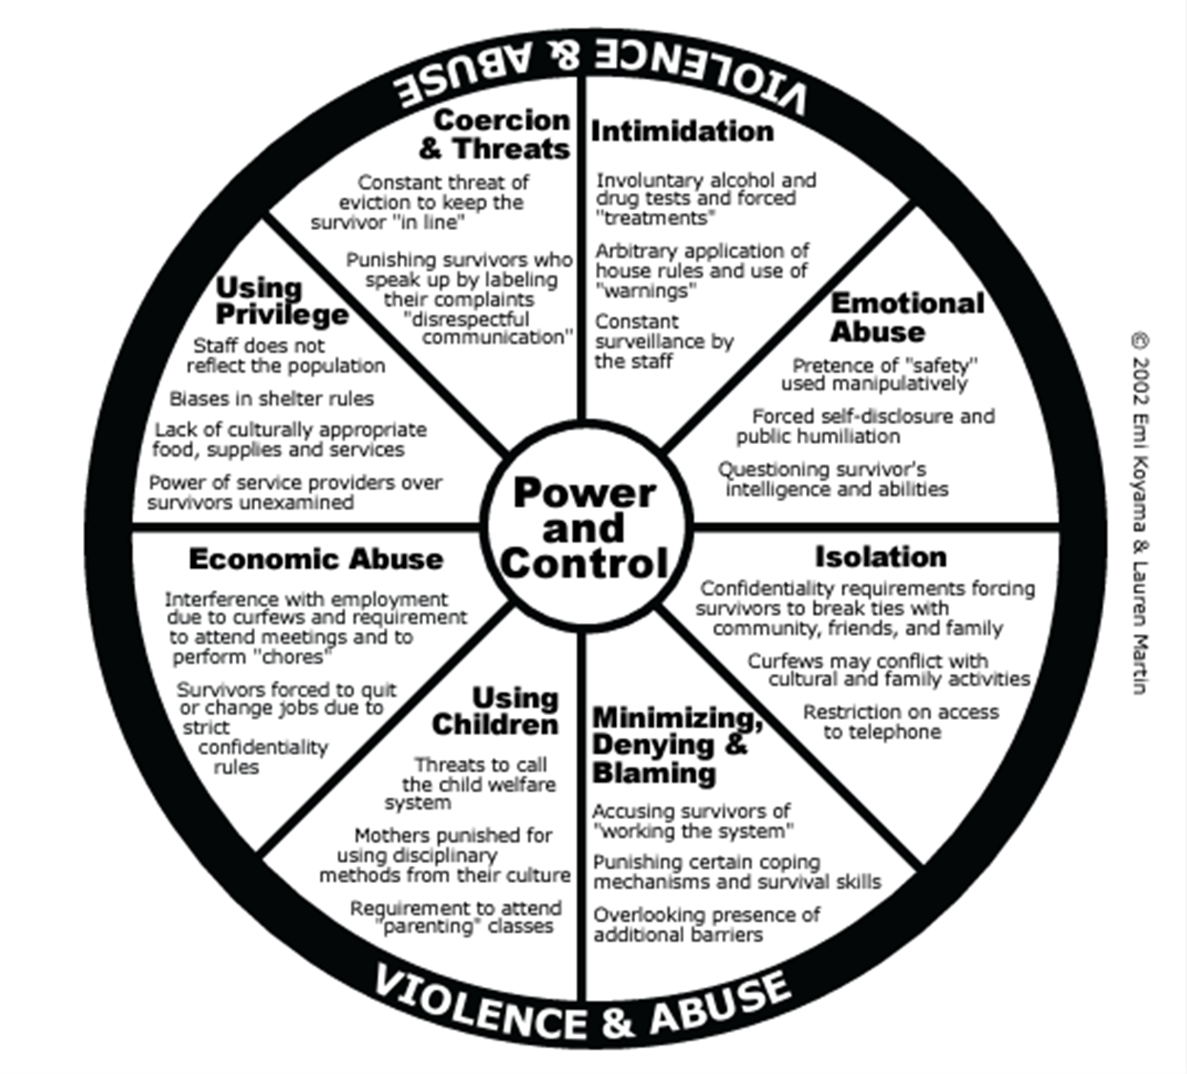
Power and Control Wheel- DV programs
Notes:
Leah

Slide 7
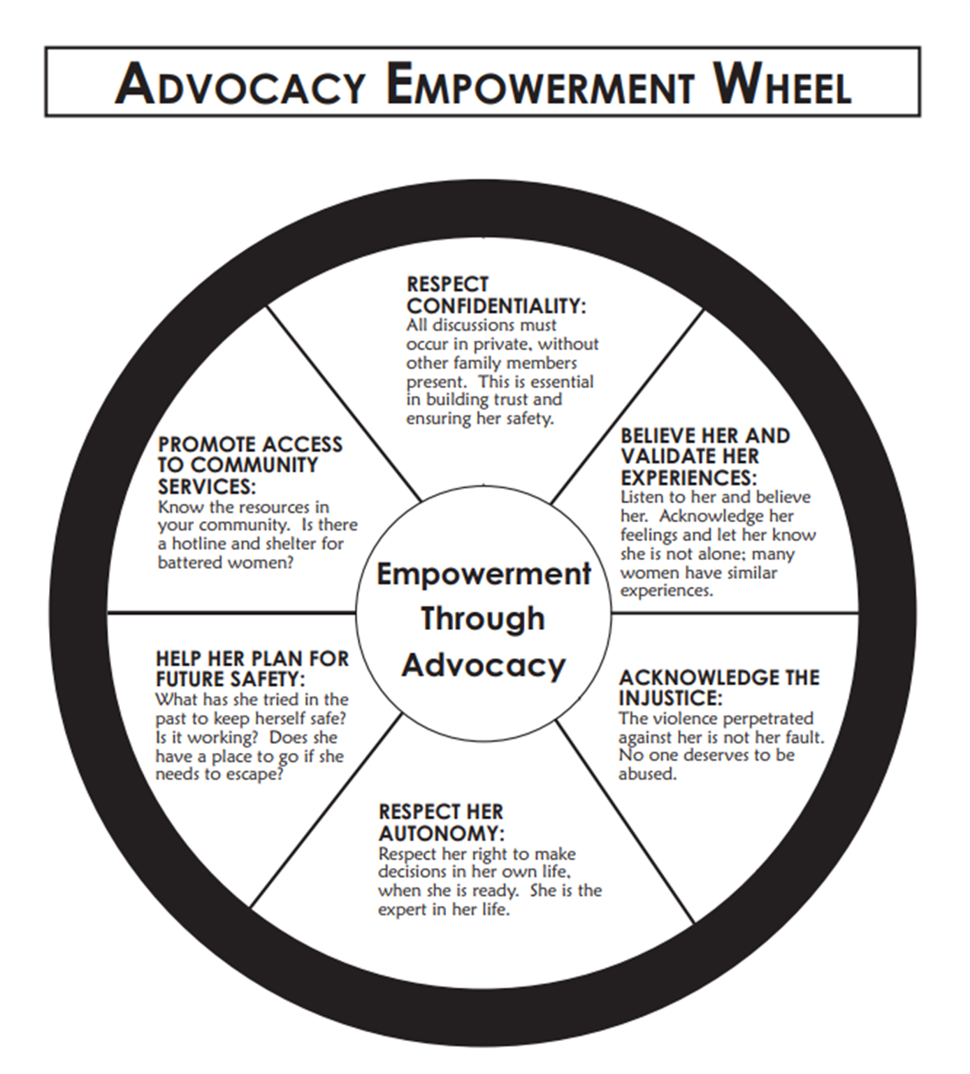
Empowerment Wheel
Notes:
Leah

Slide 8
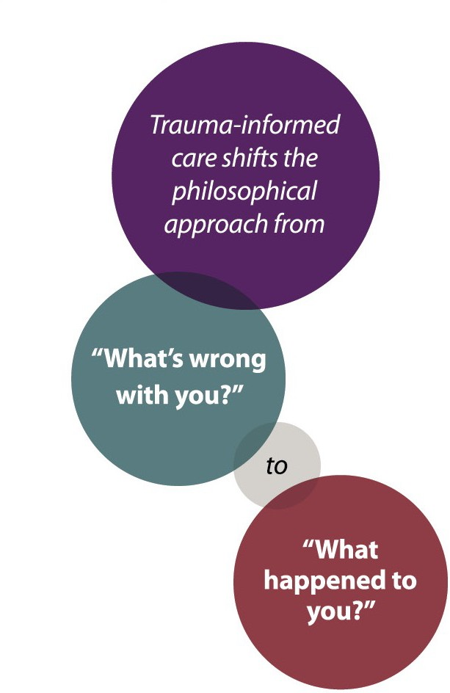
A philosophical shift occurs in Trauma Informed Care
L
S -Trauma Informed Care Manual, 4th edition, ODVN
Notes:
Leah

Slide 9




4 Rs of Trauma-Informed Care
Realization about the widespread impact of trauma and how it can affect people and groups. And the potential pathways to recovery
Recognizing the signs of trauma, the signs and symptoms of trauma in client's families, children and staff involved in the systems;
Having a system which can Respond to trauma by fully integrating knowledge about trauma into polices, procedures and practices
Seeks to actively
Resist
re-traumatization
https://www.nchv.org/images/uploads/Research_Brief_61_-_SAMHSA_Trauma_Care.pdf
L
Notes:
Leah

Slide 10

Here is the foundation of our work…
A trauma-informed approach is based on the recognition that many behaviors and responses expressed by survivors are directly related to traumatic experiences.*
-Attempts at coping,
-And parenting children impacted by trauma
*The Center for Mental Health Services National Center for Trauma-Informed Care
L
Notes:
Sonia

Slide 11
De-escalation: Now Make it Trauma-Informed
You get a call from a client who is crying and pleading with you for help when told via letter that your organization can no longer provide services due to multiple missed appointments. She is a domestic violence victim with two children and has a disability.
Notes:
What could have been handled differently about the termination and client’s lack of engagement?
What preventative steps could have been taken to prevent termination of services?
Given what we know about trauma, how do you respond?

Slide 12
Realization
Recognition
Responding
Resist Re-traumatization
Based in desire to empower and get needs met
Uses relationships, co-regulation, transparency to seek solutions
Flexible, adaptable
Leads to power-with dynamics
Notes:
These framework fit together and are meant to be used in conjunction to support survivors through crisis. This doesn’t mean we don’t have boundaries. It means we respond appropriately with the knowledge we have about trauma and with strategies that support both the safety and self-determination of the person we’re working with.

Slide 13
Reflection- Think back to a time you had to de-escalate a crisis.
L
When did you first notice the situation was escalating? What did you observe externally and internally?
What, if anything, was helpful? What did not feel helpful?
Notes:
Ask folks to identify situations from either personal or professional life. They can share them out loud or type them in a private message in the chat to Leah and can be read anonymously.

Slide 14
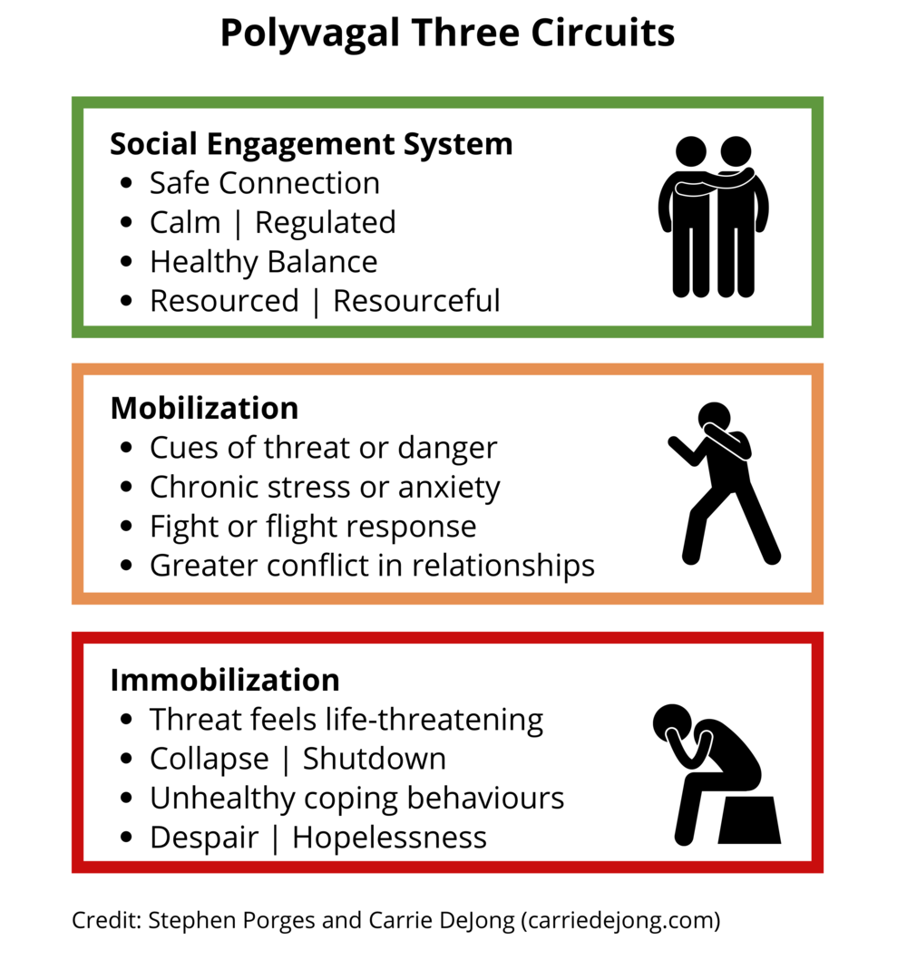

Slide 15
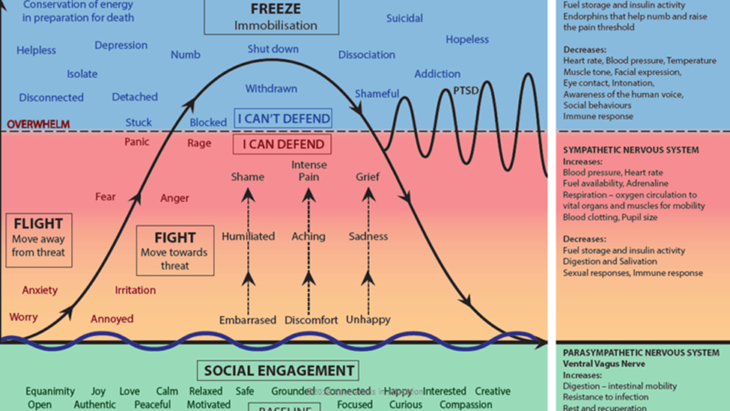
Adaptation of Dr. Steven Porges Polyvagal Theory Chart, Endseclusion.org, 2021
Notes:
Important to note here that anxiety does not equal crisis. Anxiety, irritation, even anger and fear are still within the realm of ability to internally regulate. We start to get into true crisis within the panic, rage, and overwhelmed place. This is when folks move into shut down move and are much less likely to be able to internally regulate in healthy, helpful ways in the moment.

Slide 16
De-escalation Strategy Timeline
Prevention
Response
Aftercare

Slide 17
De-escalation Strategies
Timing is key! Read the room.
Do not elevate, stay grounded.
Keep escalation contained or remove others from area.
Share observations, not judgements or opinions.
Acknowledge feelings and listen reflectively.
Provide options.
Co-regulation and support.

Slide 18
Scenario #2
C
Notes:
Identification of where person is scenario is in the escalation timeline and appropriate interventions.
Consider asking question: What do you think of when you think of a survivor in crisis? What does that look like? (scenario follows this question?)

Slide 19

Case Scenario
James arrived your organization visibly agitated. He demanded immediate housing assistance, spoke rapidly, and was sweating profusely. Staff suspected he was under the influence of stimulants. He began pacing, accused staff of lying, and threatened to “make a scene” if not helped.

Slide 20

Case Scenario (continued)
James had called the day prior telling one staff member that he needed housing assistance, but when the staff member asked questions about why he couldn’t continue to stay at the homeless shelter he’s been residing at, he became frustrated. The staff member said that this homeless shelter was the only one in the county, and James hung up.

Slide 21
Case scenario: response
What are your first thoughts as to how to intervene in this situation?
What concerns you the most?
Notes:
Have folks create the timeline

Slide 22
Case scenario: Intervention
Safety first
Clear the space of other people
Maintain calm, non-threatening posture
Connect
“I hear you’re really frustrated and need help right now. I want to understand what’s going on.”
Manage the Space
Move to a quiet space
Offer water, food

Slide 23
Intervention (continued)
Avoiding Escalating Triggers:
Avoid arguing, correcting, or challenging delusional statements.
Instead of saying “You’re on drugs,” use language like, “It seems like you’re going through something really difficult.”
Clarifying Needs:
Once calmer, James explained he had been kicked out of a shelter and was afraid to sleep on the street.
Affirm his need for safety and explain options.

Slide 24
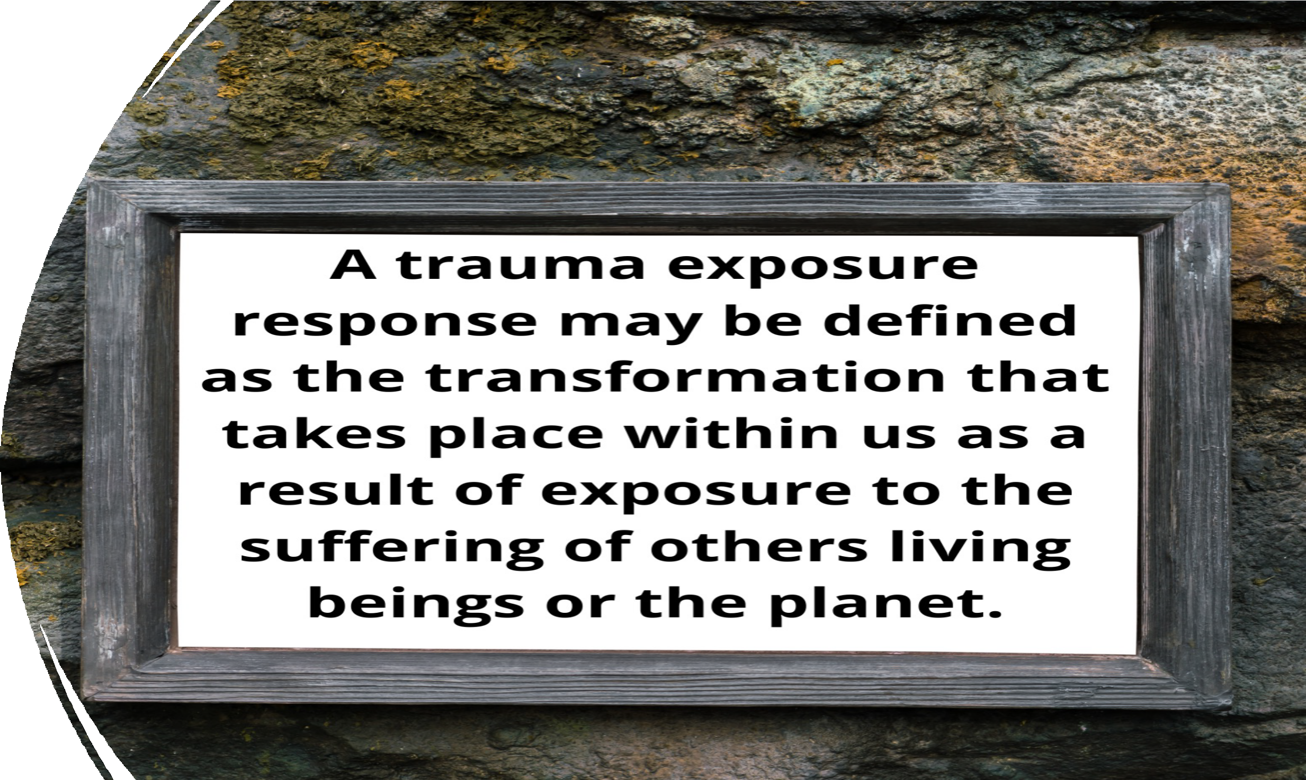
C
Secondary Trauma
Exposure --
Laura van Dernoot Lipsky 2010
Notes:
Cheryl

Slide 25
Co-regulation and the Importance of Self-Awareness
Co-regulation can be defined as “the way in which one person’s autonomic nervous system sensitively interacts with another person’s autonomic nervous system in a way that facilitates greater emotional balance and physical health.”
-Dr. Arielle Schwartz
Notes:
Leah

Slide 26

Mirror Neurons
A group of specialized neurons that “mirrors” the actions and behavior of others.
The involvement of mirror neuron system (MNS) is implicated in neurocognitive functions (social cognition, language, empathy, theory of mind) and neuropsychiatric disorders.
Notes:
Leah

Slide 27

Relationships!!!
Because recovery from trauma occurs in the context of relationships, it is important for trauma survivors to be able to re- establish safe connections with others.
The magic of OUR JOBS!
Notes:
Leah

Slide 28
Scenario #3
You are walking down a hallway and hear raised voices getting louder. You peak your head into the room the sounds are coming from to see a client and fellow staff member in an argument. The client is shouting and standing over the staff member, who is sitting and also talking very loudly, telling the client to “Calm down”. You know the client, because you have interacted with them many times and know how stressful things with their divorce case has been recently and that this is not a typical response.
Notes:
How might you use your relationship with the client to intervene?
What first step are you taking to regulate yourself before stepping in?
What do support look like towards the client and your co-worker?

Slide 29
Questions?

Slide 30

Stay in Touch!
www.odvn.org
Leah Stone- Leahs@odvn.org

