Slide 1
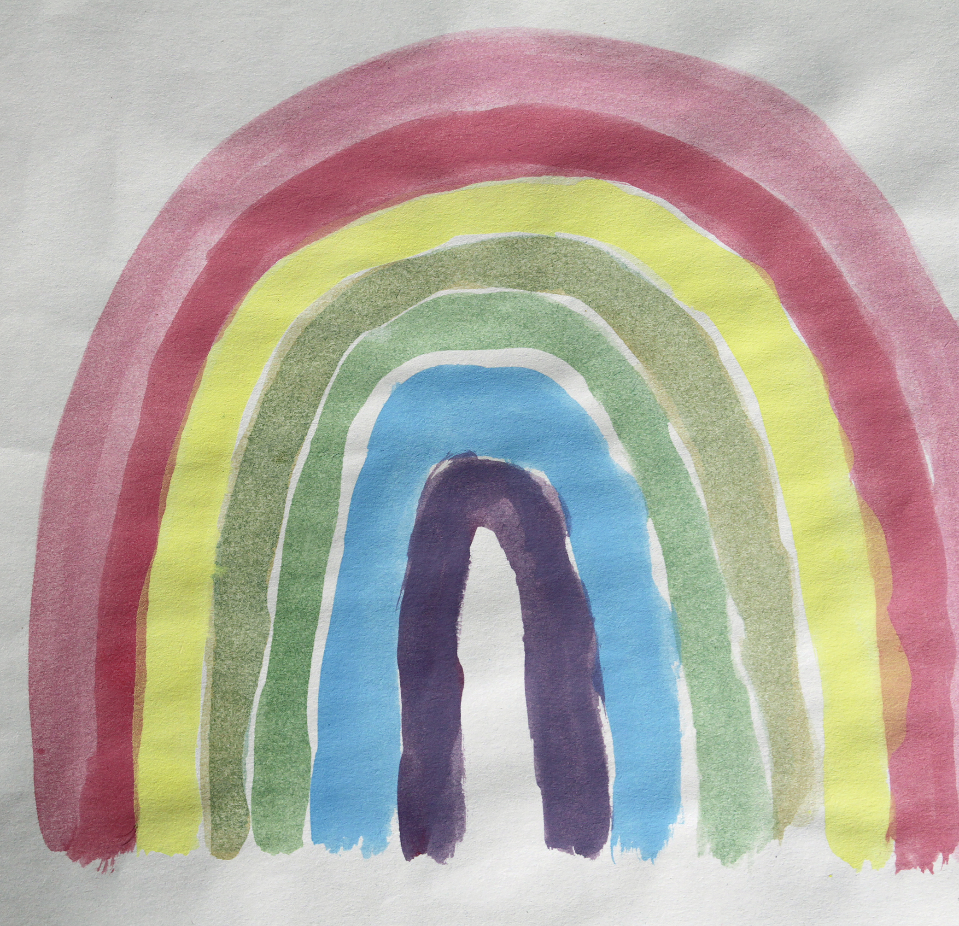
Talking with Kids about Traumatic Loss
Dr. Kailey Bradley Ph.D., LPCC-S, NCC, FT
kailey@allrefuge.com

Slide 2



Dr. Kailey Bradley, Ph.D., LPCC-S, NCC, FT
Clinical Director, Refuge Counseling LLC
Executive Director, Co-Founder, The Ohio Bereavement Collaborative
Adjunct Professor of Thanatology

Slide 3
Some reflection questions.
How comfortable are you talking with kids about grief and loss?
What comes up from you when you consider having to broach this topic with kids?
What would help ease anxiety?

Slide 4

Definitions
Trauma
Grief
Loss
Suicide
Overdose

Slide 5
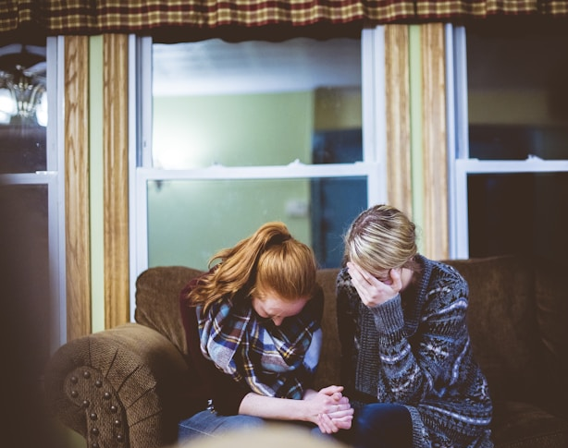
Traumatic Grief
This Photo by Unknown Author is licensed under CC BY-NC-ND

Slide 6
Defining Traumatic Grief
Traumatic grief is a form of bereavement that includes post-traumatic stress symptoms
sudden, unexpected, or violent loss, such as an accident, murder, or natural disaster.
Overdose loss, suicide loss (we are going to talk about both of these today)

Slide 7

Ambiguous Loss

Slide 8
Defining Ambiguous Loss
Ambiguous loss, a term coined by psychologist Pauline Boss, describes a type of loss without clear resolution or closure, a loved one is physically absent but psychologically present (like a soldier missing in action) or physically present but psychologically absent (as in Alzheimer's disease).

Slide 9
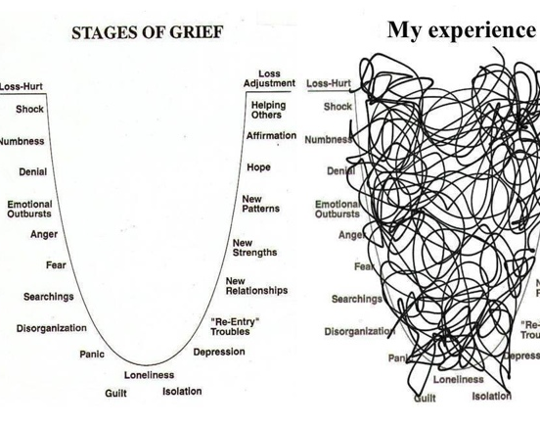
Disenfranchised Grief
Disenfranchised grief occurs when a person experiences a loss that is not recognized or valued by others. This can include losses that society deems insignificant or situations where the grieving person feels unable to express their sorrow due to social norms. Examples include the loss of a pet, the end of a relationship, or the death of someone not considered a close family member.
This Photo by Unknown Author is licensed under CC BY-NC-ND

Slide 10

Disenfranchised grief
Kenneth Doka
Relationship is not recognized
Loss is not acknowledged
Griever is not recognized

Slide 11

Suicide Loss
Consciously use the word suicide
Helps to destigmatize the word
May define suicide as: took their own life, ended their own life, killed themselves
Talking about suicide with kids does not “plant ideas.”

Slide 12
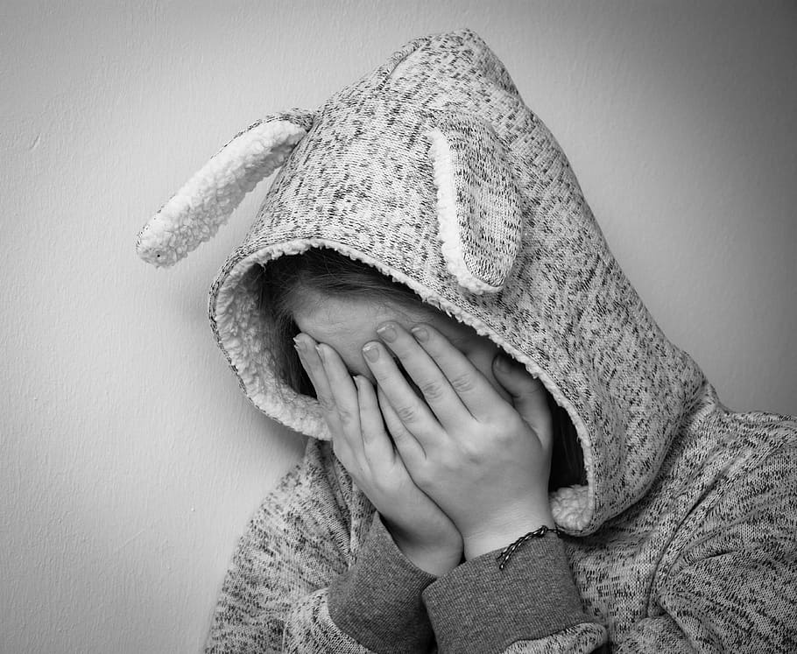


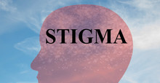

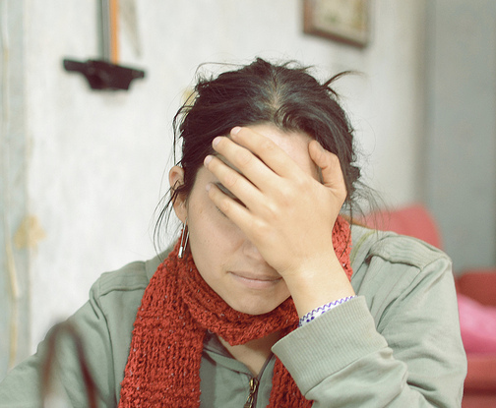
Overdose Loss
This Photo by Unknown Author is licensed under CC BY-ND
This Photo by Unknown Author is licensed under CC BY-SA-NC

Slide 13
Loss and addiction
Overdoses are now the number one cause of accidental death surpassing even auto fatalities

Slide 14

Some Additional Stats
Nearly 80 % of overdose deaths in 2022 involving heroin also involved synthetic opioids other than methadone (primarily fentanyl).

Slide 15
An estimated 2 in 5 U.S. adults know someone who has died from overdose.

Slide 16
Common Myths About Addiction

Slide 17

Myth
Myth: Using alcohol or other drugs is a choice, so if someone gets addicted, it’s their fault.
Reality: No one would choose to become addicted, any more than they'd choose to get cancer. Addiction is a consequence of many contributing factors, including genetics, upbringing, trauma and other influences.

Slide 18
Willpower is all one needs to beat addiction.
This is false!

Slide 19
Myth: "Addiction only happens to certain kinds of people."
Fact: Addiction can happen to anyone, no matter their race, upbringing, personality type, or grade point average. There are genetic, social, and psychological risk factors that can put some people at greater risk—but addiction has nothing to do with a person’s character.

Slide 20

Families of loved ones who are struggling with addiction encounter ambiguous loss

Slide 21

What is ambiguous loss?

Slide 22
The unique grief surrounding an addiction loss
Ambiguous Loss- “often an immobilizing situation”
Traumatic Loss
Stigmatized loss-people who struggle with stigmatized loss may feel guilt, blame, and shame.
Disenfranchised Grief-describes grieving a loss that is not openly talked about or mourned.
Complicated Loss: “I love this person, but I am angry…”
Painful memories, shame, stigma…
Secrecy, complex feelings

Slide 23

Common Reactions
Common Reactions:
Sadness
Fear of judgement from others regarding
Disappointment in yourself
Needing to place blame
Difficulty concentrating
Frustration over the lack of support and understanding from others about addiction
The need to have your loved one remembered for the good in him/her and not the way he/she died
Feeling isolated from supports and possibly lacking places to talk about your grief • Fear of this happening to others you care about

Slide 24
How can you help?
Children often feel that it is their fault
May blame another person
Don’t try to minimize or take away guilt or blame

Slide 25
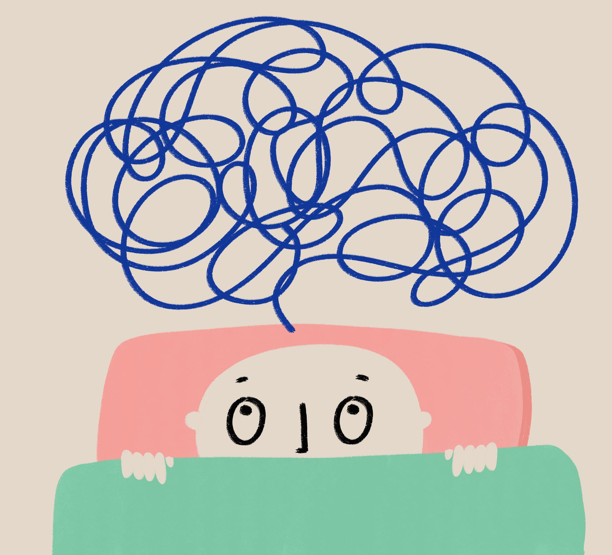
Avoiding Euphemisms

Slide 26
Examples of euphemisms
“They went to sleep.”
“They took a long trip.”
Deceased
Passed away
These can be confusing to kids!
Which euphemisms have you heard?
Why do you think we use them?

Slide 27

Benefits of Truth-Telling
This Photo by Unknown Author is licensed under CC BY-SA

Slide 28

More on truth-telling
“why am I finding this out from a stranger?”
When considering what details to share-Think: what information will actually serve them? What information are they truly seeking?
Make sure the story is shared by a safe person in a safe place with timing in mind.

Slide 29

Development Matters

Slide 30
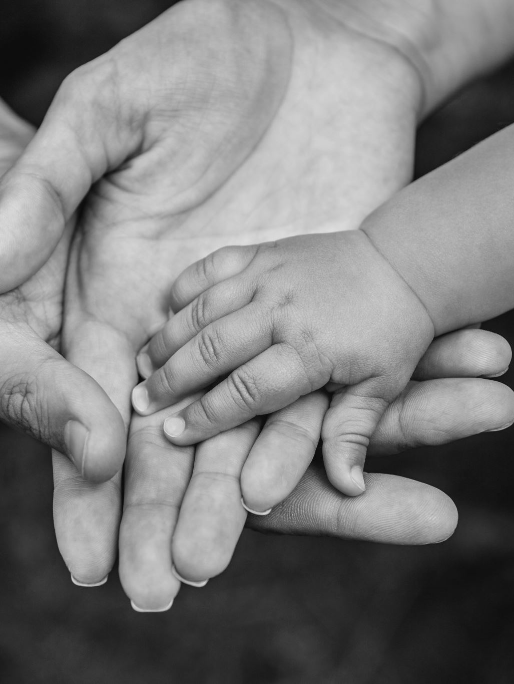
A Developmental Perspective
Children grieve developmentally; they encounter different symptoms and experiences based on how old they are.
A developmental perspective on grief means that the needs of children and adolescents are different, and interventions should be tailored to fit those needs. For example, a child may not grasp the permanency of death, whereas a teenager does.

Slide 31

Peer Support

Slide 32

Benefits of Peer- Support
Peer support allows children and teens to feel like they are not-alone, and that they are able to share without judgment.
Peer-support groups for grieving children and teens are a great resource!
It is therapeutic to know you aren’t alone!

Slide 33

Importance of Dialectical Thinking

Slide 34
The Power of Both/And
Kids and teens navigating loss may experience conflicting emotions
“I love my dad, but I’m angry that he took too many drugs and died.”
Allow space and normalize contradictory emotions!

Slide 35
Suicide Loss
Consciously use the word suicide
Helps to destigmatize the word
May define suicide as: took their own life, ended their own life, killed themselves
Talking about suicide with kids does not “plant ideas.”

Slide 36
“Backpack Activity.”

Slide 37

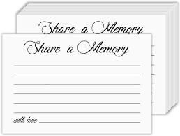
Spend time sharing
Share stories
Share memories

Slide 38

Resource Sharing

Slide 39





Resources:

Slide 40
Thank You!
Dr. Kailey Bradley
Kailey@allrefuge.com

Slide 41

Questions????
This Photo by Unknown Author is licensed under CC BY-NC

Slide 42
Contact me: kailey@allrefuge.com

