Slide 1
Identifying and Responding to Domestic Violence:
Supporting Child and Parent Survivors

Slide 2


Slide 3
Overview
In this webinar, we will cover:
Dynamics of domestic violence, including tactics and types of abuse commonly used to gain or maintain power over victims.
Impacts (short and long-term) on parent and child survivors.
Trauma-Informed, Victim-Centered strategies to promote safety and access to services.
Local and community resources for domestic violence advocacy.

Slide 4






1. Black, M.C., Basile, K.C., Breiding, M.J., Smith, S.G., Walters, M.L., Merrick, M.T., Chen, J., & Stevens, M.R. (2011). The National Intimate Partner and Sexual Violence Survey (NISVS): 2010 Summary Report. Atlanta, GA: National Center for Injury Prevention and Control, Centers for Disease Control and Prevention.
2. Hamby, Finkelhor, Turner, & Ormrod, 2011

Slide 5
What do you think when you hear “Domestic Violence”?
Notes:
Pair and share- what formative depictions of domestic violence have you seen in your lifetime? How was the survivor portrayed? How was the perpetrator portrayed? Based on these portrayals, what definition of DV would you come up with? (this is what will be shared)

Slide 6
Social Definition
A pattern of coercive and controlling behaviors
including physical, sexual and psychological attacks, as well as economic coercion
that adults and adolescents use against their intimate partners.
Notes:
We’re gonna start with the social definition of Domestic Violence. This is likely the definition that is used in most domestic violence programs, all also maybe even media about domestic violence. An important feature of this definition and of domestic violence is that is it occurs across a spectrum of relationships, people, behaviors, and time. No one abusive relationship will look the same. They can be brief or very long term. However, Domestic Violence is cannot simply be boiled down to just ONE event. It is a PATTERN of behaviors. Another feature shared by most abusive relationships is that the abusive partner tries to establish or gain power and control through many different methods, at different times. This behavior could include physical or sexual abuse, as well as mental or emotional attacks, and very often financial abuse and control. This abuse can occur between parents against children, intimate partner against intimate partner, or other of close relationships.
; Social def is the one that’s most widely used in the DV field . It’s a pattern of (read definition)Key words are Pattern and coercive; DV is not about an isolated incident or a one-time fight. It’s a pattern of behaviors and they are coercive that means using force or threats to make someone do something. In all AB relationship. There is s a power imbalance. 1 person tries to wield P and C over another, in cases of DV the other person is their partner.. Goal of ABR is to control their partners’ thoughts actions and beliefs and take away their partners independence and freedom of choice.

Slide 7
Knowingly causing or attempting to cause physical harm
Recklessly causing serious physical harm
By threat of force knowingly causing another to believe the offender will cause imminent physical harm
Ohio Revised Code Definition (ORC 2919.25)
The criminal law defines domestic violence as doing any of the following to a Family or Household Member
Notes:
So now, let’s switch gears and talk about the legal definition. The Ohio Revised Code defines domestic violence as doing any of the following to a Family or Household Member: Knowingly causing or attempting to cause physical harm
Recklessly causing serious physical harm
By threat of force knowingly causing another to believe the offender will cause imminent physical harm
This is what the LAW considers domestic violence and may be a bit different from what we use to talk with our clients and the survivors with work with about DV. If you have seen the Netflix Series “MAID”, this discrepancy is brought up when the main character, Alex, leaves her abusive relationship wit the father of her children, and goes to a DV shelter. She is told by the staff at the DV shelter that what she is experiencing is abuse, but when she talks to an attorney for her custody case, she brings up the fact that the DV shelter is telling her she is a victim of DV, but the courts are saying she isn’t. She uses some colorful language to describe her frustrations, but these are frustrations that many survivors experience because the LAW does not always encompass the full extent of the abuse they are experiencing.

Slide 8
Forms of Domestic Violence
Survivors may suffer from any number of the following forms of Intimate Partner Violence:
Physical
Emotional
Psychological
Verbal
Spiritual
Sexual
Financial
Stalking/Monitoring
Property/Pet
Notes:
There are many kinds of abuse that may fall under this definition of domestic violence. Here are some key examples of what those kinds of abuse can look like. We often are led to think about physical assault, the black eye, the bruises, as being what represents DV. However, there are many different abusive behaviors and tactics that one partner might use over another to gain and maintain control. This often includes, and even starts with, emotional and mental abuse– convincing their partner that what is happening is NORMAL, that THEY are the “Crazy” one, and giving lots of love and affection at first, then pulling that away with seemingly very minor or even no action by the person experiencing the abuse. Verbal abuse is also very common and looks like someone calling their partner or children horrible things to degrade them and make them feel less than. This can also look like threats, like “If you don’t listen to me I’m going to make this worse for you.” or “I am going to hurt you if you leave.” Spirtual abuse might happen if one partner uses religious teaches to keep the other partner in the relationship, or use scripture or teachings to control or manipulate their partner. One partner might also try to shame or isolate their partner from the spiritual community as a way to gain further control. Sexual violence is also an common experience of DV survivors, although one that we as a society still do not talk about often enough. Intimate partners may be convinced by their partner, family, or society, that they must give their partner sex whenever they want and sexually appease their partner. We will talk a bit more about financial abuse more in the next couple of slides, but this is also a common tactic use by abusers to maintain power and control over their partner and stop them from leaving. Stalking is a tactic an abuser may use when their partner goes to work, leaves the house, sees family and friends, to “keep an eye” on them. This may also come into the picture once a survivor leaves the abusive relationship. Stalking can occur through following in a car or constantly calling and texting their partner and expecting a quick response, or using technology to monitor where their partner is going and who they are talking to. Property and pet abuse is also a dangerous and unfortunately common form of abuse and intimidation. If you have every see the Netflix show Maid, you may remember that Alex’s partner through glass and punched walls when he was angry, with was very intimidating to her and their child. This is also abuse and is not OK.

Slide 9
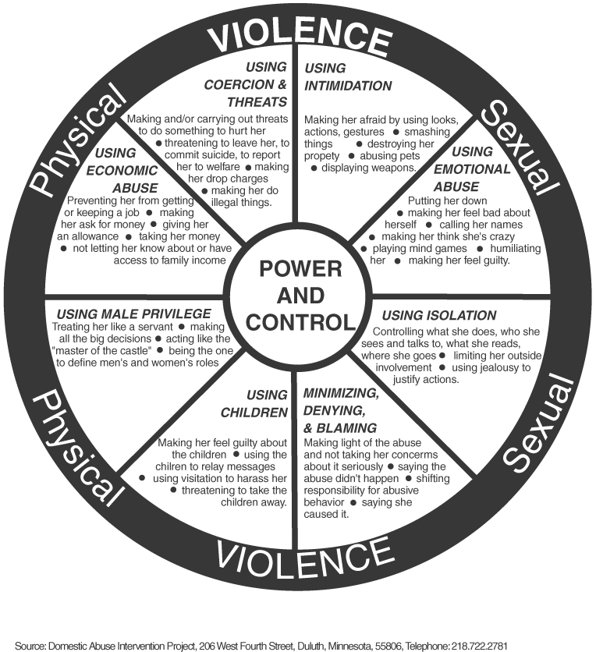
Dynamics of DV- Power and Control Wheel
Notes:
This is what we can the P&C Wheel. It really highlights everything that we talked about earlier with the types of abuse, but it sets it up in a way to show how P&C is at the center of the wheel, meaning that it drives the abusers’ behaviors. You can also see that physical and sexual abuse is holding the wheel together, while the inside of the wheel are the behaviors that provide the structure and make it so hard for survivors to leave. Think of this as a bicycle wheel. All parts and components are necessary to keep the wheel turning, and once they are in place, it can make it very hard to get out of the cycle. Hard but not impossible.

Slide 10










Abusive Tactics- Life and Batterer Generated Risks
Notes:
Talk about tactics life/batterer generated risks (employment, physical and mental health, pets and children, substance use, courts)

Slide 11
Financial abuse occurs in what percentage of domestic violence situations?
94 to 99 percent
1. Postmus, J. L., Plummer, S.-B., McMahon, S., Murshid, N. S., & Kim, M. S. (2012). Understanding Economic Abuse in the Lives of Survivors. Journal of Interpersonal Violence, 27(3), 411–430. https://doi.org/10.1177/0886260511421669
Notes:
Alright so we have another poll question, and this might not be information you know and that’s OK, but try to guess about what percentage of domestic violence situations also involved financial abuse. I will give everyone a moment to answer.
Unfortunately, the correct answer is 94 to 99%. That is huge! This number comes from this study about ten years ago, and although that is a while ago, in DV programs, we haven’t seem much change and even as technology advances and there are more and more ways to monitor someone through technology and gain access to personal information through apps, phone scams, and identity theft, these incidents are more common than not.

Slide 12
Barriers to Leaving
Finances
Fear of violence
Shared Children/Custody
Lack of Support and Resources
Cultural/Spiritual Beliefs or Values
Emotional Attachment
Pets
Notes:
Have people identify additional barriers

Slide 13
If I stay or if I go
If I go?
Possible escalation of violence
Risk of losing children
Loss of support system, judgment from loved ones
Lack of financial resources/work
No home
If I stay?
Ongoing, and probably escalating, abuse
Risk of losing children
Loss of support system, judgment from loved ones
Financial dependence on abusive partner
Home isn’t safe
Notes:
Scenario:
Alex lives with her partner of 7 years, which whom she shares a 4 year old daughter. Alex does not work and stays at home while Sam, the father, works and is the sole source of income. Alex has a GED and has not worked since having their daughter. The mortgage and deed to their home is in Sam’s name because they are not married and Sam is the only one with income. Alex is estranged from both parents but is close with Sam’s family. Everyone is their church likes Sam, who regularly volunteers to repair small issues with cars or the occasional leaky faucet. Very few people know that Sam drinks 8-10 beers every night after work. When their child goes to bed, Sam after yells at Alex for not keeping up with cleaning around the house. Recently, Sam threw a dirty place at Alex, who ducked, barely missing getting hit. Their daughter had snuck out of bed and watched as this happened. Alex called the local DV shelter out of fear, who said they were full but could put Alex on a waitlist.

Slide 14

Why don’t they just leave?
The most dangerous time for a survivor is in the 3 to 18 months after leaving an abusive relationship, with 75% of domestic violence related homicides occurring post-separation.
McFarlane J, Nava A, Gilroy H, Maddoux J. Risk of behaviors associated with lethal violence and functional outcomes for abused women who do and do not return to the abuser following a community-based intervention. J Womens Health (Larchmt). 2015 Apr;24(4):272-80. doi: 10.1089/jwh.2014.5064. Epub 2015 Feb 25. PMID: 25714332; PMCID: PMC4394888.
Notes:
75 minutes in
What does this statistic shift for you about best ways to support victims/survivors?

Slide 15
Why are they so afraid of this person just calling?
89 percent of femicide victims who had been physically assaulted had also been stalked in the 12 months before their murder.
McFarlane, J., Campbell, J.C., Wilt, S., Ulrich, Y., & Xu, X. (1999). Stalking and Intimate Partner Femicide. Homicide Studies 3 (4), 300-316.

Slide 16

Won’t he be less violent because she’s pregnant?
Homicide is the leading causes of death for pregnant women in the United States.
Wallace M, Gillispie-Bell V, Cruz K, Davis K, Vilda D. Homicide During Pregnancy and the Postpartum Period in the United States, 2018-2019. Obstet Gynecol. 2021 Nov 1;138(5):762-769. doi: 10.1097/AOG.0000000000004567. Erratum in: Obstet Gynecol. 2022 Feb 1;139(2):347. doi: 10.1097/AOG.0000000000004671. PMID: 34619735; PMCID: PMC9134264.

Slide 17
If they were choked, why aren’t there bruises?
Non-fatal strangulation is the highest predictor of murder.
https://www.domesticshelters.org/articles/identifying-abuse/strangulation-is-the-highest-predictor-of-murder

Slide 18
Impacts of Trauma
Notes:
Anchor- What do you already know about how trauma impacts the brain and body?

Slide 19
What is Trauma?
One Time (little “t”) v. Long Term or Chronic (bit “T”)
  Domestic violence is a chronic, recurring trauma
“Trauma is in the nervous system, not the event” – Peter Levine
Impacts an individual in many spaces of their life, including relationships, mental health, physical health, work, school, and in the community.
Notes:
Domestic violence is something we call a Chronic, Big T trauma. And that means that first off, as we talked about before, it’s not just one event, it’s a pattern. That means that these abusive acts are being experienced day after day, over a period of time. This impacts the nervous system differently than just one traumatic event does. It causes survivors to have to change and adapt their behavior for survival, but these behavior changes, while well suited for survivor, might not be well suited for the rest of their lives. As Peter Levine said, it is not just the event that leads to trauma, it is how our bodies and brains are naturally geared and wired to respond to trauma, especially those that happen over and over again. And these impacts spill over to many parts of a survivor’s life, including relationships, their mental health, physical well being, work, school, and pretty much everywhere. Domestic violence isn’t contained to the home it’s happening it.

Slide 20
Impacts of Domestic Violence
You may be:
  Feeling jumpy and constantly on alert for danger
  Doing reckless or self-destructive things
  Remembering things that happened when you don’t want to
  Thinking non stop about what happened
  Avoiding people, places or things that remind you of what happened
  Losing interest in activities or blaming yourself
  Detaching and feeling numb or disconnected to everything
  Trusting people less
  Forgetting everything that has happened
  Substance use and numbing behaviors
Trauma Rack Card “Understanding Trauma” ODVN
Notes:
Here are some of those mental health impacts of DV that we might see [read slide]

Slide 21
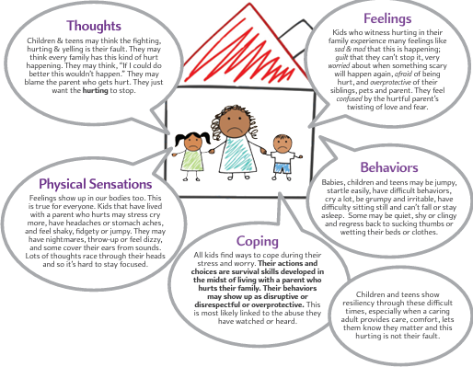

Slide 22
Impacts of Brain Injury
Physical Problems
  Headaches
  Fatigue
  Changes in vision
  Ringing in ears
  Dizziness or balance problems
  Seizures
  Pain in head, face, neck
Mental/Emotional problems
  Forgetfulness
  Difficulty Focusing
  Difficulty Organizing Things
  Lack of Motivations
  Difficulty controlling emotions
  Personality Changes
“Has Your Head Been Hurt?” ODVN
Notes:
But there are also other impacts. Brain injury like hitting your head on something, being punched in the head, even being strangled, can result in short and long-term impacts. [read slide] The more we are learning about DV, the more we are understanding that Brain Injury is actually a pretty common experience for DV survivors, so this is an important thing to consider and look out for.

Slide 23
Signs of Abuse in Relationships
Person is starting to isolate from those around them.
Person may often cancel plans at the last minute.
Person may get frequent calls from their partner, their partner “checking in” on them at work, or be frequently and urgently responding to texts from their partner.
Person expresses fear or is in crisis about their partner being angry with them, may go out of their way to placate their partner.
Person may casually mention abusive behavior but brush off reactions or say “It’s not big deal.”
Person may have unexplained injuries or offer explanations that don’t make sense.
Notes:
Just let we said, there is no ONE WAY for a DV relationship to look, but there are some signs you can look out for if your red flags are starting to be raised a bit. [read slides]
These can also be found in a handout that will be sent to you in an email after today. This resource includes information about signs to look out for and how to help someone who might be experiencing DV.

Slide 24
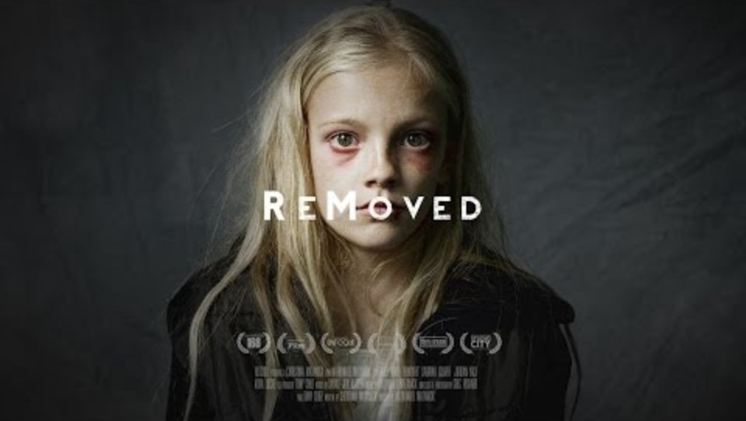
Signs of Abuse in Children
Notes:
95 minutes in- Take a break
How has the little girl in this video been impacted by the abuse in her home?
How might she be impacted in the future?

Slide 25
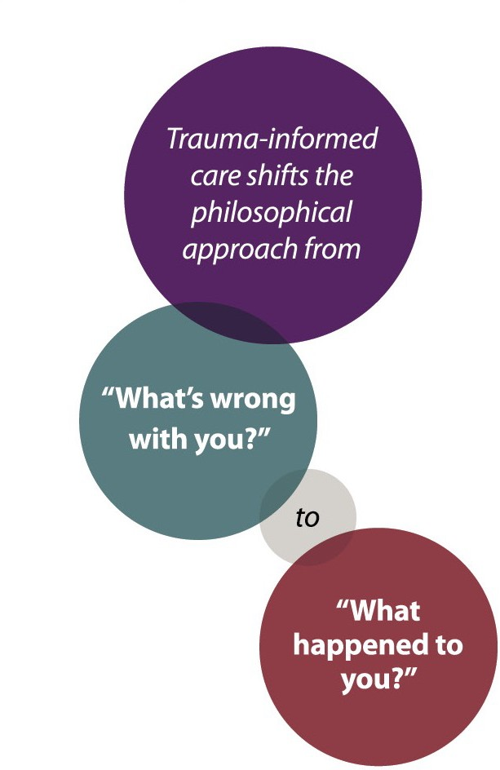
A philosophical shift occurs in Trauma Informed Care
S -Trauma Informed Care Manual, 4th edition, ODVN

Slide 26


Slide 27
CARE by…
Connect by…
  Building a relationship
  Establishing rapport
  Asking questions
  Respecting boundaries
Acknowledge by…
  Educating about the impacts of abuse on adults and children
  Saying “I believe you.”
  Validating how hard it is to reach out for support
Respond by…
  Offering resources and support
  Providing referrals for areas that they identify needing help with
  Creating a plan that keeps their safety and privacy into account
Evaluate by…
  Checking in with the family or parent
  Providing a way for them to give you feedback

Slide 28
How can I help? Trauma Informed Responses
Do…
  Ask specific questions about what you are noticing or hearing
  Listening without judging
  Tell them that they are not alone and help is available
  Trust their knowledge
  Highlight their strengths and courage
  Learn about and offer community resources
  Provide information on Domestic Violence
  Contact police immediately ONLY if you witness or hear a violent episode
Don’t…
  Criticize their partner
  Make choices for them
  Sound angry or upset
  Suggest couples counseling, it can be dangerous
  Use terms such as “victim” or “abuser”
“Do You Know Someone Who is Being Abused?
A Guide for Friends and Family” ODVN
Notes:
Here are some simply does and don’ts of responding in a trauma informed, helpful way. [read slide] you can also find this in your handouts after today.

Slide 29
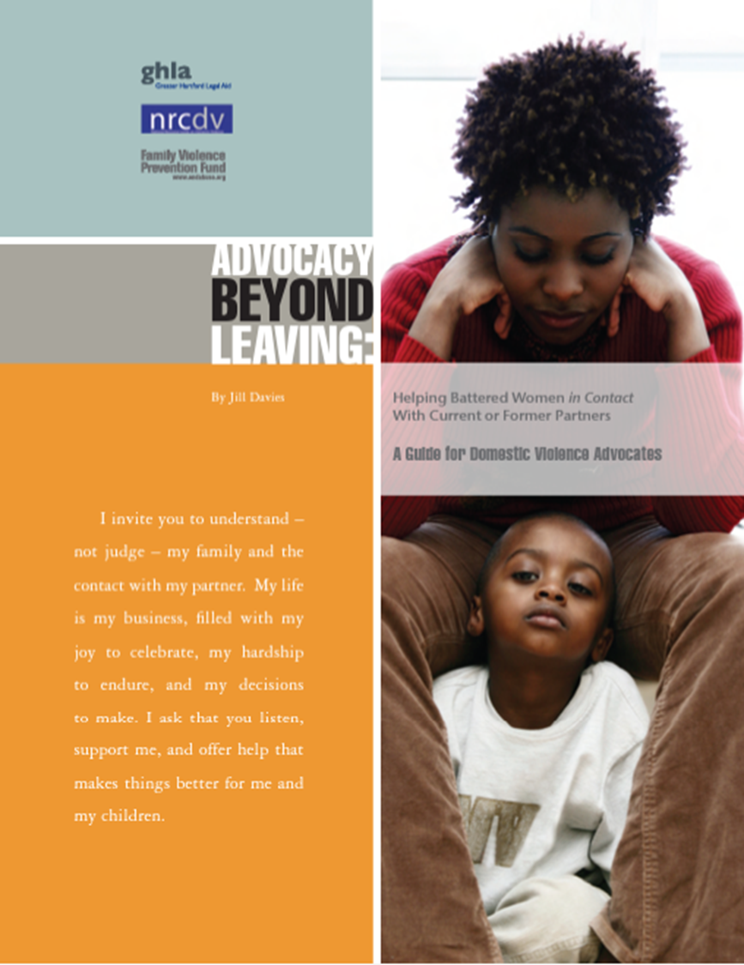
Effective Safer Planning is...
Safer Planning
FLEXIBLE
Works for survivor, is ongoing
COMPREHENSIVE
Considers all aspects of survivor’s life
CONTEXTUAL
What has happened, is happening, and might happen?
INDIVIDUALIZED
Considers uniqueness of survivor’s needs and situation

Slide 30

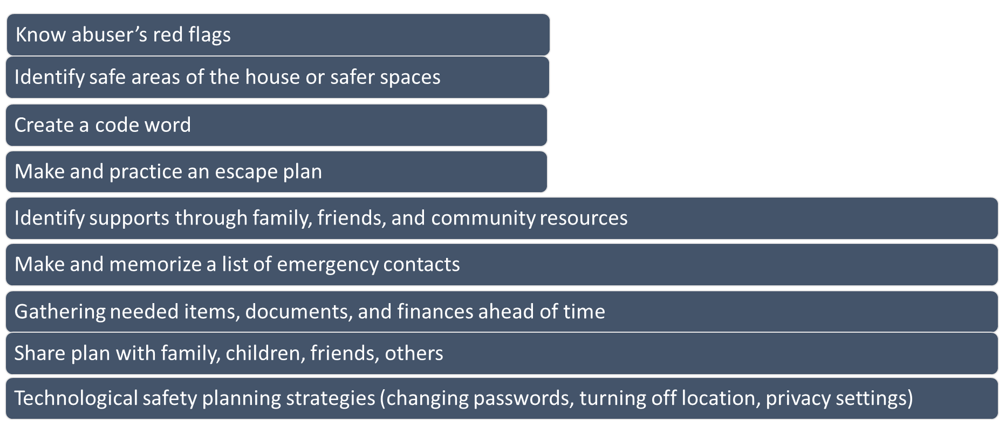
Safer Planning Strategies
Notes:
Ask folks to add

Slide 31
Local and ODVN Resources
Notes:
3 minutes without phone, 1 minute with phone

Slide 32
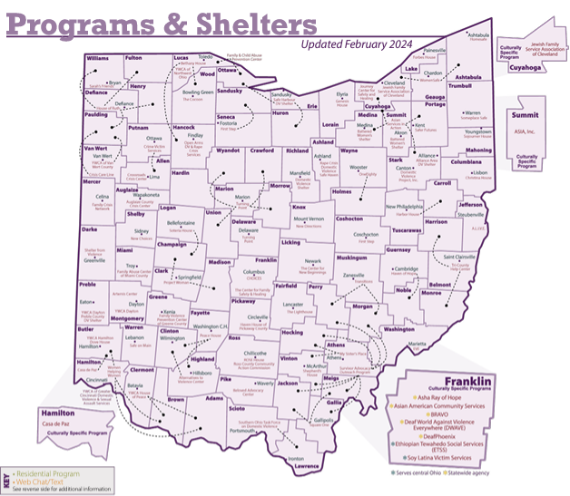
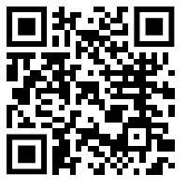
www.odvn.org/find-help/
Notes:
Mention that people do not need to engage with the legal or criminal justice system in order to seek help. Have folks scan the QR code to take a minute and fill in their resources list.

Slide 33

ODVN Resources
Relocation and Safety Assistance
Legal Assistance
REACH Rapid Re-Housing Program
Notes:
Here are the four resources we will be talking about: Relocation and Safety Assistance, Flexible Spending, Legal Assistance, REACH Rapid RE-Housing Program. Have folks add this information to their resource list.

Slide 34
Ohio Domestic Violence Network
Address
Website
Phone
174 E. Long Street, Suite 200
Columbus, OH 43215
www.odvn.org
614-781-9651
Follow us on social media!

