Slide 1
Understanding Compassion Fatigue In Child Welfare Work:
Supporting Children and Families While Sustaining Ourselves

Slide 2

Outline For Today
The Emotional Reality of Child Welfare Work
What Compassion Fatigue Is
Signs and Impacts
Prevention and Management Strategies
Practical Tools for Sustaining Yourself in the Work

Slide 3
Learning Objectives
By the end of this training, participants will be able to:
Understand what compassion fatigue is and why it occurs in child welfare work
Recognize common signs and early warning signals
Reflect on how compassion fatigue may affect their own work and wellbeing
Identify practical strategies to prevent and manage compassion fatigue

Slide 4
The Emotional Reality of Child Welfare Work
Professionals and volunteers in child welfare systems often:
Hear repeated stories of trauma, neglect, and adversity
Work with complex family situations that may take months or years to resolve
Navigate systems where outcomes are uncertain and decisions are shared across agencies and courts
Encounter systemic barriers such as limited resources, heavy caseloads, and bureaucratic processes

Slide 5
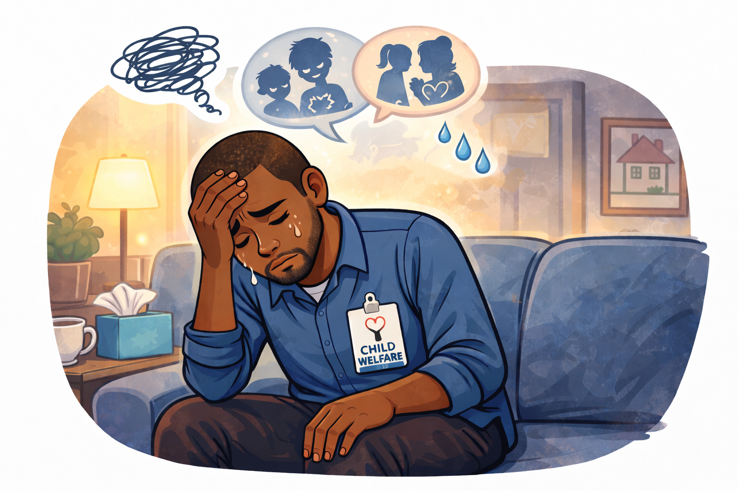
The Emotional Reality of Child Welfare Work
This work requires deep empathy and persistence. Over time, the emotional demands of supporting children and families through difficult circumstances can accumulate.

Slide 6
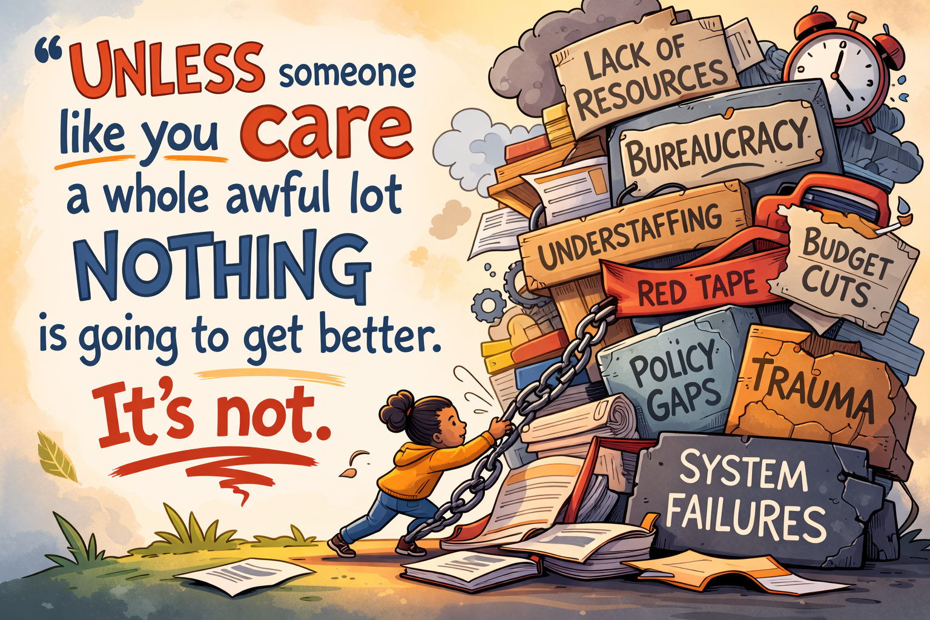
Compassion fatigue is not a failure of empathy. It is often the cost of caring deeply in difficult systems.

Slide 7
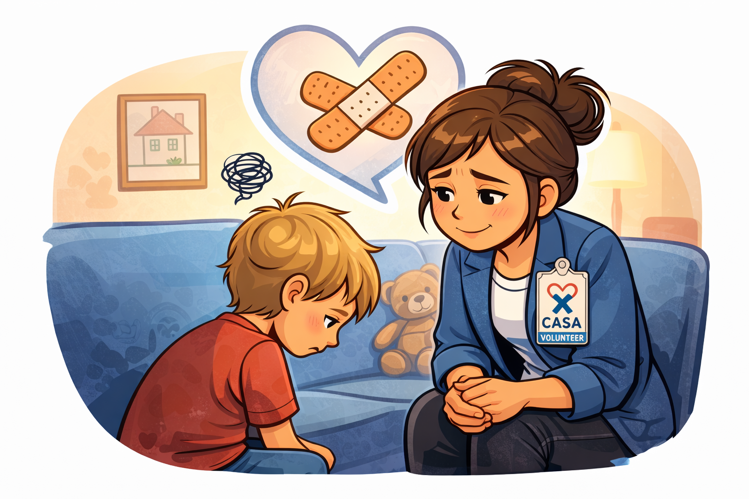
What Is Compassion Fatigue?
Compassion fatigue is:
Emotional exhaustion that results from prolonged exposure to others’ trauma and suffering
A natural response to sustained caregiving and advocacy roles
Common in child welfare work due to high emotional demands
It includes elements of:
Burnout
Secondary traumatic stress (also called vicarious trauma)

Slide 8
Related Concepts
Burnout
Exhaustion caused by workload, stress, and system pressures
Feeling overwhelmed or ineffective
Secondary Traumatic Stress (Vicarious Trauma)
Stress responses resulting from exposure to others’ traumatic experiences
Compassion Fatigue
The cumulative emotional toll of caring for people who have experienced trauma
Burnout + Secondary Traumatic Stress = Compassion Fatigue

Slide 9
Compassion Fatigue vs. Burnout vs. Secondary Trauma
Concept | Caused by | Feels Like
Burnout | workload/system stress | exhaustion, frustration
Secondary traumatic stress (vicarious trauma) | exposure to trauma stories | intrusive thoughts, emotional distress
Compassion fatigue | Burnout + Vicarious Trauma | All the above + numbness, detachment
Many people in child welfare experience all three at different times.

Slide 10
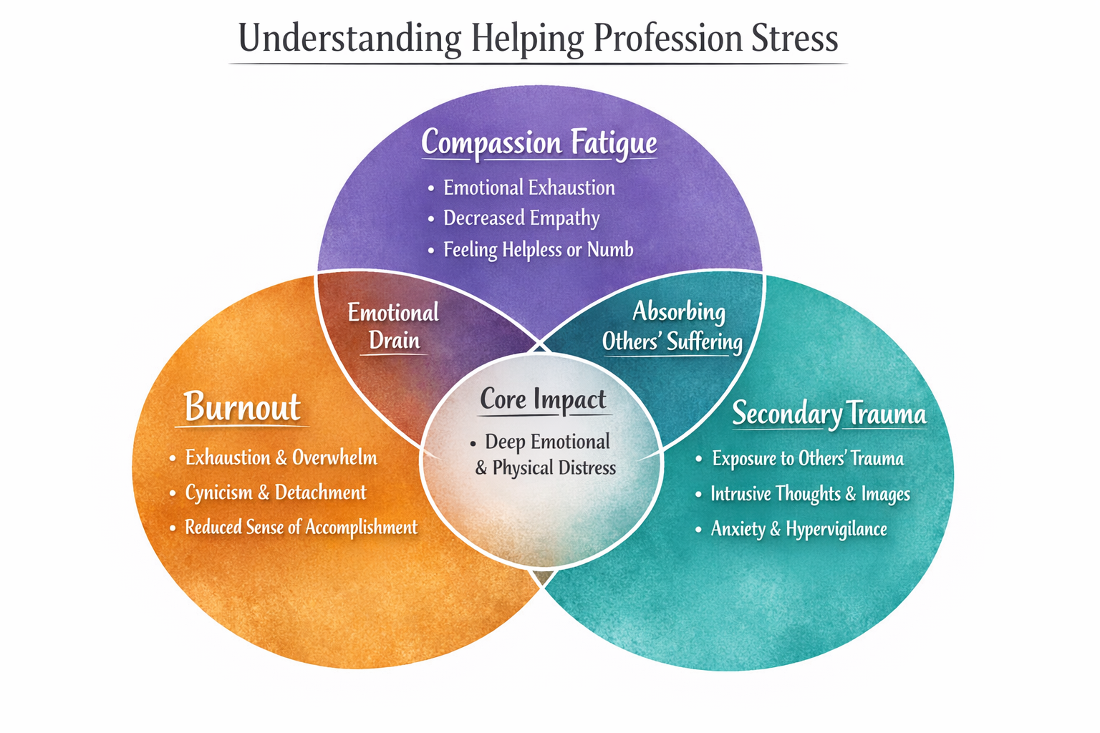

Slide 11
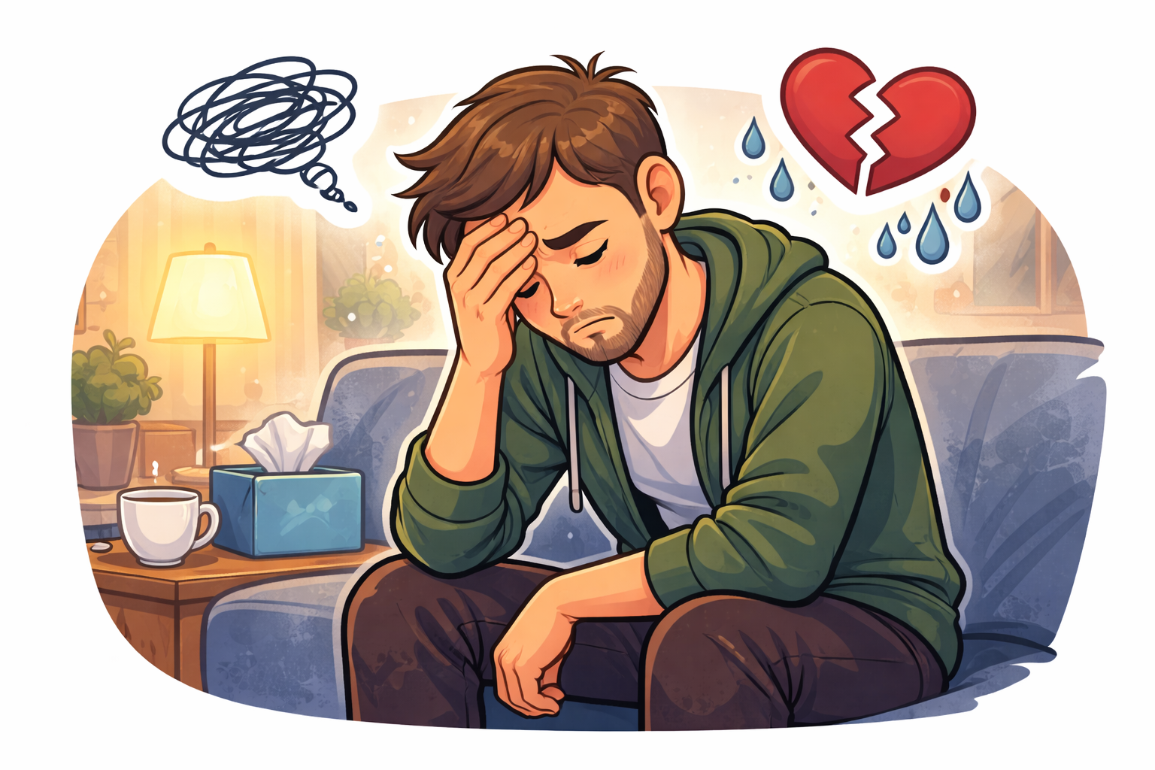
Why Child Welfare Professionals, Volunteers, & Advocates are Vulnerable
Work in child welfare often includes:
Exposure to trauma narratives and difficult life circumstances
High emotional investment in children's safety and wellbeing
Limited control over final decisions or case outcomes
Long-term involvement with complex family systems
Pressure to advocate effectively within constrained systems

Slide 12
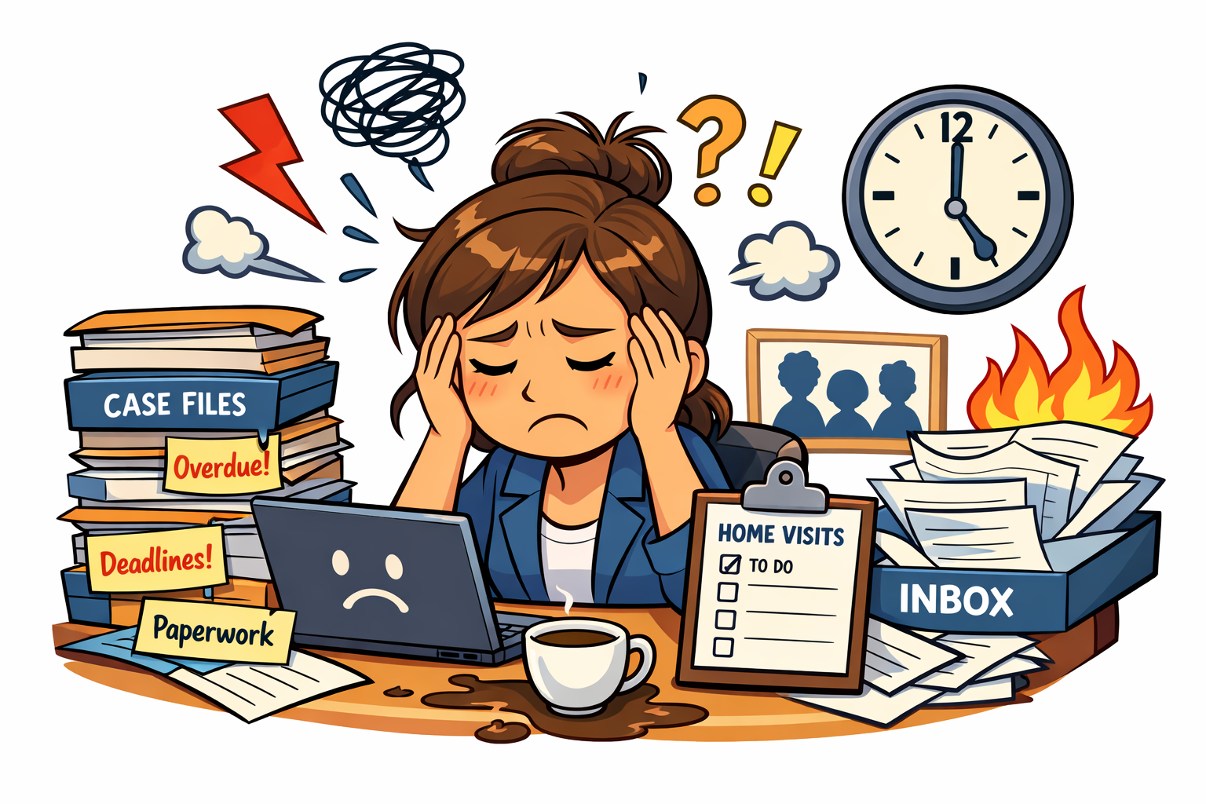
Signs of Compassion Fatigue
Irritability, cynicism, numbness
Feeling detached or helpless
Physical symptoms: headaches, sleep problems
Increased need to escape/distract
  Mindless scrolling on phone
  Increased use of substances such as alcohol or nicotine

Slide 13
Additional Warning Signs
Compassion fatigue may also appear as:
Emotional
Reduced empathy
Feeling overwhelmed
Cognitive
Difficulty concentrating
Persistent worry about cases
Behavioral
Withdrawal from colleagues or loved ones
Avoidance of certain cases or situations
Recognizing these signs early can help prevent deeper burnout.

Slide 14
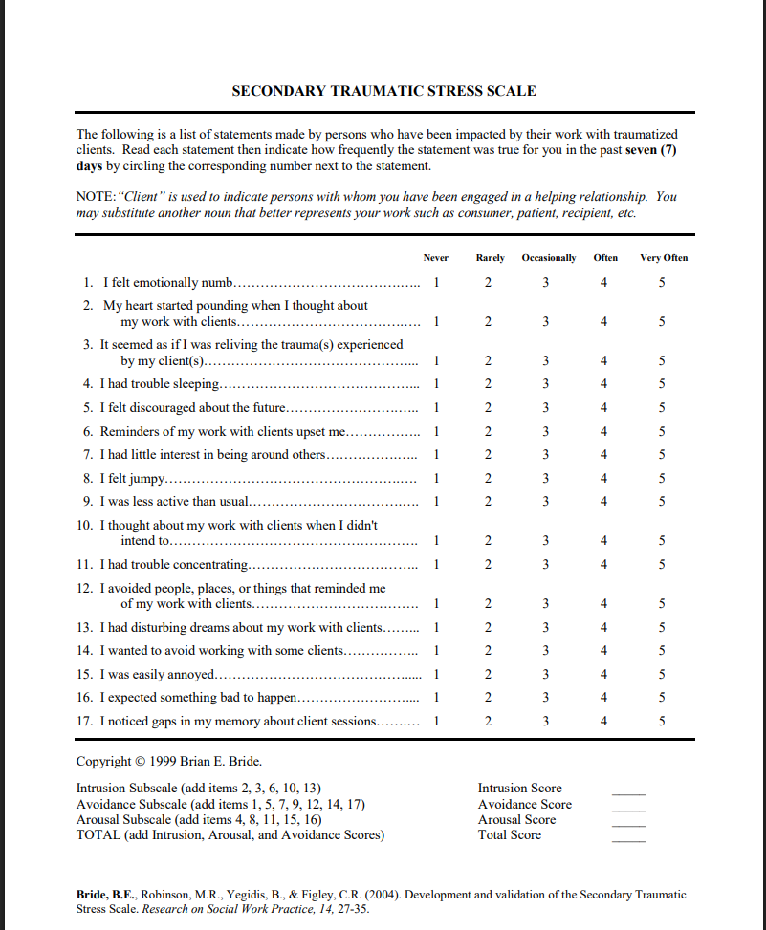
Am I Suffering From Compassion Fatigue?
SECONDARY TRAUMATIC STRESS SCALE

Slide 15
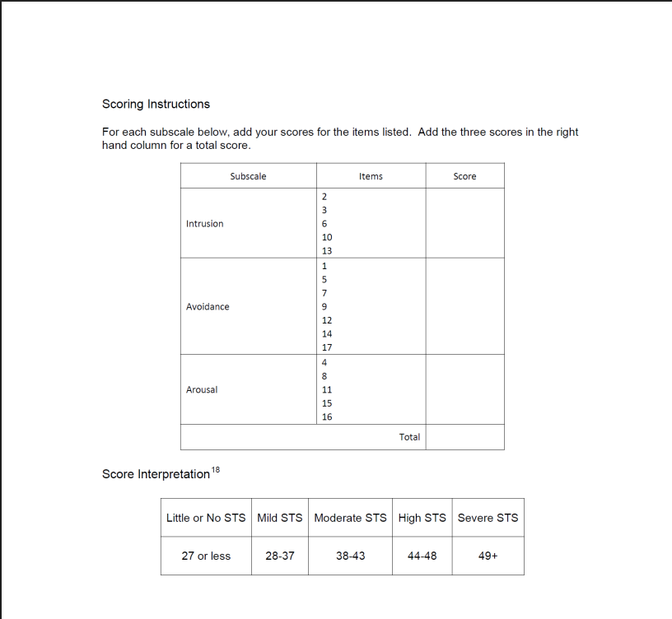
Am I Suffering From Compassion Fatigue?
SECONDARY TRAUMATIC STRESS SCALE SCORING

Slide 16
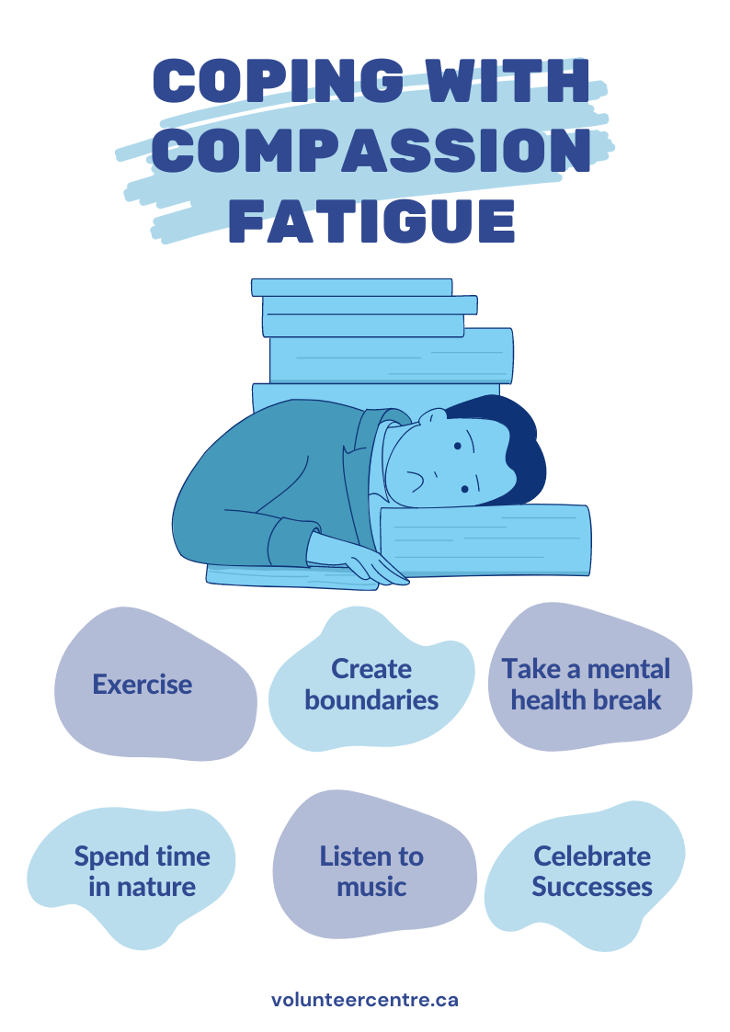
Preventing and Managing Compassion Fatigue
Four key areas help sustain people in this work:
Self-awareness
Support and reflective practice
Healthy emotional boundaries
Consistent self-care

Slide 17
Practice Self-Awareness

Slide 18
Self-Awareness
Why It Matters: You can’t address what you don’t notice.
Self-awareness is what allows you to catch compassion fatigue early before it becomes burnout or emotional shutdown.
Without it:
Stress accumulates unnoticed
Reactions (irritability, withdrawal, over-involvement) feel automatic
You may misattribute symptoms to personality rather than exposure
With it:
You can recognize, “Something is shifting in me”
You gain a moment of choice instead of reaction
Early intervention becomes possible

Slide 19
Preventing and Managing Compassion Fatigue
Practice Self-Awareness
Daily check-ins with yourself.
Pause and ask, “How am I feeling physically, emotionally, and mentally right now?” or “What emotions am I carrying from my work today?”
Recognize early warning signs
  Notice irritability, withdrawal, or physical symptoms (headaches, exhaustions) and name them as signals, not personal failing.
Journaling
Write short reflections about cases, emotions, and reactions to help separate what belongs to you versus what you’re carrying from others.
Mind-Body Awareness
  Use breathing, stretching and mindfulness practices to reconnect with your own state before and after difficult interactions
Boundary Reflection
  Ask yourself, “Am I over-identifying with this client’s situation? Am I carrying more than is mine to hold?”

Slide 20
2. Use Support and Reflective Practice (Talk About It)

Slide 21
Support & Reflective Practice
Why It Matters: What is shared can be processed. What is held alone often builds.
Child welfare work is not meant to be processed alone. Reflection helps you separate your thoughts and emotions from the work itself.
Without it:
Emotional experiences stay internalized
Perspective narrows (“I’m failing,” “Nothing is working”)
Increased engagement in cognitive distortions (see list https://www.uth.edu/studenthealth/assets/docs/scs/cognitive-distortions.pdf)
Isolation increases risk of burnout
With it:
You regain perspective and shared reality
You can release what isn’t yours to carry
Emotional load is distributed, not absorbed

Slide 22
Preventing and Managing Compassion Fatigue
External Reflective Practices & Support
Engaging with support:
Use supervision, peer support groups, and team discussions to process feelings, not just logistics.
  These can be formal or inform meetings.
Normalize vulnerability
  Share moments when you felt overwhelmed, frustrated, or ineffective and explore them without shame.
Seek perspective
  Supervisors and colleagues can help you reframe challenges, recognize what’s within your role, and release what’s beyond your control.
Engage in your own mental health therapy

Slide 23
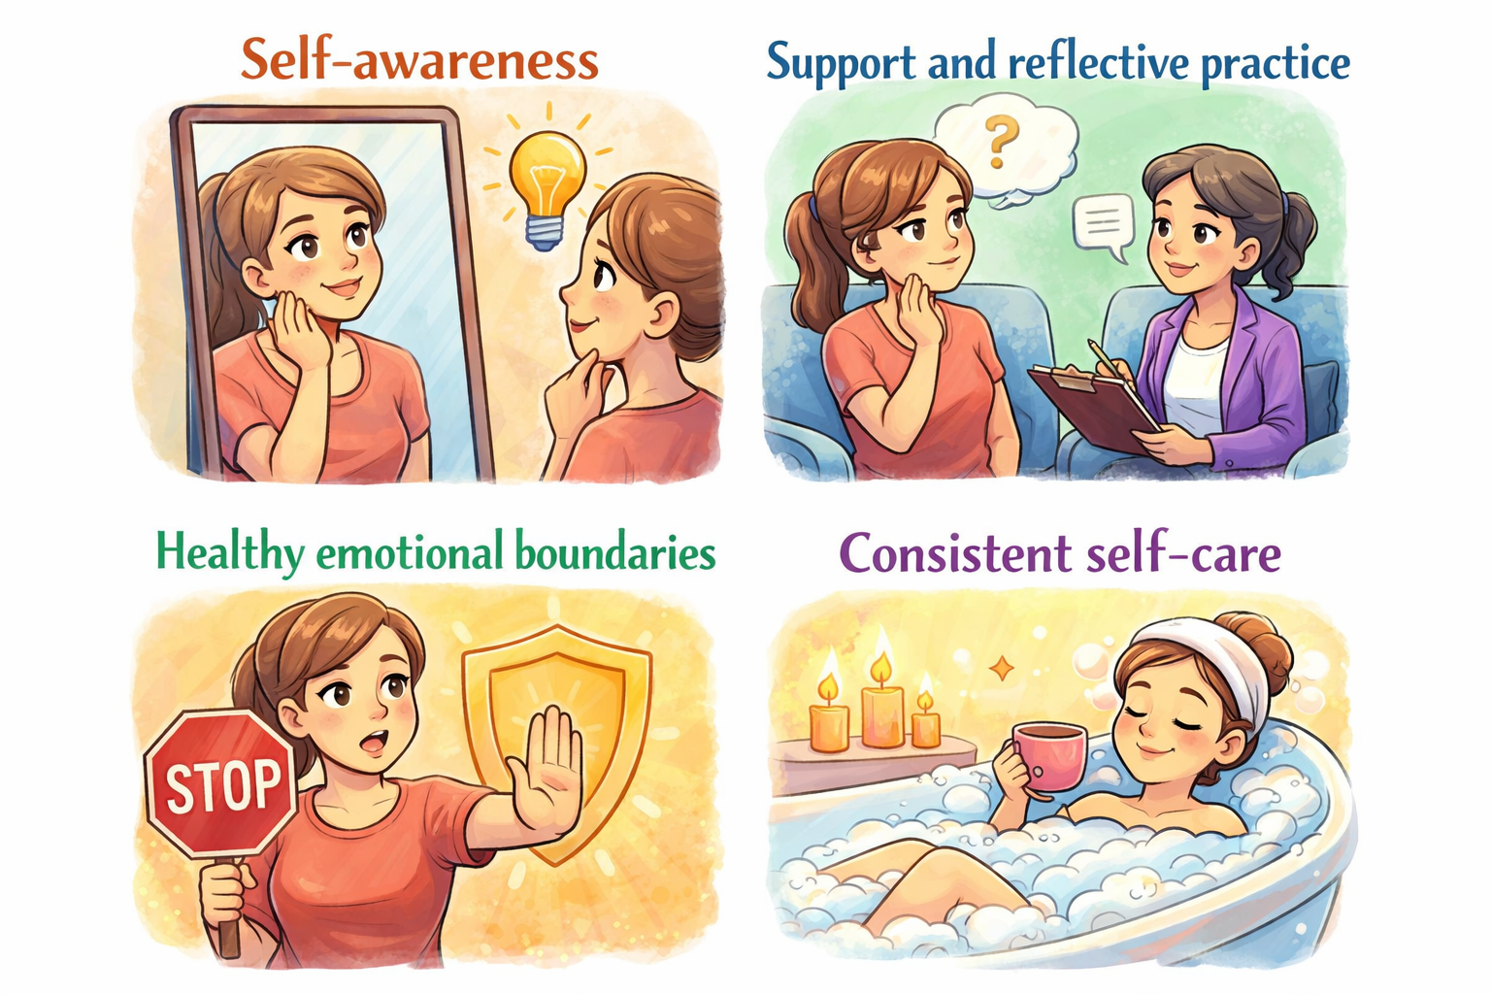
Preventing and Managing Compassion Fatigue
External Reflective Practices & Support
Why?
Talking about difficult experiences helps:
Process emotions
Gain perspective
Reduce isolation
No one should do this work alone.

Slide 24
3. Set Emotional Boundaries

Slide 25
Healthy Emotional Boundaries
Why It Matters: Boundaries make your work and compassion sustainable.
Boundaries are what allow you to care deeply without becoming overwhelmed or over-responsible.
Without them:
You may over-identify with children or families
Feel responsible for outcomes you cannot control
Carry emotional weight outside of your role
With them:
You stay connected without absorbing everything
You protect your ability to stay in the work long-term
You maintain clarity about your role vs. the system’s role

Slide 26

Emotional Boundaries:
Emotional boundaries are the mental limits that define where your psychological space ends and another person's begins, allowing you to take ownership of your feelings while respecting others' autonomy.

Slide 27
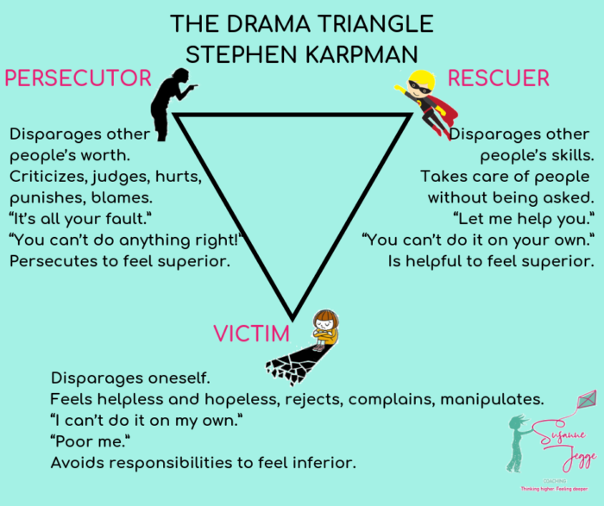

Slide 28
Preventing and Managing Compassion Fatigue
Set Emotional Boundaries
Define What Is Yours vs. Theirs
  Remind yourself, “I am responsible for supporting and advocating, not for fixing or controlling the outcome.”
Limit Emotion Over-Identification
  Notice when you’re carrying a client’s pain home with you and gently set it down
  Container exercise
Time Boundaries
  Give yourself permission to stop case-related calls/emails after work hours (except for emergencies).
Mental Transition Rituals
  Do something symbolic at the end of the day to separate work from personal life
    I.e. change clothes, take a short walk, have a symbolic touch point or ritual to leave work in its physical space

Slide 29
Preventing and Managing Compassion Fatigue
Set Emotional Boundaries
Emotional Pause Button
  If a conversation feels overwhelming, allow yourself to take a breath, ground yourself, or take a short break before continuing.
Choose How To Disclose Personally
  Share warmth and empathy without oversharing your own struggles which can blur roles.
Avoid “Rescuer Mode”
  When you find yourself trying to do more than your role allows, step back and reflect.
Say No When Necessary
  If taking another case or responsibility would compromise your wellbeing, advocate for your limits.
Healthy boundaries help sustain long-term involvement in child welfare work.

Slide 30

Preventing and Managing Compassion Fatigue
Set Emotional Boundaries
Let’s practice: Container Exercise

Slide 31
Brief Grounding Exercise
Container Exercise
Imagine placing the difficult emotions or images from your work into a container.
The container can be:
a box
a vault
a file cabinet
You can close it and remind yourself:
I can return to this when needed, but I do not have to carry it all the time.

Slide 32
“I care deeply, and I don’t carry everything.”

Slide 33
4. Consistent Self-Care

Slide 34
Consistent Self-Care
Why It Matters: You cannot continuously give from a system that isn’t being replenished.
Self-care is not about comfort. It is about restoring capacity after emotional output.
Without it:
Stress becomes cumulative
Physical and emotional resources deplete
Recovery never fully happens
With it:
Your nervous system resets
You maintain the energy required to stay engaged
You reduce long-term risk of burnout and detachment

Slide 35
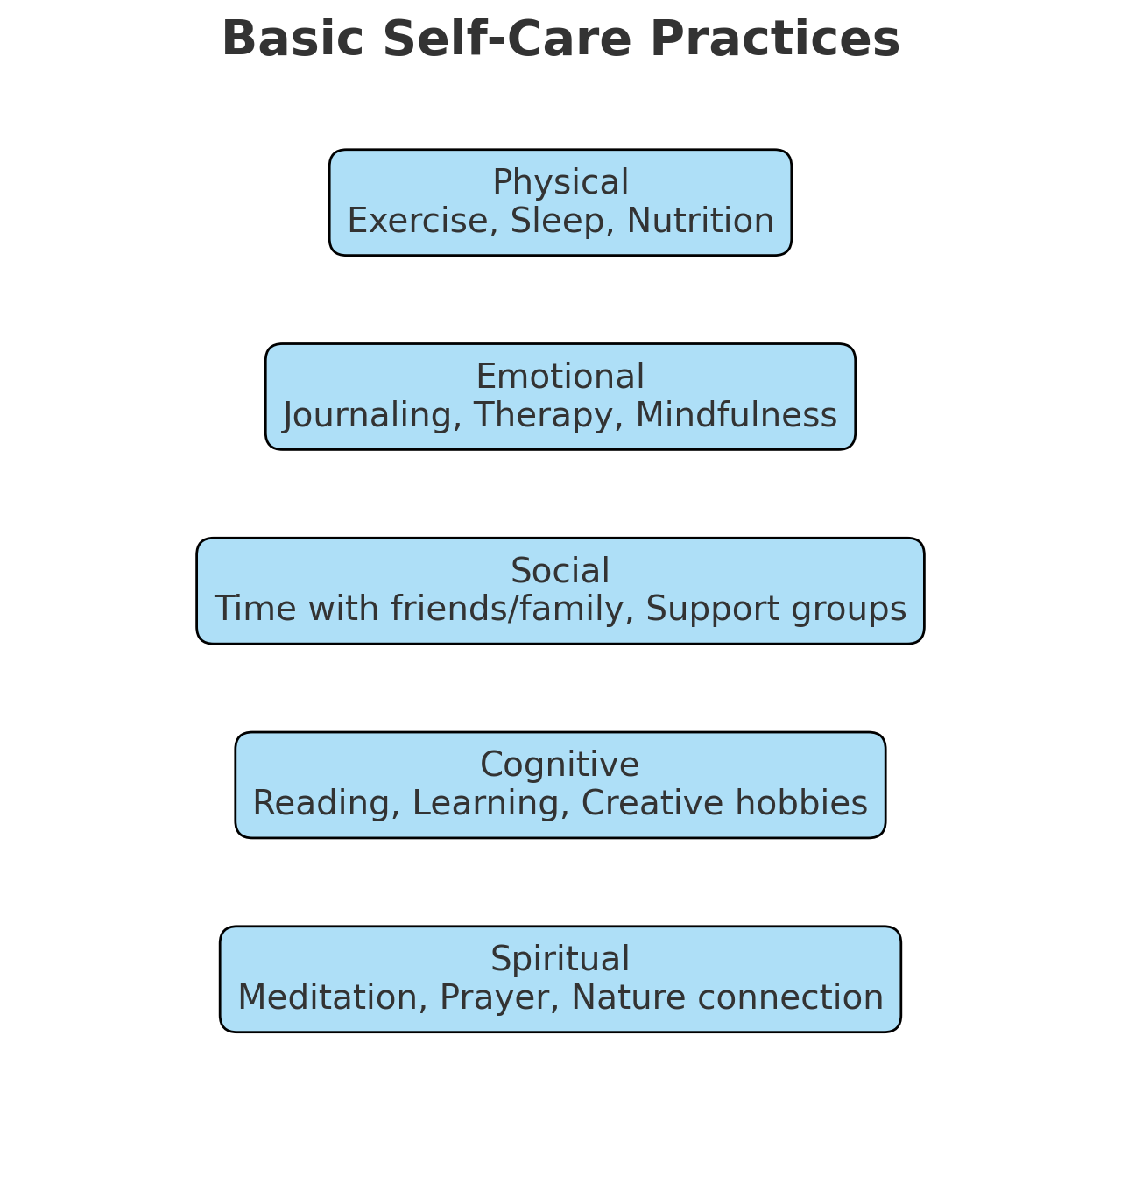
Preventing and Managing Compassion Fatigue
Engage in Regular Self-Care
Link: Self-Care Test
Link: Self-Care Assessment | Therapist Aid

Slide 36
Preventing and Managing Compassion Fatigue
Engage in Regular Self-Care
Physical
Sleep
Nutrition
Movement
Emotional
Journaling
Therapy
Mindfulness
Social
Time with supportive people
Cognitive
Creative hobbies
Learning and reading
Spiritual
Nature, meditation, or personal reflection

Slide 37

Compassion Satisfaction
Compassion satisfaction refers to:
The fulfillment that comes from helping others
Seeing progress in children and families
Contributing to a safer and more supportive system
Actively noticing these moments can strengthen resilience.
Despite the challenges, many people find deep meaning in child welfare work.

Slide 38
Recognizing Compassion Fatigue In Practice

Slide 39
Vignette 1: The Emotional Carryover
Scenario
Jordan is a CASA volunteer assigned to a young child who has experienced significant neglect. After visits, Jordan finds themselves thinking about the child late into the evening—wondering if the child is safe, replaying conversations, and feeling a persistent sense of worry. Over time, Jordan begins having difficulty sleeping and notices they feel emotionally drained even on days without visits.
What This Illustrates
Emotional over-identification
Difficulty “turning off” after exposure to trauma
Early signs of compassion fatigue (intrusive thoughts, sleep disruption)
What Might Help
Practice a transition ritual after visits (e.g., brief walk, music, or journaling)
Use a container exercise to mentally “set down” the case at the end of the day
Remind themselves: “I care deeply, but I am not responsible for controlling the outcome.”
Bring these concerns to supervision or peer support for perspective and reassurance

Slide 40
Vignette 2: The Frustration With The System
Scenario
Alex is a caseworker managing multiple cases, including one involving repeated court delays and limited family engagement. Despite consistent effort, progress is slow. Alex begins to feel frustrated and discouraged, thinking, “Nothing I do is making a difference.” They notice increasing irritability during team meetings and a growing sense of cynicism about the system.
What This Illustrates
Burnout + compassion fatigue overlap
Loss of sense of effectiveness
System-related stress contributing to emotional exhaustion
What Might Help
(Self-Awareness and Boundaries) Reframe their role by focusing on what is within their control (documentation, advocacy, consistency)
(Support) Process frustration in supervision or consultation, rather than internalizing it
(Reflection) Identify small indicators of progress to rebuild a sense of impact and meaning
(Boundaries) Set limits where possible (e.g., workload discussions, realistic expectations)

Slide 41
Vignette 3: The Numbness Response
Scenario
Taylor is an attorney who regularly hears detailed accounts of abuse and trauma in court. Over time, Taylor notices they feel less emotionally affected by cases that once felt deeply upsetting. While this helps them function in the moment, they also feel increasingly detached—not only at work, but in their personal life as well.
What This Illustrates
Emotional numbing as a protective response
Reduced empathy or connection
Spillover into personal life
What Might Help
(Self-Awareness)Recognize numbness as a protective response, not a personal failure
(Self-Care) Reconnect with emotions through mindful practices (e.g., body awareness, grounding)
(Self-Care) Engage in activities outside of work that foster connection and enjoyment
(Support) Consider personal therapy or consultation to process cumulative exposure to trauma

Slide 42

Final Thoughts
Working with children and families facing adversity is meaningful but demanding.
Remember:
You play an important role, but you are not responsible for every outcome.
Boundaries and support help sustain long-term involvement in the work.
Taking care of yourself strengthens your ability to care for others.

Slide 43
References
Albany Training Toolkit. (n.d.). Lesson two: The effects of trauma.
https://knilt.arcc.albany.edu/Lesson_Two:_The_Effects_of_Trauma
Berenz, E., PhD. (n.d.). 5 ways trauma changes your brain and body (and how you can start taking back control). Anxiety and Depression Association of America.
https://adaa.org
Mayo Clinic. (n.d.). Post-traumatic stress disorder (PTSD): Symptoms and causes.
https://www.mayoclinic.org
National Center for Biotechnology Information. (n.d.). Understanding the impact of trauma: Trauma-informed care in behavioral health services.
https://www.ncbi.nlm.nih.gov/books
PACEsConnection. (n.d.). The interconnection of safety and belonging.
https://www.pacesconnection.com

Slide 44
References
SAMHSA. (2016). Understanding child trauma (White paper).
Note: Source has since been removed from the original URL.
Turnaround for Children. (n.d.). What is co-regulation and what does it look like in the classroom?
https://turnaroundusa.org
Trauma Dissociation. (n.d.). PCL-5: PTSD checklist for DSM-5.
https://traumadissociation.com/pcl5-ptsd
University of Northern Colorado, Assault Survivors Advocacy Program. (n.d.). Neurobiology of trauma.
https://www.unco.edu
Verywell Health. (n.d.). Hyperarousal in PTSD.
https://www.verywellhealth.com
Verywell Mind. (n.d.). What to know about PTSD in teenagers.
https://www.verywellmind.com

Slide 45
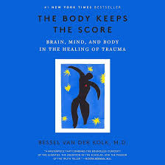

Recommended Reading
The Body Keeps the Score: Brain, Mind, and Body in the Healing of Trauma by Bessel van der Kolk | Goodreads
Adult Children of Emotionally Immature Parents: How to Heal from Distant, Rejecting, or Self-Involved Parents by Lindsay C. Gibson PsyD

Slide 46
Other Recommended Resources
On Burnout:
Video: 3 Essential Strategies for Managing Burnout for Modern Knowledge Workers
Video: ER Doctor Teaches How to Overcome Burnout from a Body-Based Perspective w Dr. Laura Hays, MD
https://www.youtube.com/watch?v=CNLVShxsV04
On Secondary Traumatric Stress (STS):
Window of Tolerance -An Essential Skill for PTSD, Trauma and Nervous System Regulation
Free Resources | STS Consortium

