Slide 1

Dysregulation in Families impacted by grief and adverse childhood experiences
Tanikka C. Price, JD, EdD

Slide 2
today’s Agenda
Why Dysregulation, Grief and Adverse Childhood Experiences? To understand Adverse Childhood Experiences To understand how Adverse Childhood Experiences can lead to dysregulation and adverse coping skills To understand the bigger picture of how trauma experienced in childhood can be informing clients behavior To understand cultural implications of adverse childhood experiences and how they may affect ones ability to deal with grief To understand how personal trauma can impact working with clients.
Notes:
Caroline

Slide 3
ACE Questionnaire
Measures traumatizing experiences
0-18 years of age
Score of 4 or more
  Associated with adverse mental and physical health consequences (Felitti et al., 1998; Larkin et al., 2012).
Notes:
Felitti, V. J., Anda, R. F., Nordenberg, D., Williamson, D. F., Spitz, A. M., Edwards, V., Koss, M. P., & Marks, J. S. (1998). Relationship of childhood abuse and household dysfunction to many of the leading causes of death in adults. The Adverse Childhood Experiences (ACE) Study. American Journal of Preventive Medicine, 14(4), 245–258. https://doi.org/10.1016/s0749-3797(98)00017-8
Felitti, V. J. (2009). Adverse childhood experiences and adult health. Academic Pediatrics, 9(3), 131-132. https://doi.org/10.1016/j.acap.2009.03.001

Slide 4
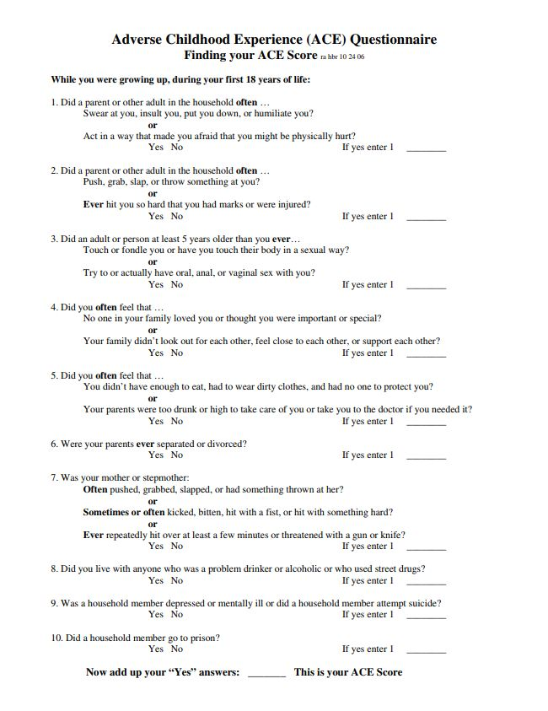
Adverse Childhood Experiences (ACE) Score (mdcalc.com)
Notes:
Felitti, V. J., Anda, R. F., Nordenberg, D., Williamson, D. F., Spitz, A. M., Edwards, V., Koss, M. P., & Marks, J. S. (1998). Relationship of childhood abuse and household dysfunction to many of the leading causes of death in adults. The Adverse Childhood Experiences (ACE) Study. American Journal of Preventive Medicine, 14(4), 245–258. https://doi.org/10.1016/s0749-3797(98)00017-8

Slide 5
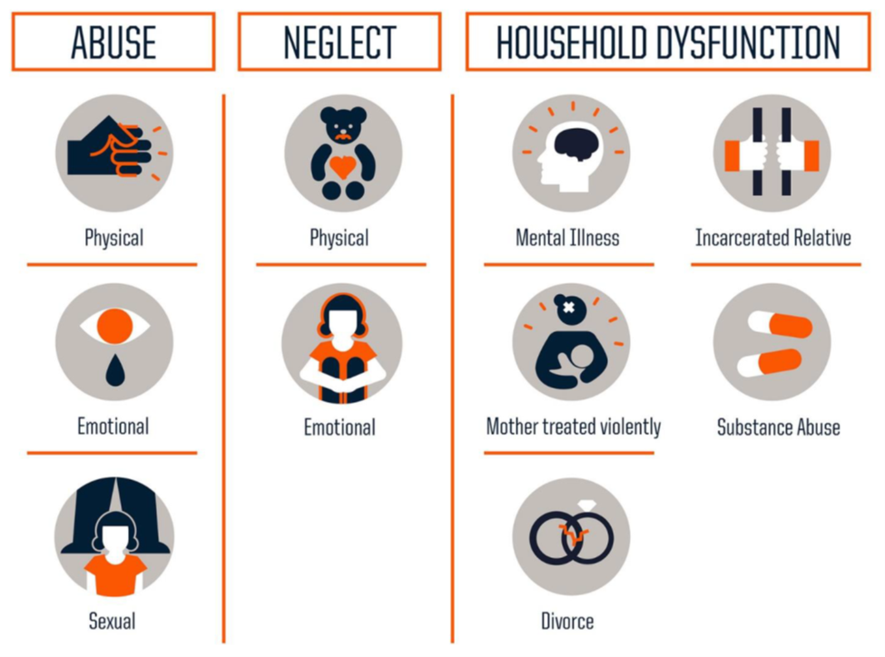
This is a pictograph of ACEs. The three main categories of ACEs are Abuse, Neglect, and Household Dysfunction. Abuse includes physical, emotional and sexual abuse; neglect includes both physical and emotional neglect and household dysfunction includes having a parent with a mental illness, substance use disorder, divorce, domestic violence in the home or having an incarcerated relative.
Notes:
Image: CDC, Robert Wood Johnson Foundation

Slide 6
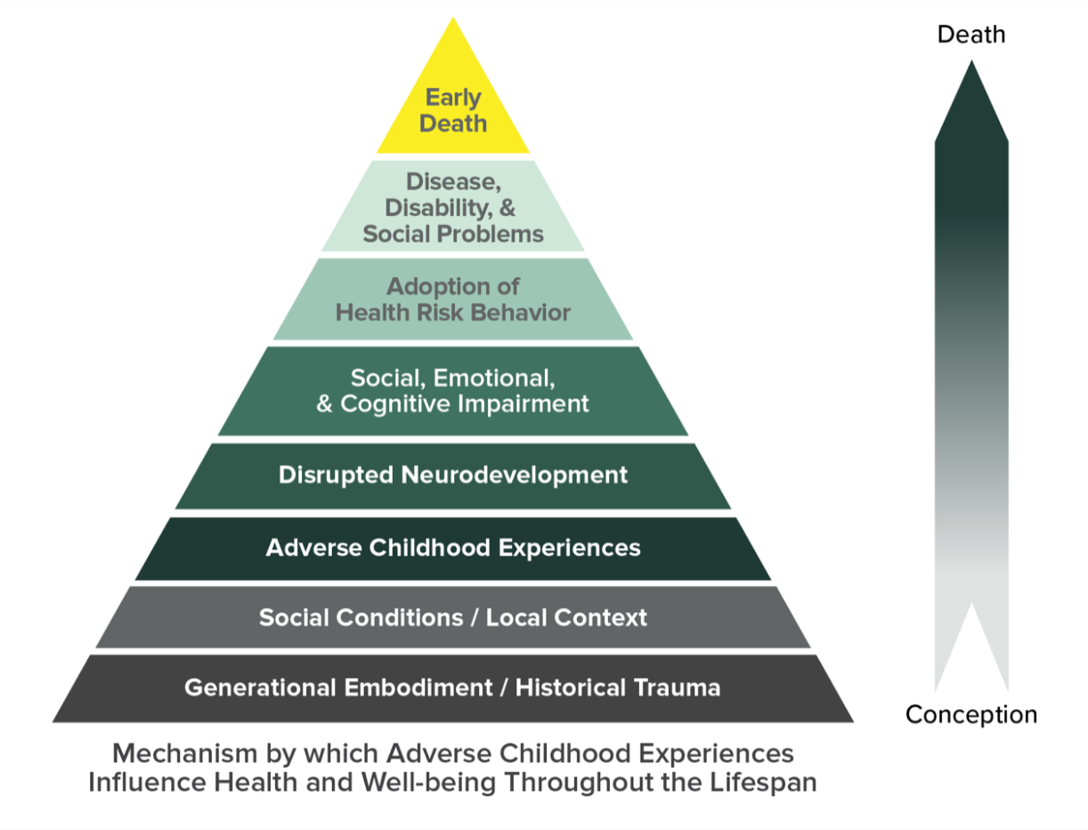
Notes:
ace_pyramid_lrg.png (1266×960)

Slide 7
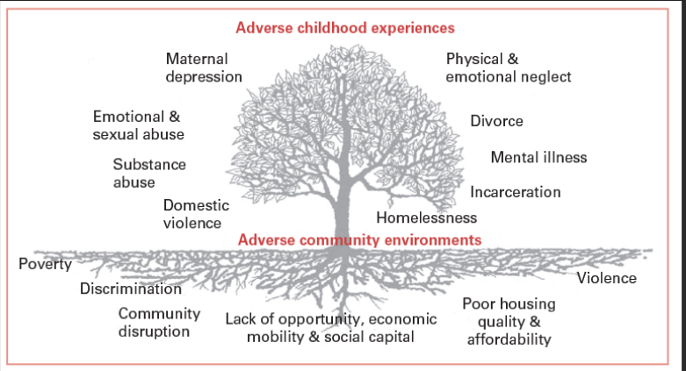
Notes:
Ellis WR, Dietz WH. A New Framework for Addressing Adverse Childhood and Community Experiences: The Building Community Resilience Model. Acad Pediatr. 2017 Sep-Oct;17(7S):S86-S93. doi: 10.1016/j.acap.2016.12.011. PMID: 28865665.

Slide 8

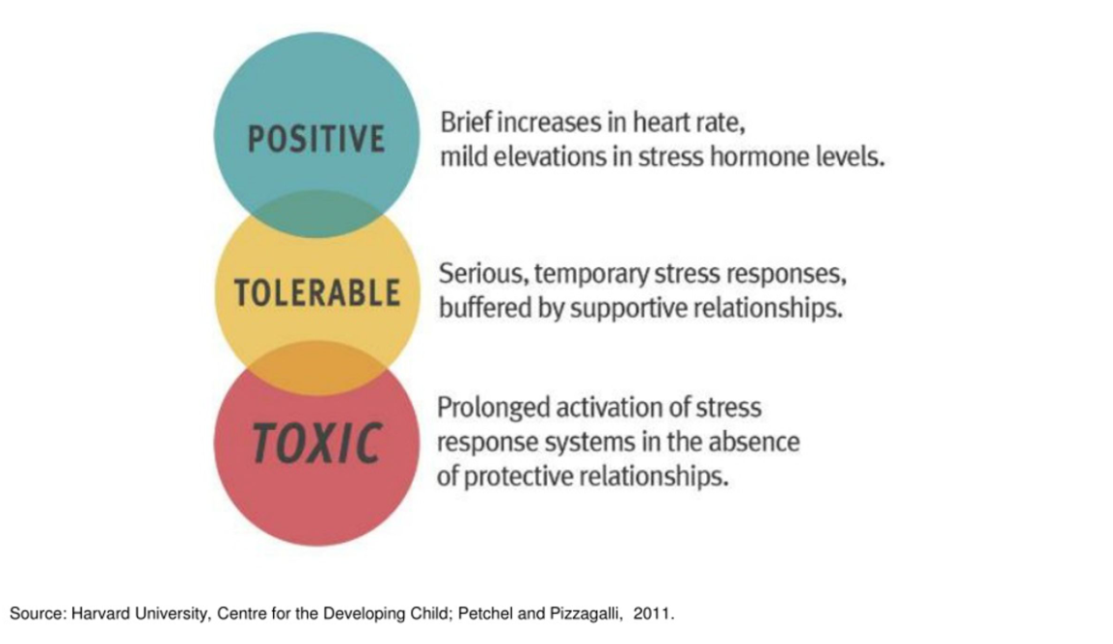
Stress is not bad. There are many things that have happened in our lives that create positive stress. We were never meant to endure prolonged activation of stress. That was only supposed to occur a few times in our lives.
Notes:
Harvard University, Centre for the Developing Child; Petchel and Pizzagalli, 2011.

Slide 9


Slide 10
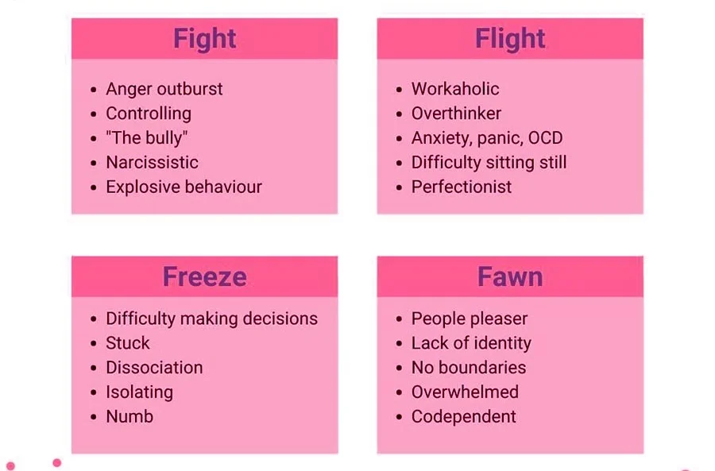
Notes:
https://therapymantra.co/wp-content/uploads/2022/03/FFFF-768x768.jpg

Slide 11
Trauma and the Future
Why does our brain take a panoramic picture when we are exposed to a traumatic situation?
Notes:
Epigenetic transmission of Holocaust trauma: can nightmares be inherited? - PubMed (nih.gov)

Slide 12
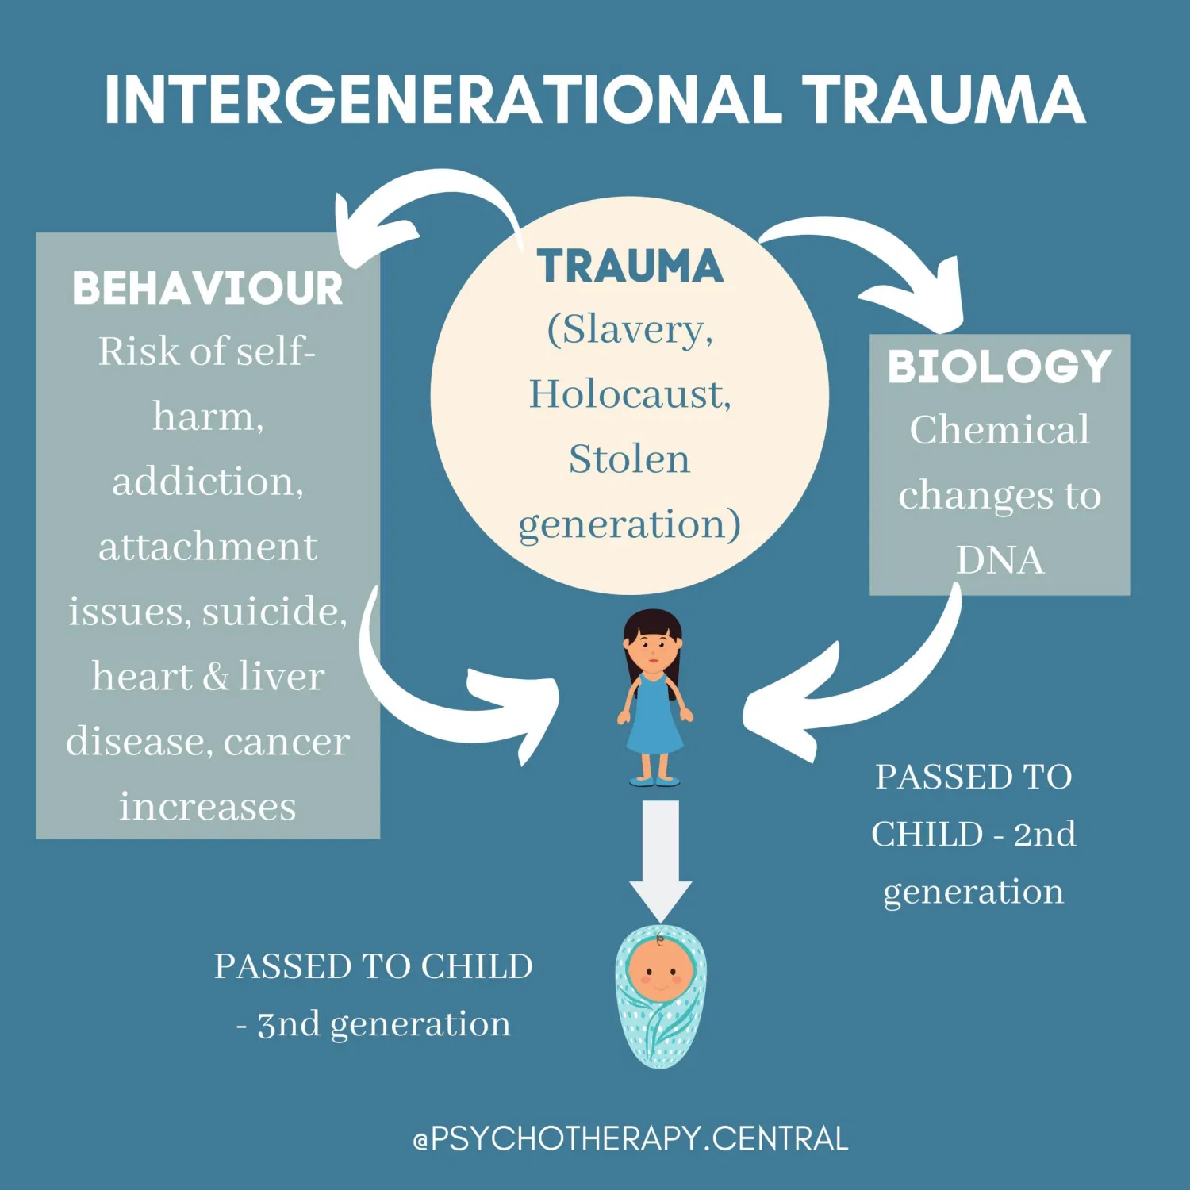
ACEs pass from one Generation to another
Having high ACE scores makes it more likely that you will experience an unplanned pregnancy, teen pregnancy and experience poverty, thereby raising children in a situation where they are more likely to experience ACEs.
Notes:
INTERGENERATIONAL-TRAUMA-copy-scaled.jpg (1024×1024)

Slide 13
Effects of Trauma
Trauma
Evokes the feeling of helplessness and fear (Brunzell, Stokes, & Waters, 2016).
Two people having the same experience can process differently
  Agency vs. Helplessness
Researchers linked trauma to various problems in adulthood, including poor health outcomes, mental health problems, homelessness, and crime (Kalmakis & Chandler, 2013).
Notes:
Trauma-informed positive education: Using positive psychology to strengthen vulnerable students.
Adverse childhood experiences: towards a clear conceptual meaning - Kalmakis - 2014 - Journal of Advanced Nursing - Wiley Online Library

Slide 14
Processing Grief
Grief
A collection of strong, often painful feelings that happen after a loss or in anticipation of a loss (Arizmendi, B. & O’Connor, M., 2015).
It is a process that people go through to come to terms with their loss and find ways to adapt to the changes in their life (Arizmendi, B. & O’Connor, M., 2015).
  Grief and trauma can intersect but not all trauma involves grief and not all grief involves trauma.
    An example would be a loss that is traumatic in nature i.e. murder or suicide.
    Being a trauma survivor could make it likely that you would stay stuck in shock and delay the grieving process
Notes:
Arizmendi, Brian & O'Connor, Mary-Frances. (2015). What is “normal” in grief?. Australian Critical Care. 28. 10.1016/j.aucc.2015.01.005.

Slide 15
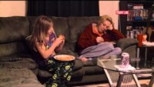
Notes:
https://youtu.be/TuIOt-_VSFE?si=BeLroewdZB5D4LHd
Frontline Poor Kids Preview Kids are Too Aware, PBS, 2012

Slide 16
ACEs Lead to Negative Coping Skills
To Deal with the high levels of cortisol released and the constant fight, flight or freeze, we may pick up coping skills to make us feel regulated.
Smoking
Drinking alcohol
Drugs
Sex
Shopping
Gambling
Overeating
Notes:
Understanding the stress response - Harvard Health

Slide 17
Tools to deal with dysregulation, grief and trauma:
In place of bad habits that lead to negative outcomes, we can adopt:
Practicing Meditation
Practicing Deep Breathing
Practicing Affirmations
Seeing people for who they are, not what they have been through
Working on our own trauma, grief and dysregulation so we don’t project onto our clients or get triggered or retraumatized.
Dealing with individuals with CPR (Twinkle French Schottke)
  Consistency, Predictability and Reliability
Notes:
10 Best Ways to Break Bad Habits | My Brain Rewired

Slide 18
Thank you for your time and attention!
Contact Info: Tanikka Price
614-370-9601, Tanikka@healthimpactohio.org

