Slide 1
The Three R’s:
Recruitment
Retention Recognition
Beth Cardina, Program Director, Summit County Sarah Harvan, Training Coordinator, Summit County

Slide 2



Agenda
1.
The Three R’s Framework
2.
The Male Recruitment Gap
3.
Building Men of CASA
4.
Men of CASA Principles
5.
Recognition and Retention Strategies
6.
7.
The Strategic Impact of Recognition
Panel Presentation
C A S A
Court Appointed Special Advocates
F O R C H I L D R E N

Slide 3












The "3 R's" are not isolated tasks, but a continuous cycle. A well-recognized volunteer (Recognition) is more likely to remain (Retention) and, in turn, recommend the program to others (Recruitment).
Recognition
Recruitment
Retention

Slide 4

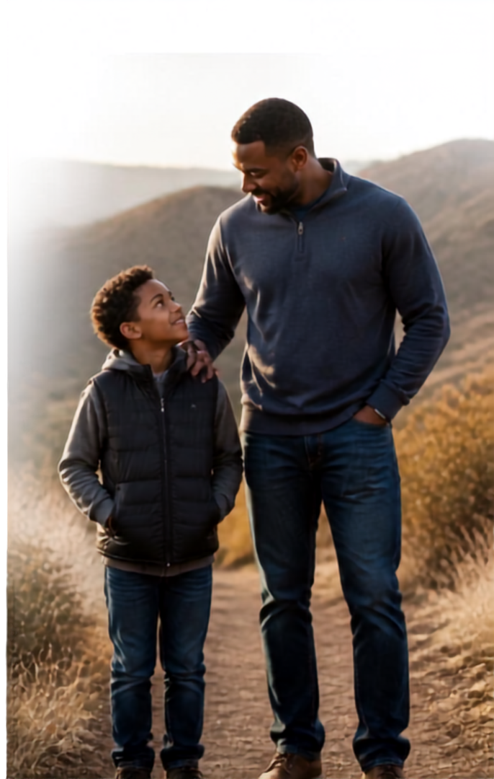









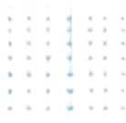
Male Recruitment:
The Core Problem & The Gap
The Reality:
Around 51% of the children in the child welfare system are male.
The Disparity:
Only 16% assigned CASA/GAL advocates
are male.
51%
16%
Key Message:
There is a severe shortage of male figures who can uniquely relate to and advocate for young boys navigating the child welfare system.

Slide 5


Summit County modeled their recruitment efforts after the Texas Initiative:
“Men of CASA- Fighting for Kids”

Slide 6
1
1.Create a list of the current male staff members, board members and advocates in your program; decide upon a diverse core group of 5-9 men that you believe have the qualities to lead and grow Men of CASA for your program. If you serve more than one county, consider including at least one male from each county you serve.
Steps to Creating Your Own Men of CASA Event
2
2. Invite your selected core group to attend a learning event about Men of CASA. Once the final core group has been established, define roles within the group. The male CASA staff member (or designate an experienced male CASA volunteer) can serve as the liaison between the group and the Executive Director.

Slide 7
Steps to Creating Your Own Men of CASA Event
Meet with your core group to plan your first Men of CASA event. This is for men only, so plan something men might enjoy, e.g. a Beer & BBQ event, an outing to Top Golf, etc.

Slide 8
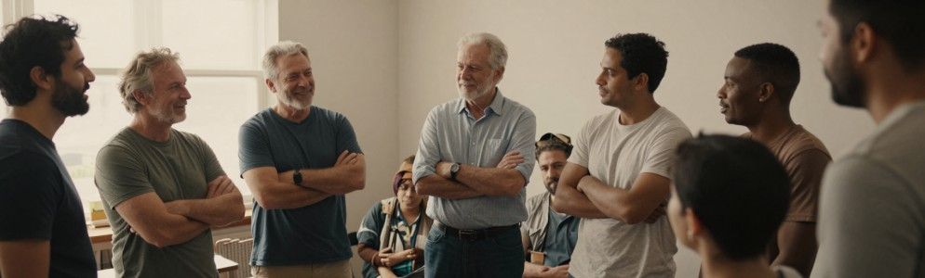
Invite men and men ONLY. Attendees can include all the men on the original list from Step1, the significant others/husbands of CASA staff and volunteers, and any other men in your community that you know. Ask each person you invite to bring 1-3 other men with them.
Steps for Creating Your Own Men of CASA Event

Slide 9
Men of CASA have the power to change a child’s future.
Men of CASA help build a better system. Men of CASA protect the vulnerable.
PRINCIPLES OF MEN OF CASA

Slide 10

PRINCIPLES OF MEN OF CASA
Men of CASA make clarity out of chaos.
Men of CASA lead cases forward.
Men of CASA are a testimony to the power of a positive male influence.

Slide 11


Slide 12


Slide 13


Slide 14


Slide 15





Topgolf Akron (April, 2025)
45 registrations, 40 people in attendance
20 were "new to CASA"
11 current volunteers who helped recruit by bringing guests
9 staff (including Doug and Haley)

Slide 16


Slide 17

Second MOC
Event

Slide 18
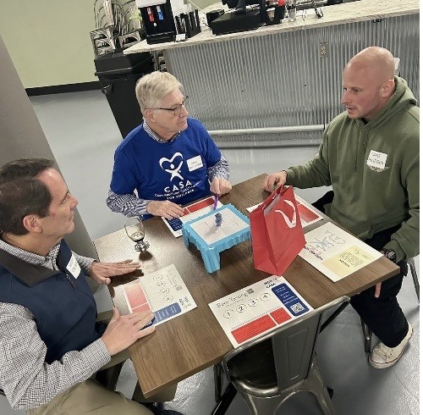
Hops and Heroes (November, 2025)
34 registrations, 28 in attendance
13 were "new to CASA"
6 staff

Slide 19



VOLUNTEER RECRUITMENT EVENT
Did you know current
CASA Volunteers are our best recruiters? Please invite an interested friend (or two!) and join us for an informative evening of trivia, food, and good company — all are welcome.
November 9, 2026
5:30 – 7:30 PM
Missing Falls Brewery 540 S. Main St. Suite 112
Akron, OH 44311
C A S A
F O R C H I L D R E N

Slide 20
Recognition:
Builds long-term commitment, boosts morale, and shows people that their unpaid time and hard work directly support the group's core mission. Meaningful appreciation transforms a simple task into a deep sense of belonging and community connection.
“
Meaningful appreciation transforms a simple task into a deep sense of belonging and community connection.

Slide 21

Volunteer recognition is an ethical, emotional, and operational necessity for CASA/GALS because of the high-stakes, emotionally draining cases involving child abuse and neglect

Slide 22
Because CASA/GALs cannot share confidential details with friends, and frequently face systemic frustration, structured recognition is the primary defense against advocate burnout and
turnover.

Slide 23




The Strategic Impact of CASA Recognition
Prevents Compassion Fatigue:
CASA advocates regularly digest
traumatic case files. Regular, trauma-informed recognition reminds them of their worth when legal outcomes are slow or heartbreaking.

Slide 24
Recogntion/Retention
In-person
Book Club
Recruitment Events
Speaking on the CASA Panel during Pre-service

Slide 25
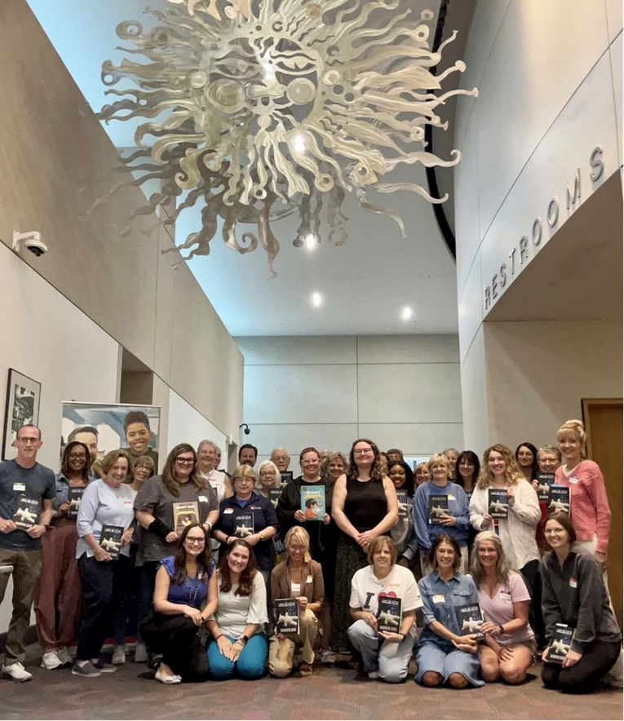
Book Club
April, 2026:
22 (6 men)
August, 2026:
39 registered (5 men)
December, 2025: 28
(5 men)
August, 2025:
23 (4 men)
May 2025: 13 (5 men)

Slide 26
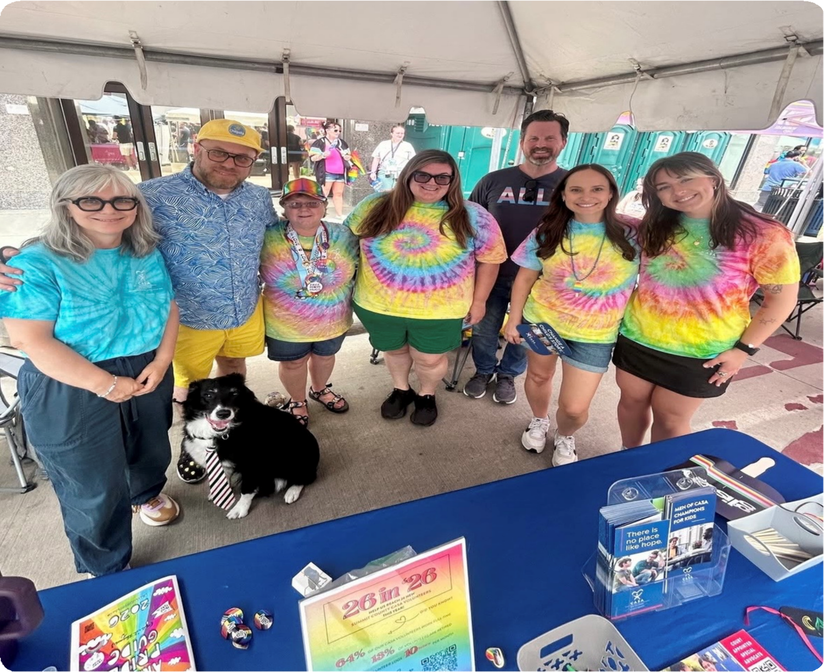
Recruitment in the Community

Slide 27
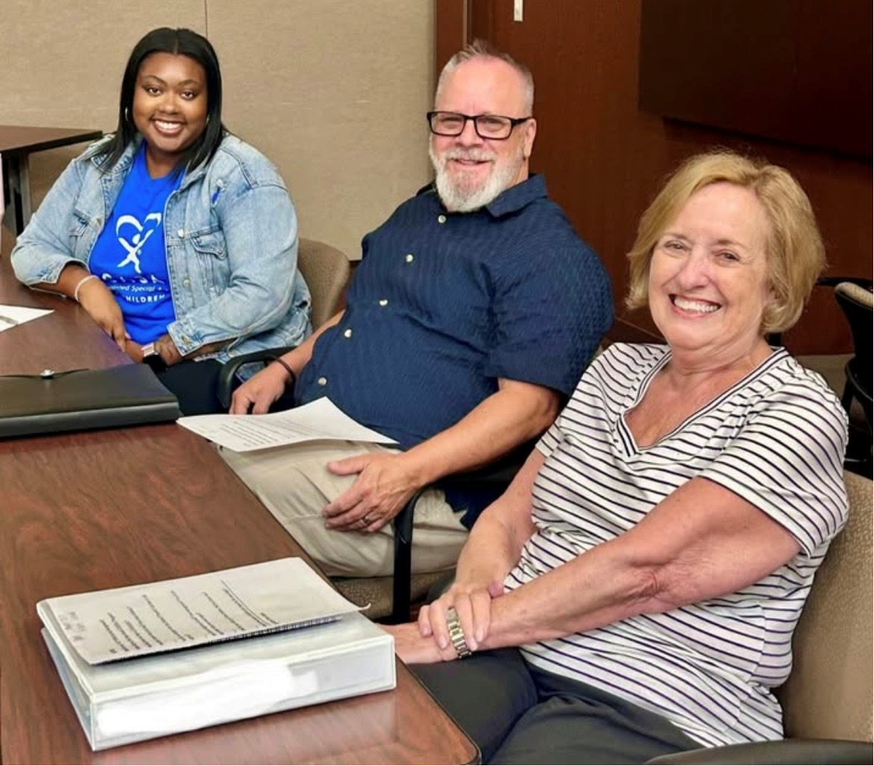
Pre-service Panel Presentation

Slide 28




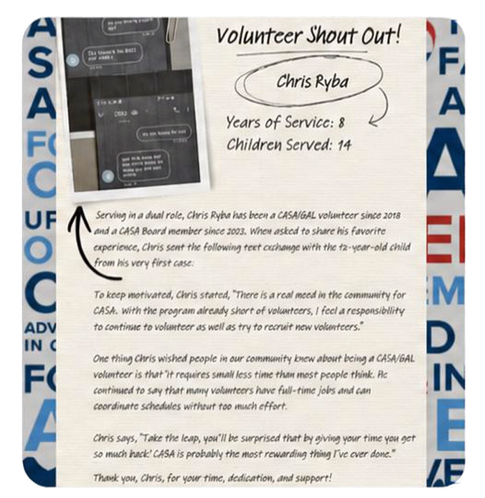






Social Media
A special salute to our volunteers this month from the Judge/Magistrate!
Volunteer ‘Shout Out’
Short Videos (Testimonials)

Slide 29
The Strategic Impact of CASA/GAL Recognition
Protects Child Continuity: Children in foster care experience constant turnover (different caseworkers, foster parents, court personnel). Retaining a CASA/GAL volunteer through consistent recognition provides the child with the only stable adult in their life.

Slide 30
Validates Hidden Hard Work: Advocates spend dozens of unseen hours driving to placements, reading court reports, and sitting in waiting rooms. Public and private acknowledgment validates this invisible labor.
The Strategic Impact of CASA
Recognition

Slide 31
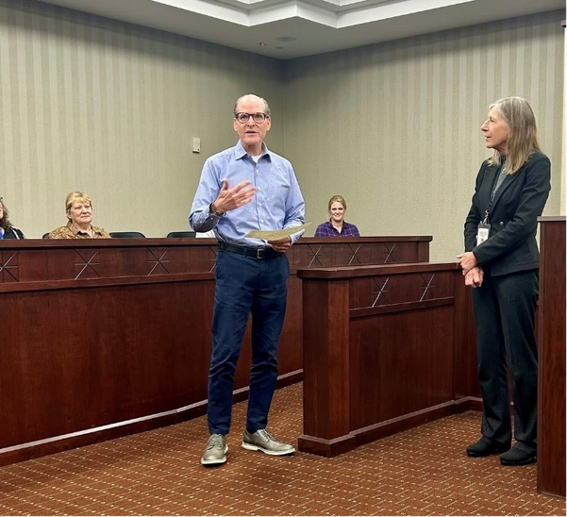
New Volunteers:
In 2025, Summit County CASA trained 20 new CASA/GAL volunteers and 9 of those were men! (Almost half!)
Of the 108 active CASA/GAL volunteers, 26 are men which increased our male volunteer population from 20% to 25%

Slide 32
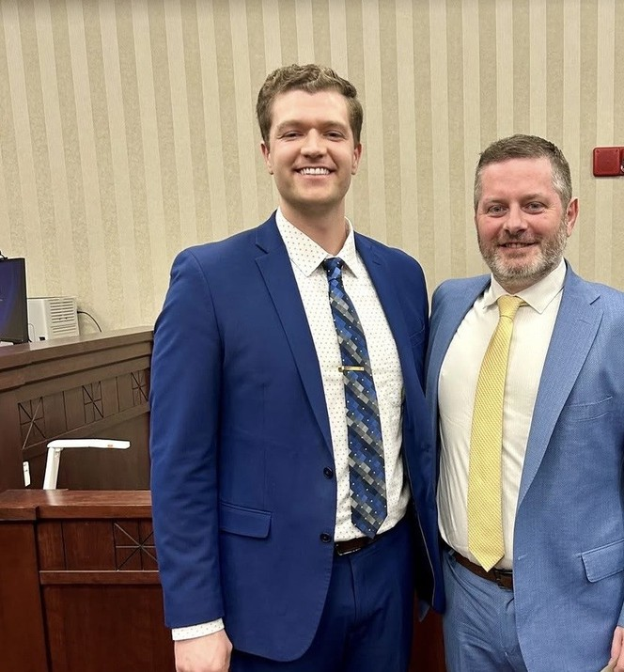
In 2026, 97 active volunteers: 74
female and 23 male (almost 24%)
In 2026, we trained 19 new volunteers: 4 were men

Slide 33
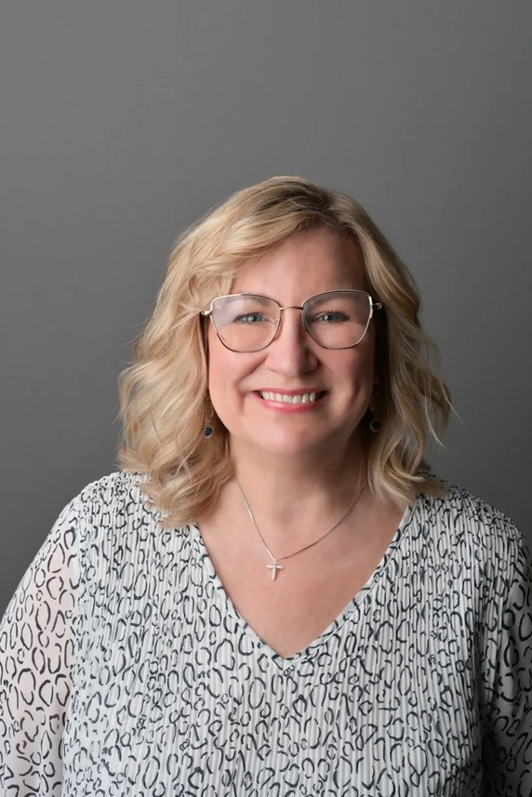
Tammy Barnes- Summit County CASA/GAL Program
A Volunteer Coordinator’s Perspective

Slide 34










Summit County
Men of CASA
Panel Presentation
Josh Borschowa Matt Coberly Brian Mariotti Chris Ryba

Slide 35




Questions & Answers
Open discussion and next steps

Slide 36


Thank You for Attending
Beth Cardina
bcardina@juvenilecourt.summitoh.net
Sarah Harvan
sharvan@juvenilecourt.summitoh.net

